Slide 1
ANNOUNCEMENTS today is No Laptop Monday! 🙅‍♂️💻🎉 WARMUP (discuss with people you don't know) what does 2 + 2 like...mean? 🧠 🌞 TODAY Fundamentals of Java Part 1

Slide 2
thank you to those who emailed DrJava questions! note: my email responses tend to be really short; it doesn't mean i'm annoyed; i just have to write emails really fast because there are ~64 students in this class 🙂👍 ps screenshots are really helpful if you email me!

Slide 3
is there anyone here who is not yet enrolled in CS 136 and would like to be?

Slide 4
questions before we begin?

Slide 5
record lecture?

Slide 6
type

Slide 7
variables in Java have a specified type
# okay in Python
foo = 7 # foo is an int
foo = False # now, foo is a boolean
// NOT okay in Java
int foo = 7; // foo is an int
foo = false; // Error: incompatible types:
// boolean cannot be converted to int

Slide 8
in Java, declaring and initializing variables are separate things
// Option A: two lines int foo; // declare a variable foo of type int foo = 7; // initialize foo to 7
// Option B: one line int foo = 7; // declare int foo and initialize it to 7

Slide 9
built-in data types

Slide 10
primitive data types

Slide 11
boolean, char, double, int
a boolean stores a truth value
true, false
a char stores a character
'\0', 'a', 'Z', '!', '\n'
a double stores a floating point number
0.0, -0.5, 3.1415926, Double.NEGATIVE_INFINITY
an int stores an integer number
0, -1, 4

Slide 12
primitive data type Venn diagram
integers
numbers
char
double
boolean
int

Slide 13
char is an integer type
a char is an integer type
each char has a corresponding integer, for example ('a' == 97)
the letters are in order ('a' == 97), ('b' == 98), ('c' == 99)...
the numbers are also in order ('0' == 48), ('1' == 49)...
you can do math with char's
char foo = 'a' + 2; // foo is 'c'
char bar = '0' + 7; // bar is '7'
int baz = '6' - '0'; // baz is 6

Slide 14
zero
each primitive data type has its own notion of what it means to "be zero"
int zero = 0;
double zero = 0.0;
boolean zero = false;
char zero = '\0'; // the "null character"

Slide 15
String

Slide 16
String (1/2)
a String is a sequence of characters
"Hello World", "Foo123"

Slide 17
String (2/2)
String's have several useful functions/methods (which are described in our Documentation)
String string = "Hello"; // makes a new String
System.out.println(string.length()); // 5
System.out.println(string.charAt(1)); // 'e'
System.out.println(string.substring(0, 3)); // "Hel"

Slide 18
operators (except for bitwise operators, which we'll do later maybe)

Slide 19
assignment operator

Slide 20
assignment operator
= assigns the value on the right-hand side to the variable on the left-hand side
int i = 0; // 0 ("int i now has the value 0")
double foo = coolFunction();
☠ the assignment operator returns the value it assigned this is usually pretty confusing
boolean b = false;
boolean c = (b = foo());

Slide 21
arithmetic operators

Slide 22
basic arithmetic (number) operators
+ adds two numbers
- subtracts two numbers
* multiplies two numbers
/ divides two numbers
☠ an int divided by an int is an int
int foo = 8 / 2; // 4
int bar = 7 / 2; // 3
Java "throws away the remainder"
- returns the negative of a number
int bar = -7; // -7 ("negative 7" or "minus 7")
int baz = -bar; // 7

Slide 23
modulo
x % y returns the remainder of (x / y) and is read "x modulo y"
int foo = 17 % 5; // 2 ("17 divided by 5 is 3 remainder 2")
☠ % probably doesn't do what you expect for negative numbers; if x can be negative, use Math.floorMod(x, y) instead
5 % 3 // 2
4 % 3 // 1
3 % 3 // 0
2 % 3 // 2
1 % 3 // 1
0 % 3 // 0
-1 % 3 // -1 🤔
Math.floorMod(-1, 3) // 2 🙂👍

Slide 24
logical operators

Slide 25
logical operators (1/2)
|| returns whether the left-hand side or the right-hand side is true
(true || true) // true
(true || false) // true
(false || true) // true
(false || false) // false
&& returns whether the left-hand side and the right-hand side are true
(true && true) // true
(true && false) // false
(false && true) // false
(false && false) // false
! returns the opposite of a boolean, and is read as "not"
(!true) // false ("not true")
(!false) // true

Slide 26
logical operators (2/2)
// example, step by step
boolean a = (2 + 2 == 5); // false
boolean b = true; // true
boolean c = (a || b); // true
boolean d = !c; // false
// same thing all on one line
boolean d = !((2 + 2 == 5) || true); // false
// equivalent code
boolean d = false;

Slide 27
☠ logical operator short-circuiting
(false && foo()) "lazily" evaluates to false without evaluating foo()
(true || foo()) "lazily" evaluates to true without evaluating foo()

Slide 28
comparison operators

Slide 29
☠ equality (is equal to)
== returns whether the left-hand side is equal to the right-hand side
boolean b = (foo == bar);
if (foo == bar) { ... }
☠ this does NOT work for String's
instead, use (stringA.equals(stringB) )
☠ this (usually) does NOT work for double's
instead, use (Math.abs(double1 - double2) < 0.00001)

Slide 30
is greater than, is less than
> returns whether the left-hand side is greater than the right-hand side
< returns whether the left-hand side is less than the right-hand side

Slide 31
convenient operators (feel free to ignore these for now)

Slide 32
inequality
!= returns whether the left-hand side is not equal to the right-hand side
(left != right) is exactly the same as (!(left == right))

Slide 33
greater than or equal to, less than or equal to
>= returns whether the left-hand side is greater than or equal to the right-hand side
(left >= right) is basically the same as ((left > right) || (left == right)) greater-than or equal
<= returns whether the left-hand side is less than or equal to the right-hand side

Slide 34
arithmetic assignment operators
a += b; // a = a + b;
a -= b; // a = a - b;
a *= b; // a = a * b;
a /= b; // a = a / b;

Slide 35
String concatenation
+ concatenates two String's
// String foo = "Hello".concat("World"); String foo = "Hello" + "World"; // "HelloWorld"
it also does some conversions for you (very convenient, kind of consuming)
// String foo = "Hello".concat(Integer.toString(2)); String foo = "Hello" + 2; // "Hello2"

Slide 36
increment operator
to "increment" means to increase the value of a number by one
i = i + 1;
i += 1;
the pre-increment ++i increments i and returns the new value of i
j = ++i; // i = i + 1;
// j = i;
the post-increment i++ increments i and returns the old value of i
j = i++; // j = i;
// i = i + 1;

Slide 37
decrement operator
to "decrement" means to decrease the value of a number by one
i = i - 1;
i -= 1;
the pre-decrement --i decrements i and returns the new value of i
j = --i; // i = i - 1;
// j = i;
the post-decrement i-- decrements i and returns the old value of i
j = i--; // j = i;
// i = i - 1;

Slide 38
ANNOUNCEMENTS today is No Laptop Wednesday! 🙅‍♂️💻🎉🔥 WARMUP is it bad when programs crash? 🌞🌞 TODAY Fundamentals of Java Part 2

Slide 39
Homework-00 was due in Gradescope two nights ago; if you didn't submit it yet, probably do that ASAP 🙂👍

Slide 40
Homework-01 will be harder than Homework-00; Homework-02 will be harder than Homework-01; and then hopefully we more or less plateau (feel free to reach out with any questions about course difficulty 🙂👍)

Slide 41
record LEC 01

Slide 42
flow control

Slide 43
the execution of a Java program starts at the top of main(...) and flows down down down

Slide 44
let's step through this program in our minds, and then in DrJava's debugger
class Main {
public static void main(String[] arguments) {
double a = 3.0;
double b = 4.0;
double result = Math.sqrt(a * a + b * b);
System.out.println(result);
}
}

Slide 45
functions (preview)

Slide 46
functions (preview)
when a function is called, control flow jumps to the top of the function, flows down through it, and then jumps back to right after the function call
class Main {
static double pythagoreanTheorem(double a, double b) {
return Math.sqrt(a * a + b * b);
}
public static void main(String[] arguments) {
double hypotenuse = pythagoreanTheorem(3.0, 4.0);
System.out.println(hypotenuse);
}
}

Slide 47
assert

Slide 48
assert condition; (1/2)
an assert statement crashes the program if its condition is false
assert false; crashes the program no matter what
class Main {
static double pythagoreanTheorem(double a, double b) {
assert a > 0.0;
assert b > 0.0;
return Math.sqrt(a * a + b * b);
}
public static void main(String[] arguments) {
double hypotenuse = pythagoreanTheorem(3.0, 4.0);
System.out.println(hypotenuse);
}
}

Slide 49
assert condition; (2/2)
☠ asserts are actually disabled by default in Java, and are ignored
DrJava enables them by default 🙂👍

Slide 50
if and else

Slide 51
if (condition) { body }
an if statement lets a program make a decision (instead of just stepping down down down forever down)
int choice = getIntFromUser();
if (choice == 0) {
System.out.println("The user chose 0. What a fine choice");
}

Slide 52
if (...) { if-body } else { else-body }
the body of an else statement is executed if its corresponding if statement's condition is false
int choice = getIntFromUser();
if (choice == 0) {
System.out.println("The user chose 0. What a fine choice");
} else {
System.out.println("The user did not choose 0.");
System.out.println("How avant-garde!");
}

Slide 53
if (...) { ... } else if (...) { ... } ... else { ... }
if and else statements can be chained together
this is great for decisions with many options
int choice = getIntFromUser();
if (choice == 0) {
...
} else if (choice == 1) {
...
} else if (choice == 2) {
...
} else {
assert false;
}

Slide 54
while and do...while

Slide 55
while (condition) { body }
a while loop repeats a block of code as long as the condition holds (if the condition is false the first time we see it, we never execute the body)
while (true) { ... } is an infinite loop
while (!gameOver) {
...
if (player.health <= 0) {
gameOver = true;
}
}

Slide 56
do { ... } while (...);
a do...while loop is (sometimes) useful when you know you need to do something at least once (and then potentially a bunch more times)
int choice;
do {
choice = getIntFromUser();
} while (!(0 <= choice && choice <= 2));
int choice = getIntFromUser();
while (!(0 <= choice && choice <= 2)) {
choice = getIntFromUser();
}

Slide 57
for

Slide 58
for (...; condition; ...) { ... } (1/2)
a for loop can be a convenient alternative to a while loop
for (int i = 0; i < n; ++i) {
...
}
{
int i = 0;
while (i < n) {
...
++i;
}
}

Slide 59
for (...; condition; ...) { ... } (2/2)
for loops can be kind of wild (probably stick with simple ones for now)
for (double a = 10.0; (a > 1.01); a = Math.sqrt(a)) {
...
}
for (int j = n - 1, i = 0; (i < n); j = i++) {
...
}
for (;;) {
...
}

Slide 60
break and continue

Slide 61
break
break breaks out of a loop
while (true) {
...
if (player.health <= 0) {
break;
}
}

Slide 62
continue
continue continues to the next iteration of a loop
for (int i = 0; i < numberOfSlots; ++i) {
if (!slots[i].isOccupied) {
continue;
}
... // do something with whatever is in the i-th slot
}

Slide 63
scope

Slide 64
{ ... }

Slide 65
scope
a scope is a region of code in which variables live
in Java, a scope is (usually) defined by a pair of curly braces
OUTER_SCOPE { INNER_SCOPE } OUTER_SCOPE
{
int i;
{
int j;
// you can find i here
// you can find j here
}
// you can find i here
// you can NOT find j here
}

Slide 66
common scope-related errors

Slide 67
cannot find symbol (1/2)
Error: cannot find symbol
symbol: variable foo
location: class Main
class Main {
public static void main(String[] arguments) {
if (...) {
int foo = 0;
} else {
int foo = 1;
}
System.out.println(foo);
}
}

Slide 68
cannot find symbol (2/2)
Compilation completed.
class Main {
public static void main(String[] arguments) {
int foo;
if (...) {
foo = 0;
} else {
foo = 1;
}
System.out.println(foo);
}
}

Slide 69
variable already defined (1/2)
Error: variable foo is already defined in method main(java.lang.String[])
class Main {
public static void main(String[] arguments) {
int foo;
if (...) {
int foo = 0;
} else {
foo = 1;
}
System.out.println(foo);
}
}

Slide 70
variable already defined (2/2)
Compilation completed.
class Main {
public static void main(String[] arguments) {
int foo;
if (...) {
foo = 0;
} else {
foo = 1;
}
System.out.println(foo);
}
}

Slide 71
whitespace

Slide 72
whitespace
whitespace includes spaces and newlines
🐍 Python does care about whitespace (indentation changes what code does)
Java does NOT care about whitespace
🗣️ do you care about whitespace?
some guidelines:
be consistent!
carefully indent your scopes (and make sure your curly braces line up)
✨ DrJava can do this for you! no excuses!
sparks joy | NOT equivalent -- doesn’t spark joy
for (int i = 0; i < 10; ++i) { if (i % 3 == 0) { System.out.println("fizz"); } } | for (int i = 0; i < 10; ++i) { if (i % 3 == 0) { } System.out.println("fizz"); }

Slide 73
exceptions to scope being the same as curly braces

Slide 74
for (...; ...; ...) { ... }
variables declared inside the parentheses of a for loop are not available outside of the for loop (this is probably the behavior you already expected)
Error: cannot find symbol
symbol: variable i
location: class Main
class Main {
public static void main(String[] arguments) {
for (int i = 0; i < 10; ++i) {
...
}
System.out.println(i);
}
}

Slide 75
☠ if, else, for, while without braces (1/2)
☠ if you (intentionally or unintentionally) forget your curly braces, then Java will assume you wanted them go around the first statement after the if (...), else, for (...), or while (...)
in this class, i highly recommend always using curly braces
if (choice == 0)
System.out.println("The user chose 0. What a fine choice");
if (choice == 0) {
System.out.println("The user chose 0. What a fine choice");
}

Slide 76
☠ if, for, while without braces (2/2)
if (choice == 0)
System.out.println("The user chose 0. What a fine choice");
else
System.out.println("The user did not choose 0.");
System.out.println("How avant-garde!");
if (choice == 0) {
System.out.println("The user chose 0. What a fine choice");
} else {
System.out.println("The user did not choose 0.");
} // whoops!
System.out.println("How avant-garde!");

Slide 77
let's do the homework (including infinite loop example)

Slide 78
ANNOUNCEMENTS hexDigitSum CORRECTION -- don't print error message and return; instead, just crash using an assert false; 🙂👍 today is Fun Friday! 🎉🎉🎉🔥🚨🚨 WARMUP compress this code! 🙆‍♂️ TODAY goto and big O notation
boolean isEven;
if (i % 2 == 0) {
isEven = true;
} else if (i % 2 != 0) {
isEven = false;
}
if (isEven) {
...
}

Slide 79
homework hints

Slide 80
homework hints (1/2)
char is an integer type!
// char c
48 <= c
'0' <= c
we have ✨Documentation✨ linked on the website! (it's really good!)
for (char c : string.toCharArray()) {
for (int i = 0; i < string.length(); ++i) {
char c = string.charAt(i);
// i know it's more typing but you'll thank me (much) later
the starter code has ✨Examples✨ (they're relevant!)

Slide 81
homework hints (2/2)
if you get a weird "illegal start of expression" compiler error...
highlight your code and press Tab!
you're probably missing a curly brace somewhere above the error
import java.util.*;
class Main {
// returns the length of the hypotenuse of right triangle with legs of lengths a and b
static double pythagoreanTheorem(double a, double b) {
return Math.sqrt(a * a + b * b);
// returns whether n is prime
static boolean isPrime(int n) {
if (n < 2) { return false; }
for (int i = 2; i < n / 2; ++i) {
if (n % i == 0) {
return false;
}
}
return true;
}
}

Slide 82
Java doesn't have a goto

Slide 83
goto label;
a goto "goes to" some label
it turns out loops are just convenient alternatives to goto's
goto's are considered *spooky*👻
while (condition) {
...
}
label BEGINNING_OF_WHILE:
if (!condition) {
goto END_OF_WHILE;
}
...
goto BEGINNING_OF_WHILE;
label END_OF_WHILE:

Slide 84
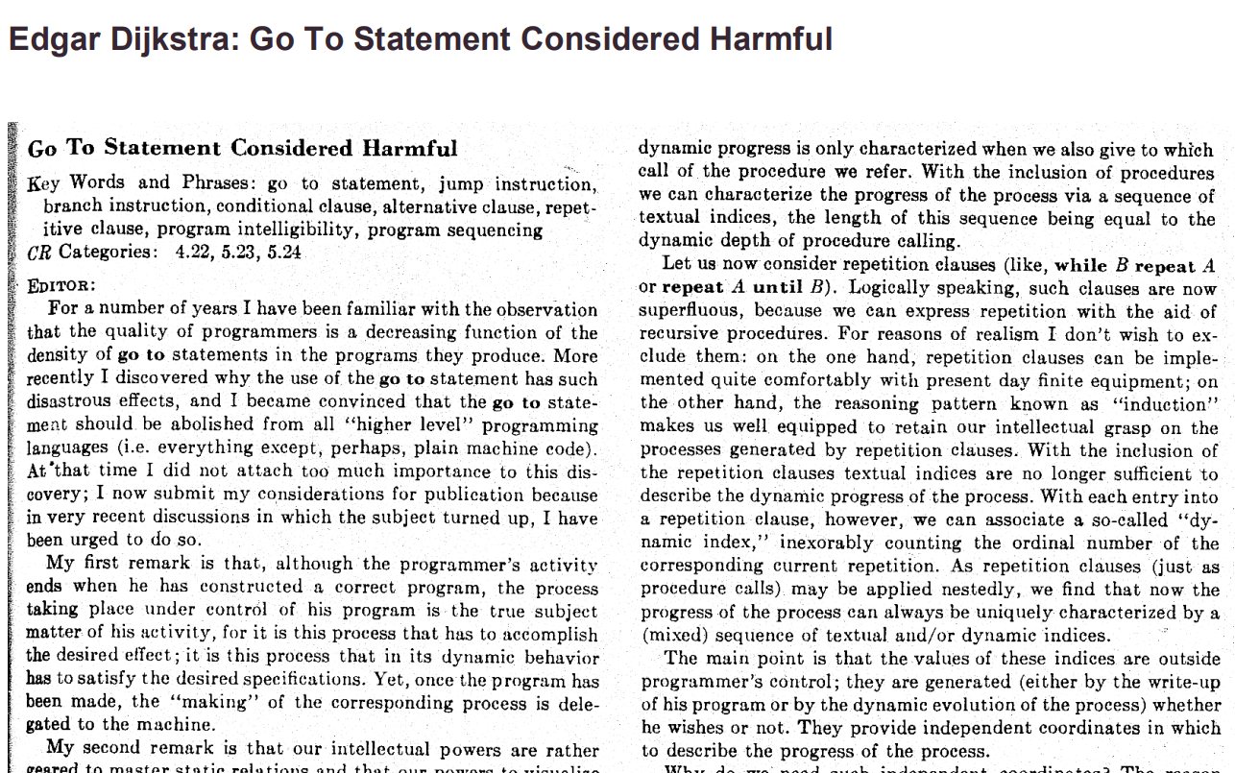

Slide 85
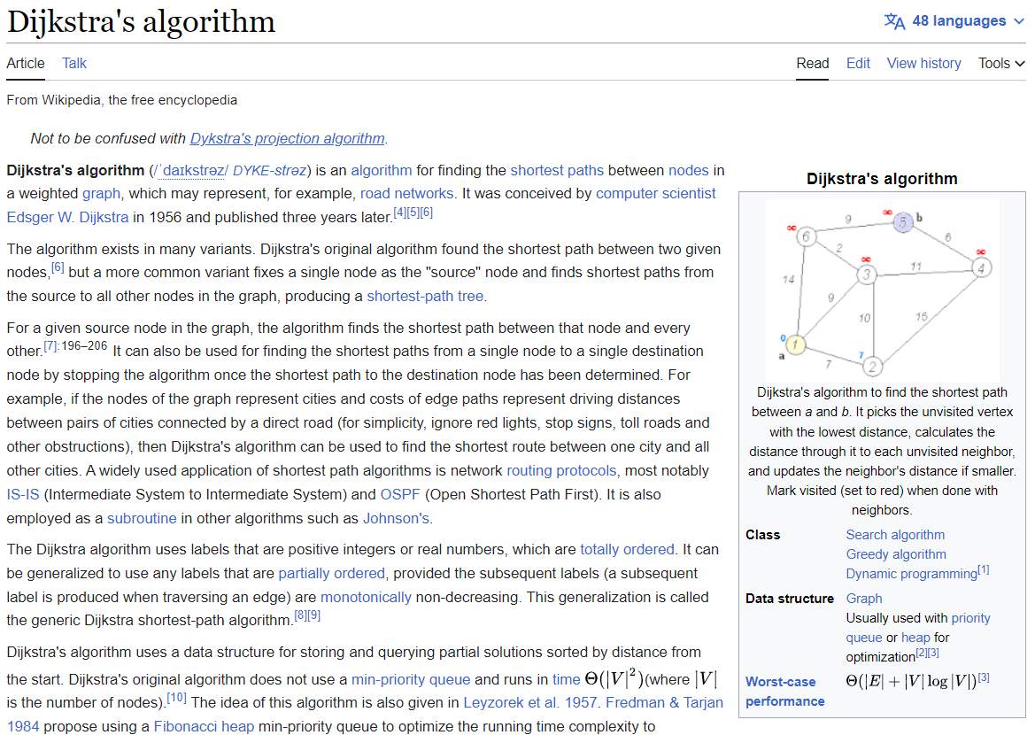

Slide 86
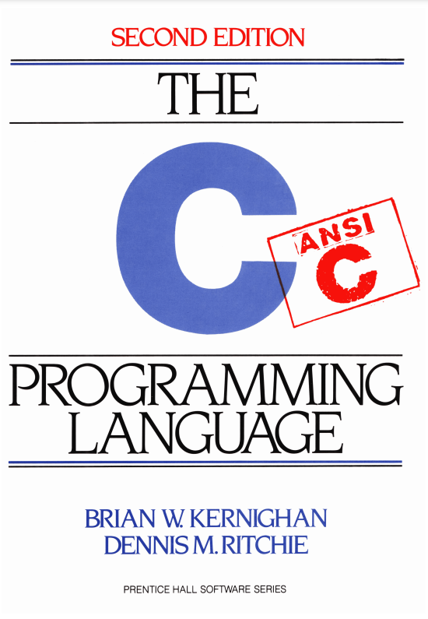

Slide 87
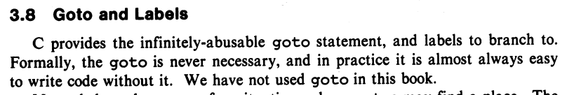
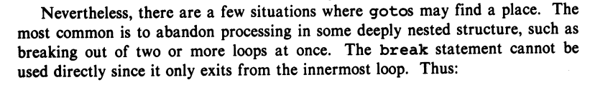
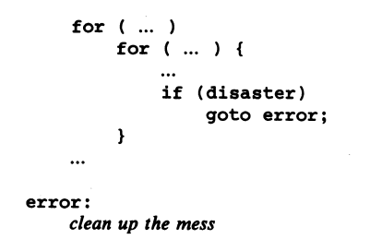

Slide 88
story time ☕️

Slide 89


Slide 90
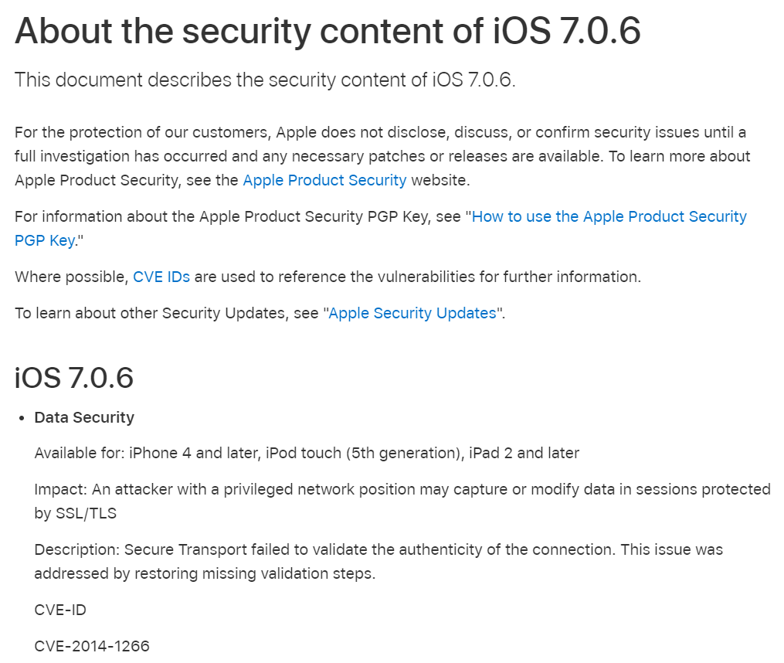

Slide 91
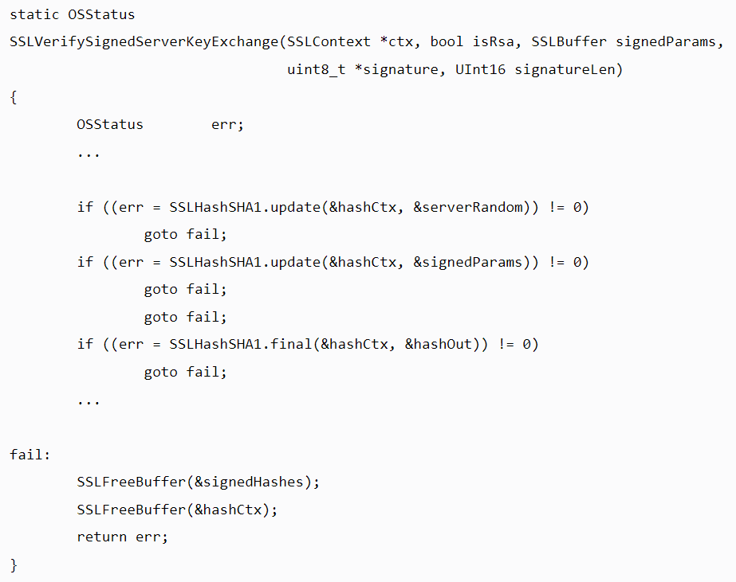

Slide 92
{
}
goto fail;

Slide 93
did the bug really happen because they left out the curly braces?

Slide 94
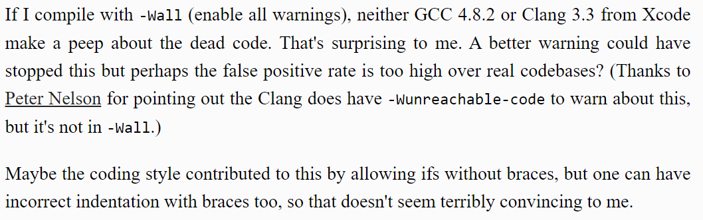

Slide 96
did the bug really happen because they left out the curly braces?

Slide 97
no, the bug happened because they didn't code in DrJava!

Slide 98
highlight your code and press Tab!

Slide 99
big O

Slide 100
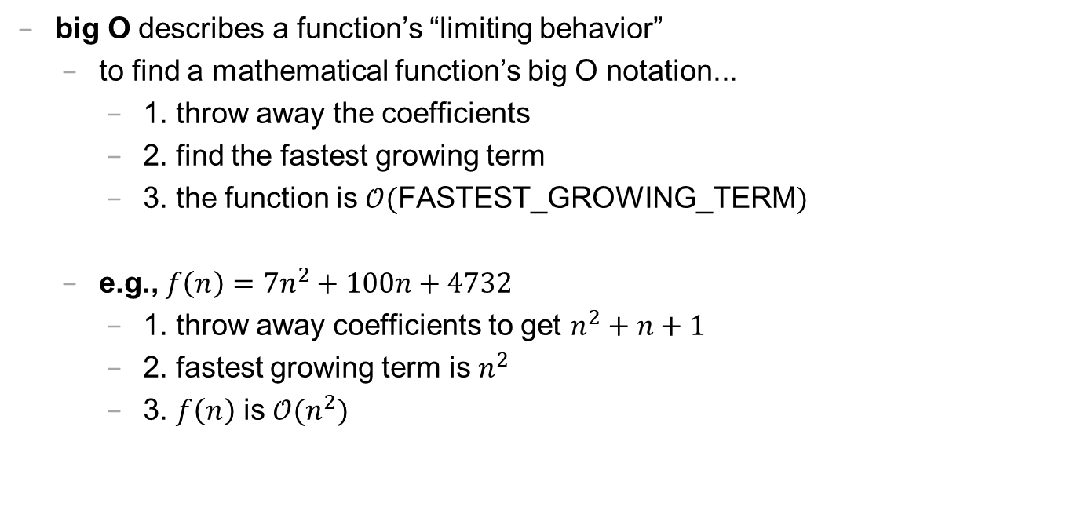
big O (1/2)
big O describes a function’s “limiting behavior”
to find a mathematical function’s big O notation...
1. throw away the coefficients
2. find the fastest growing term
3. the function is $𝒪($FASTEST_GROWING_TERM$)$
e.g., $f\left(n\right)=7n^{2}+100n+4732$
1. throw away coefficients to get $n^{2}+n+1$
2. fastest growing term is $n^{2}$
3. $f\left(n\right)$ is $𝒪(n^{2})$

Slide 101
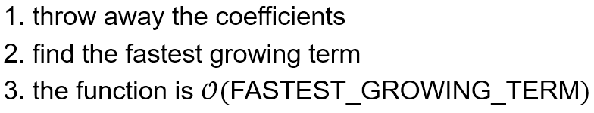
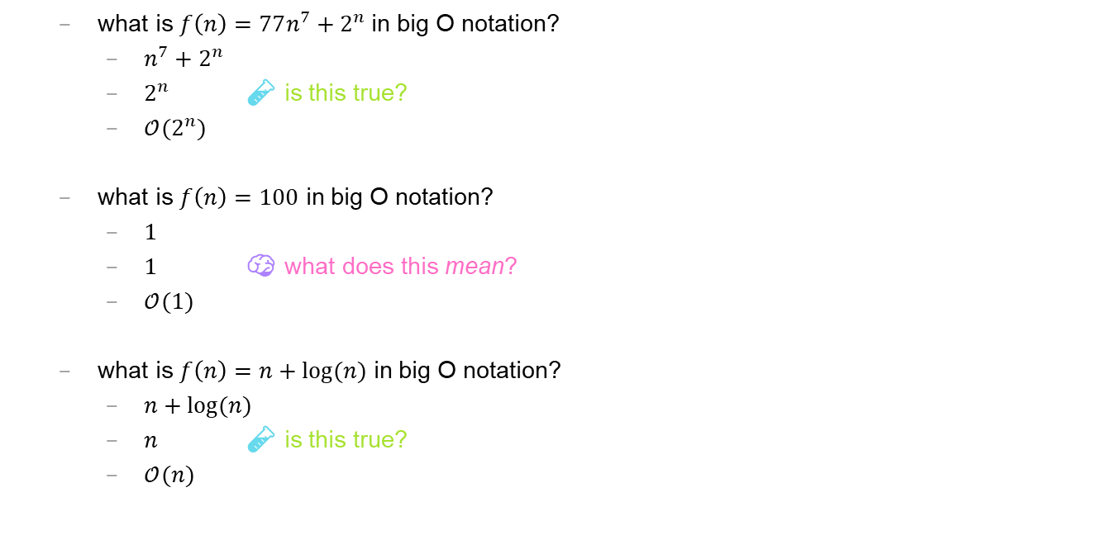
big O (2/2)
what is $f\left(n\right)=77n^{7}+2^{n}$ in big O notation?
$n^{7}+2^{n}$
$2^{n}$ 🧪 is this true?
$𝒪(2^{n})$
what is $f\left(n\right)=100$ in big O notation?
$1$
$1$ 🧠 what does this mean?
$𝒪(1)$
what is $f\left(n\right)=n+log⁡(n)$ in big O notation?
$n+log⁡(n)$
$n$ 🧪 is this true?
$𝒪(n)$

Slide 102
🗣 what is the big O of your isPrime(int n)? can you do better?

Slide 103

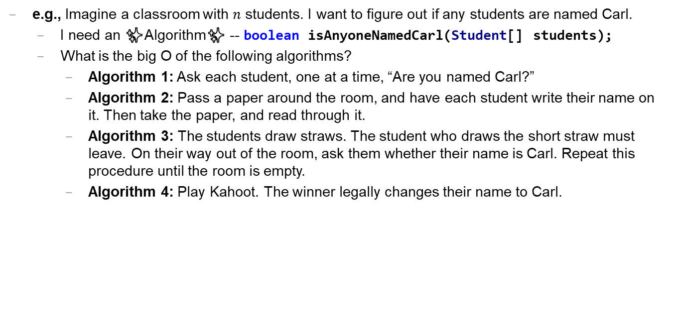
Caaaaaaaaaaaarl
e.g., Imagine a classroom with $n$ students. I want to figure out if any students are named Carl.
I need an ✨Algorithm✨ -- boolean isAnyoneNamedCarl(Student[] students);
What is the big O of the following algorithms?
Algorithm 1: Ask each student, one at a time, “Are you named Carl?”
Algorithm 2: Pass a paper around the room, and have each student write their name on it. Then take the paper, and read through it.
Algorithm 3: The students draw straws. The student who draws the short straw must leave. On their way out of the room, ask them whether their name is Carl. Repeat this procedure until the room is empty.
Algorithm 4: Play Kahoot. The winner legally changes their name to Carl.

Slide 104
extra time: practice exam questions 🤷‍♂️

Slide 105
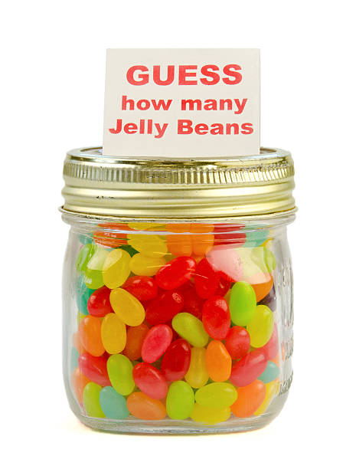
ANNOUNCEMENTS today is No Laptop Monday WARMUP how many arrays does this app use? (answer on Friday) TODAY arrays, aka, The Best Data Structure Ever
arrays

Slide 106
record LEC 02

Slide 107
arrays

Slide 108
mental model of an array

Slide 109
mental model of an array
elements live in equally-sized boxes all right next to each other
🟩🟩🟩🟩🟩🟩🟩🟩
the array itself lives "in memory"

Slide 110

mental model of an array
elements live in equally-sized boxes all right next to each other
🟩🟩🟩🟩🟩🟩🟩🟩
the array itself lives "in memory"

Slide 111
arrays

Slide 112
arrays (1/2)
an array is a fixed-size sequence of elements, all of the same type
"an array of 4372 double's"
"an array of 1 int's"
"an array of 64 Student's"

Slide 113
arrays (2/2)
we will often write an array using curly braces
{ 7, 7, 9 } is an array containing 7, 7, and 9
optionally, you can include a comma after the last element
{ 7, 7, 9, }
☠ even though sets from math also use curly braces, Java arrays have nothing to do with sets; in a set, all elements must be unique

Slide 114
array operations

Slide 115
creating an array (1/2)
you can create an array by specifying its length (the number of elements); if you do, the array is zero-initialized (all elements are initially set to zero)
int[] array = new int[8]; // { 0, 0, 0, 0, 0, 0, 0, 0 }
boolean[] array = new boolean[2]; // { false, false }
String[] array = new String[3]; // { null, null, null }

Slide 116
creating an array (2/2)
you can also create an array by specifying its elements; if you do, the array's length is the number of elements you specified
int[] array = { 7, 7, 9 };
boolean[] array = { true };
String[] array = { "hello", "world" };

Slide 117
getting an array's length
after creating an array, you can get (but not set) its length
int[] array = { 7, 7, 9 };
System.out.println(array.length); // 3
int[] array = new int[8];
System.out.println(array.length); // 8
Error: cannot assign a value to final variable length
array.length = 42;

Slide 118
getting the value of an element of an array
you can get the value of an element of an array using the square brackets and the index of the element
this is also called "accessing the array"
int[] array = { 3, 4, 5 };
int foo = array[0]; // 3
int[] array = { 3, 4, 5 };
int foo = array[42];
java.lang.ArrayIndexOutOfBoundsException: 42

Slide 119
setting the value of an element of an array
you can set the value of an element of an array using the square brackets and the index of the element
int[] array = { 7, 7, 9 };
array[1] = 8;
// { 7, 8, 9 }
int[] array = { 7, 7, 9 };
array[-1] = 1000;
java.lang.ArrayIndexOutOfBoundsException: -1

Slide 120
☠ printing the elements of an array
☠ in Java, you don't simply call System.out.println(array)
instead, you call System.out.println(Arrays.toString(array));
note: this prints with square brackets instead of curly brackets
🤷‍♂️

Slide 121
runtime of array operations

Slide 122
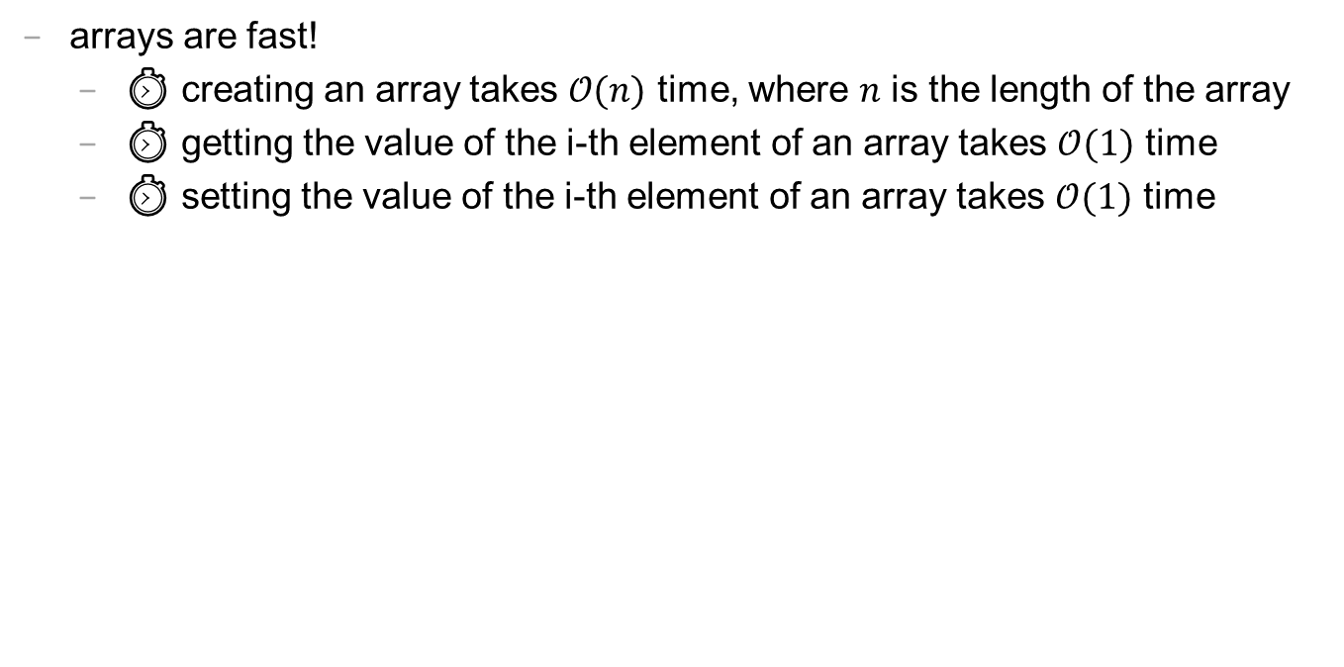
runtime of array operations
arrays are fast!
⏱️ creating an array takes $𝒪(n)$ time, where $n$ is the length of the array
⏱️ getting the value of the i-th element of an array takes $𝒪(1)$ time
⏱️ setting the value of the i-th element of an array takes $𝒪(1)$ time

Slide 123
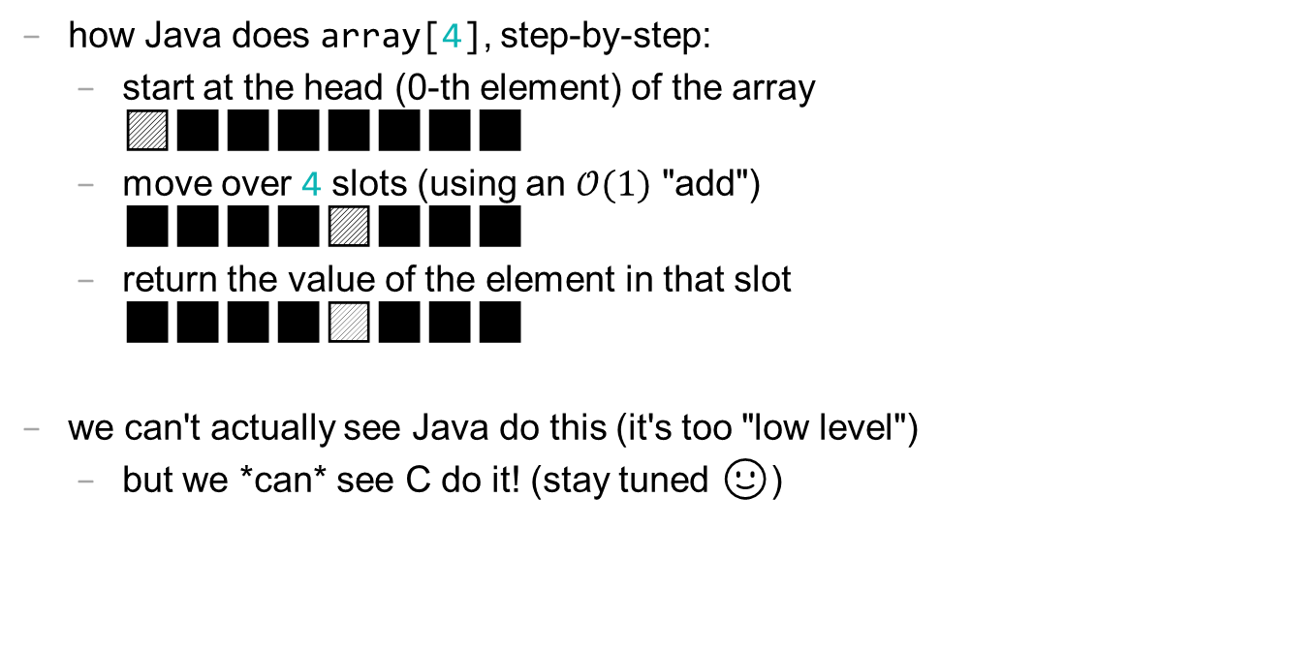
accessing an array "under the hood"
how Java does array[4], step-by-step:
start at the head (0-th element) of the array 🟦⬛⬛⬛⬛⬛⬛⬛
move over 4 slots (using an $𝒪(1)$ "add") ⬛⬛⬛⬛🟦⬛⬛⬛
return the value of the element in that slot ⬛⬛⬛⬛🟨⬛⬛⬛
we can't actually see Java do this (it's too "low level")
but we *can* see C do it! (stay tuned 🙂)

Slide 124
iterating over an array

Slide 125
iterating over an array
a for loop can be used to iterate over an array
for (int i = 0; i < array.length; ++i) {
array[i] = ...;
}

Slide 126
array examples

Slide 127
example: creating an array of the first 100 non-negative integers

Slide 128
example: creating an array of the first 100 non-negative integers
import java.util.*;
class Main {
public static void main(String[] arguments) {
int[] array = new int[100];
for (int i = 0; i < array.length; ++i) {
array[i] = i;
}
System.out.println(Arrays.toString(array));
}
}

Slide 129
example: array copy

Slide 130
example: array copy
import java.util.*;
class Main {
public static void main(String[] arguments) {
int[] source = { 3, 4, 5 };
int[] destination = new int[source.length];
for (int i = 0; i < source.length; ++i) {
destination[i] = source[i];
}
System.out.println(Arrays.toString(source));
System.out.println(Arrays.toString(destination));
}
}

Slide 131
☠ example: bad very bad broken array copy

Slide 132
☠ example: bad very bad broken array copy
import java.util.*;
class Main {
public static void main(String[] arguments) {
int[] source = { 3, 4, 5 };
int[] destination = source;
source[0] = 7;
System.out.println(Arrays.toString(source));
System.out.println(Arrays.toString(destination));
}
}

Slide 133
ANNOUNCEMENTS today is Laptop Wednesday 💻 🎉 WARMUP internally, a String is an array of characters what must stringA + stringB *do*? why might this be scary? 👻
TODAY more arrays; arrays of arrays; arrays arrays arrays

Slide 134
Homework-02 (refresh the page!) 📚

Slide 135
Pre-Lab Post-Lab

Slide 136
record LEC 02

Slide 137
example: circular array
3, 4, 5, 6, 7, 8, 9, 10, 11,

Slide 138
example: circular array
import java.util.*;
class Main {
public static void main(String[] arguments) {
int[] array = new int[5];
int indexToWriteIntoNext = 0;
while (true) {
array[indexToWriteIntoNext] = getIntFromUser();
indexToWriteIntoNext = (indexToWriteIntoNext + 1) % array.length;
System.out.println(Arrays.toString(array));
}
}
static int getIntFromUser() {
Scanner scanner = new Scanner(System.in);
while (!scanner.hasNextInt()) { scanner.nextLine(); }
return scanner.nextInt();
}
}

Slide 139
example: finding the index (and value) of an array's maximum element

Slide 140
example: finding the index (and value) of an array's maximum element
import java.util.*;
class Main {
public static void main(String[] arguments) {
double[] array = { 1.0, 3.0, -42.0, 1000.0, 99.0 };
int indexOfMaximumElement = -1;
double valueOfMaximumElement = Double.NEGATIVE_INFINITY;
for (int i = 0; i < array.length; ++i) {
if (array[i] > valueOfMaximumElement) {
indexOfMaximumElement = i;
valueOfMaximumElement = array[i];
}
}
System.out.println("array[" + indexOfMaximumElement + "] = " + valueOfMaximumElement);
}
}

Slide 141
multi-dimensional arrays

Slide 142
multi-dimensional arrays

Slide 143
multi-dimensional arrays (arrays of arrays of ...)
multi-dimensional arrays are sometimes really handy
int[][] array = { { 3, 4 }, { 5, 6 }, { 7, 8 } };
System.out.println(Arrays.deepToString(array));
// [[3, 4], [5, 6], [7, 8]]
System.out.println(array[0][1]); // 4
int[][][] array = new int[2][3][4];
array[0][0][0] = 42;
System.out.println(Arrays.deepToString(array));
// [[[42, 0, 0, 0], [0, 0, 0, 0], [0, 0, 0, 0]], [[0, 0, 0, 0], [0, 0, 0, 0], [0, 0, 0, 0]]]

Slide 144
swap

Slide 145
🐍 Python swap

Slide 146
🐍 Python swap
a = 0
b = 1
a, b = b, a # Python swap
# a is now 1
# b is now 0

Slide 147
☠️ BAD VERY BAD BROKEN swap

Slide 148
☠️ BAD VERY BAD BROKEN swap
int a = 0;
int b = 1;
{ // BAD VERY BAD BROKEN swap
a = b; // a <- 1
b = a; // b <- 1
}

Slide 149
swap

Slide 150
swap
int a = 0;
int b = 1;
{ // swap
int tmp = a; // tmp <- 0
a = b; // a <- 1
b = tmp; // b <- 0
}

Slide 151
array algorithms that use swaps

Slide 152
reversing an array

Slide 153
out-of-place reverse
we can reverse an array out-of-place using an additional array
static int[] outOfPlaceReverse(int[] array) {
int[] result = new int[array.length];
for (int i = 0; i < array.length; ++i) {
int j = (array.length - 1) - i;
result[i] = array[j];
}
return result;
}

Slide 154
in-place reverse
we can reverse an array in-place using "swaps" (no additional array)
static void inPlaceReverse(int[] array) {
for (int i = 0; i < array.length / 2; ++i) {
int j = (array.length - 1) - i;
int tmp = array[i];
array[i] = array[j];
array[j] = tmp;
}
}

Slide 155
bubble sort

Slide 156
bubble sort
bubble sort is a simple in-place sorting algorithm that uses swaps
import java.util.*;
class Main {
public static void main(String[] arguments) {
int[] array = { 2, 4, 1, 6, 0, 3, 5 };
boolean arrayIsSorted;
do {
arrayIsSorted = true;
for (int i = 0; i < array.length - 1; ++i) {
if (array[i] > array[i + 1]) {
arrayIsSorted = false;
// swap
int tmp = array[i];
array[i] = array[i + 1];
array[i + 1] = tmp;
}
}
} while (!arrayIsSorted);
System.out.println(Arrays.toString(array));
}
}

Slide 157
ANNOUNCEMENTS today is Fun Laptop Friday 💻 🎉
Post-Lab @ 1:00 – 2:00
colloquium @ 2:35; juggling club @ 4:00 WARMUP i finished my paper video (ish)!
let's count the arrays! 🐉
TODAY retry of the array tutorial; live-code; super bugs

Slide 158
how many arrays?
ARRAYS (not counting tiny arrays of 3 double's, which i use to represent points)
NOTE: Counts are very approximate
==========
strings for loading files >5
huge arrays for drawing random stuff (the floor, etc) 2
random stuff in my cow.cpp library (keyboard state, OpenGL objects, etc.) >20
random global variables 1
building the simulation >6
simulation state 3
simulation itself >20
dragon head mesh 7
dragon body mesh 7
dragon mesh 7
sphere mesh 3
cylinder mesh 3
motor configuration 3
arrays that just move data back and forth between C++ <-> unity 8
inverse kinematics >15
physics >10
----------
definitely at least 100; probably less than 1000

Slide 159
💻 array tutorial

Slide 160
💻 array tutorial (this time with a wiki page)

Slide 161
💻 array tutorial
// 🟢 ([5, 4, 7, 0, 0, 7], 7) -> 2
// 🟢 ([5, 4, 7, 0, 0, 7], 3) -> -1
static int findFirstIndexOf(int[] array, int value);
// 🟦 ([1, 3, 3, 2, 3, 4], 3) -> [1, 2, 4]
static int[] removeAllOccurences(int[] array, int value);
// ♦️ [[1, 3], [2, 4, 5], [0, 5]] -> [0, 1, 2, 3, 4, 5, 5]
static int[] mergeArrayOfSortedArrays(int[][] arrays);

Slide 162
record LEC 02

Slide 163
attempt to live-code the solutions while half-asleep 🙂👍

Slide 164
☕️ the art of coding things in the right order compile and run early, compile and run often

Slide 165
why implement Rule 22 first? why not just skip straight to the general case?

Slide 166

well, let us imagine...

Slide 167
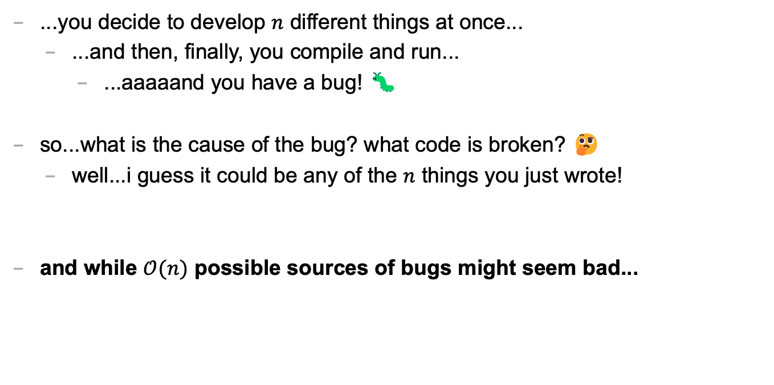
let's imagine...
...you decide to develop $n$ different things at once...
...and then, finally, you compile and run...
...aaaaand you have a bug! 🐛
so...what is the cause of the bug? what code is broken? 🤔
well...i guess it could be any of the $n$ things you just wrote!
and while $𝒪(n)$ possible sources of bugs might seem bad...

Slide 168
...the reality is ✨so much worse✨!

Slide 169

because broken code likes to interact with other broken code, to make✨super bugs✨!

Slide 171
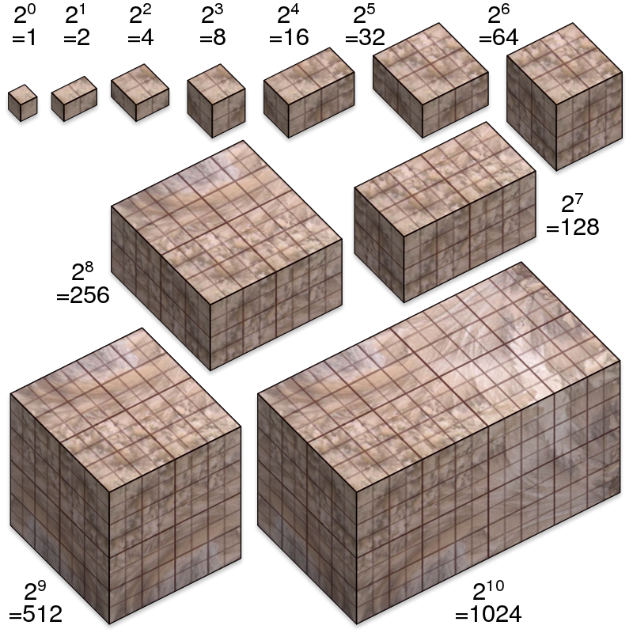
not broken
broken
developing one thing at a time

Slide 172
not broken
A is broken
B is broken
A and B are both broken
developing two things at a time

Slide 173

asymptotic bug-finding time

Slide 174
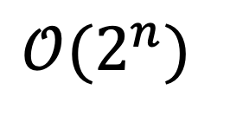
$$𝒪(2^{n})$$
gl;hf 🙂👍

Slide 175
big lesson
implement code one thing at a time
compile and run and test after implementing every single thing
this is a learned skill!
how i would actually implement the automata homework
make the array
print the array as an array
print the array as a string
update the array once using Rule 22 and print the result
wrap the printing and update in a for loop
implement code to handle all rules and test it on Rule 22
test it on the other rules

Slide 176
this is a learned skill!

Slide 177

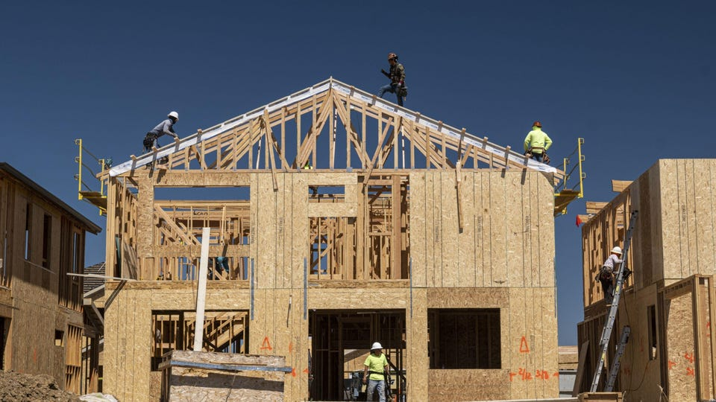
in summary

Slide 178
ANNOUNCEMENTS today is No Laptop Monday! WARMUP what is a 3, 4, 5 right triangle (from geometry)?
what are points and vectors (from geometry)?
why would you write a function?
why would you write a class?
TODAY a very class-y lecture lol

Slide 179
draw some points and lines on the board

Slide 180
monday memes

Slide 181
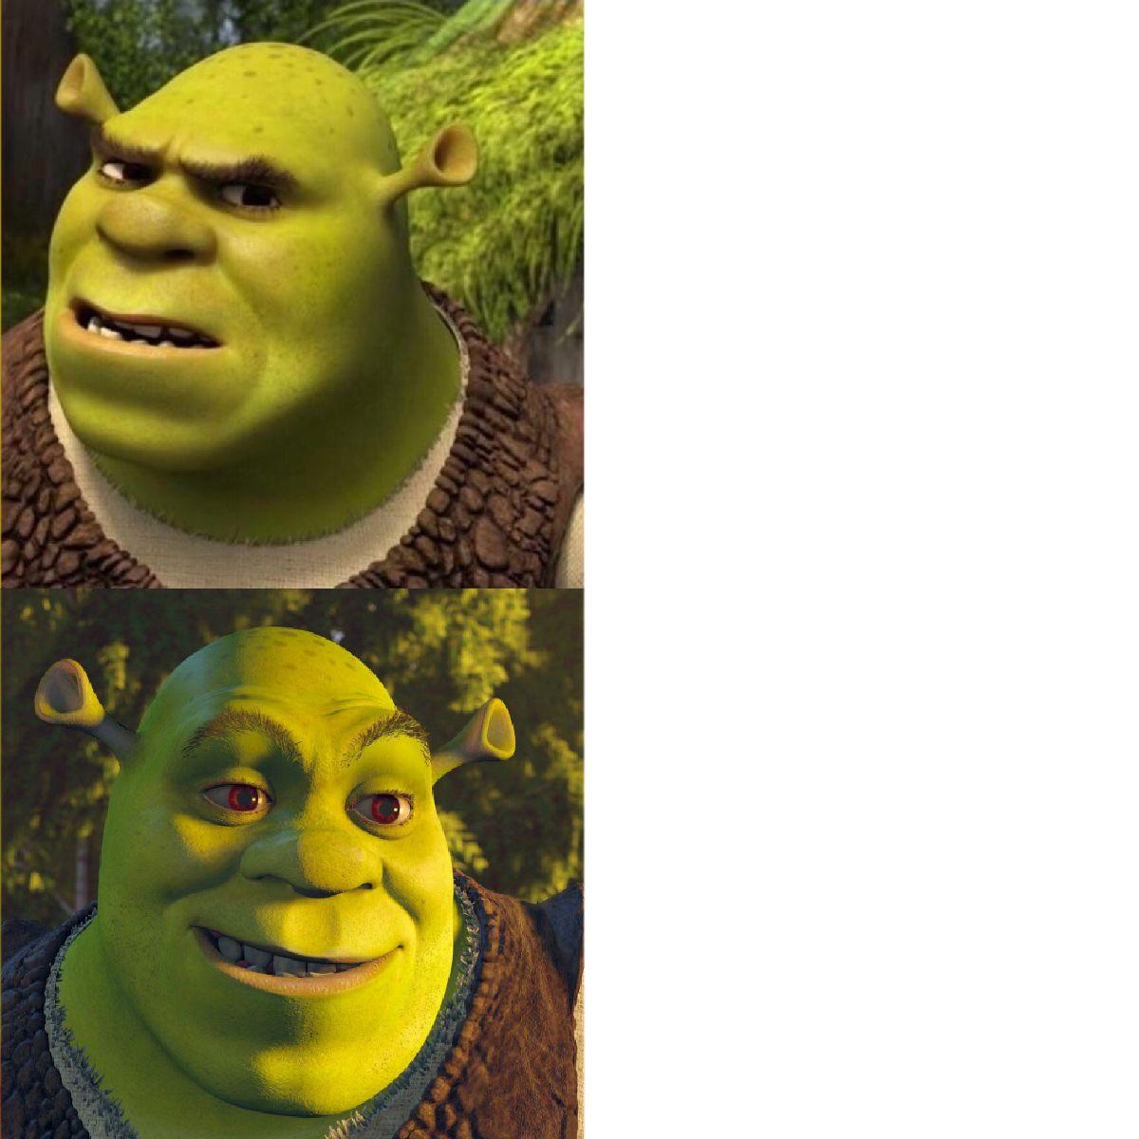
code up the entire program without compiling it
compile early; compile often

Slide 182

compilers

Slide 183
record LEC 01

Slide 184
functions

Slide 185
anatomy of a function

Slide 186
anatomy of a function (1/2)
a function is a lil chunk of code you can call from elsewhere
a function takes any number of arguments
... foo(int arg) { ... } // function foo takes an int
a function with a non-void return type must return a value of that type
int bar(...) { ... } // bar returns an int
void baz(...) { ... } // baz doesn't return anything
ReturnType functionName(ArgumentOneType argumentOne, ...) {
...
}

Slide 187
anatomy of a function (2/2)
void drawLine(Vector2 pointA, Vector2 pointB, Vector3 color) {
...
}

Slide 188
function arguments

Slide 189
arguments
a function can take arguments

Slide 190
return

Slide 191
return (1/2)
a return statement stops execution of a function and returns the program to where the function was called
some return statements return a value
return 123;
others do not
return;

Slide 192
return (2/2)
a function with a non-void return type must return a value of that type, regardless of the path taken through the function
Error: missing return statement
static boolean isPrime(int n) {
if (n <= 1) { return false; }
for (int i = 2; i <= Math.sqrt(n); ++i) {
if (n % i == 0) { return false; }
}
}

Slide 193
return (2/2)
a function with a non-void return type must return a value of that type, regardless of the path taken through the function
static boolean isPrime(int n) {
if (n <= 1) { return false; }
for (int i = 2; i <= Math.sqrt(n); ++i) {
if (n % i == 0) { return false; }
}
return true;
}

Slide 194
void

Slide 195
void
void is a special return type meaning a function does not return a value
void functions often modify (the objects referenced by) their arguments
static void reverseArrayInPlace(int[] array) { ... }
// no need to return a reference to array // (user of the function already has one)
in Java, the main method is a void function
public static void main(String[] arguments) { ... }

Slide 196
the call stack

Slide 197
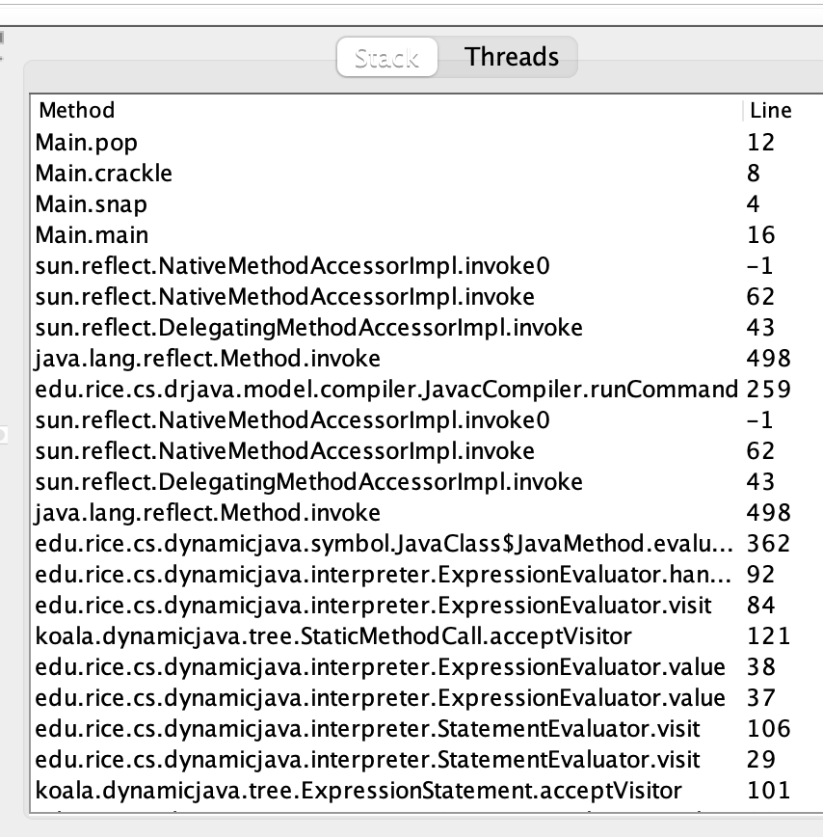
the call stack
functions can call other functions
the resulting "stack" of function calls is called the call stack
class Main {
static void snap() {
crackle();
}
static void crackle() {
pop();
}
static void pop() {
return;
}
public static void main(String[] arguments) {
snap();
}
}

Slide 198
🤔

Slide 199
recursion

Slide 200
recursion (1/2)
a recursive function is a function that calls itself
each call must make progress towards a base case (when the function finally returns without calling itself)
✨ when in doubt, try something like zero for your base case
class Main {
static int digitSum(int n) {
if (n == 0) {
return 0;
}
return digitSum(n / 10) + (n % 10);
}
public static void main(String[] arguments) {
System.out.println(digitSum(256)); // 13
}
}

Slide 201
static int digitSum(int n) {
if (n == 0) {
return 0;
}
return digitSum(n / 10) + (n % 10);
}
return 0;
return digitSum(0) + 2;
return digitSum(2) + 5;
return digitSum(25) + 6;
int a = digitSum(256);

Slide 202
static int digitSum(int n) {
if (n == 0) {
return 0;
}
return digitSum(n / 10) + (n % 10);
}
return 0;
return digitSum(0) + 2;
return digitSum(2) + 5;
return digitSum(25) + 6;
int a = digitSum(256);

Slide 203
static int digitSum(int n) {
if (n == 0) {
return 0;
}
return digitSum(n / 10) + (n % 10);
}
return 0 + 2;
return digitSum(2) + 5;
return digitSum(25) + 6;
int a = digitSum(256);

Slide 204
static int digitSum(int n) {
if (n == 0) {
return 0;
}
return digitSum(n / 10) + (n % 10);
}
return 2;
return digitSum(2) + 5;
return digitSum(25) + 6;
int a = digitSum(256);

Slide 205
static int digitSum(int n) {
if (n == 0) {
return 0;
}
return digitSum(n / 10) + (n % 10);
}
return 2;
return digitSum(2) + 5;
return digitSum(25) + 6;
int a = digitSum(256);

Slide 206
static int digitSum(int n) {
if (n == 0) {
return 0;
}
return digitSum(n / 10) + (n % 10);
}
return 2 + 5;
return digitSum(25) + 6;
int a = digitSum(256);

Slide 207
static int digitSum(int n) {
if (n == 0) {
return 0;
}
return digitSum(n / 10) + (n % 10);
}
return 7;
return digitSum(25) + 6;
int a = digitSum(256);

Slide 208
static int digitSum(int n) {
if (n == 0) {
return 0;
}
return digitSum(n / 10) + (n % 10);
}
return 7;
return digitSum(25) + 6;
int a = digitSum(256);

Slide 209
static int digitSum(int n) {
if (n == 0) {
return 0;
}
return digitSum(n / 10) + (n % 10);
}
return 7 + 6;
int a = digitSum(256);

Slide 210
static int digitSum(int n) {
if (n == 0) {
return 0;
}
return digitSum(n / 10) + (n % 10);
}
return 13;
int a = digitSum(256);

Slide 211
static int digitSum(int n) {
if (n == 0) {
return 0;
}
return digitSum(n / 10) + (n % 10);
}
return 13;
int a = digitSum(256);

Slide 212
static int digitSum(int n) {
if (n == 0) {
return 0;
}
return digitSum(n / 10) + (n % 10);
}
int a = 13;

Slide 213
fin.

Slide 214
recursion (2/2)
a stack overflow error happens when functions call too many functions without returning; these errors are usually caused by broken recursive code
class Main {
static void stackOverflow() {
stackOverflow();
}
public static void main(String[] arguments) {
stackOverflow();
}
}
java.lang.StackOverflowError
at Main.stackOverflow(Tmp.java:3)
at Main.stackOverflow(Tmp.java:3)
at Main.stackOverflow(Tmp.java:3)
at Main.stackOverflow(Tmp.java:3)
at Main.stackOverflow(Tmp.java:3)
at Main.stackOverflow(Tmp.java:3)
at Main.stackOverflow(Tmp.java:3)
at Main.stackOverflow(Tmp.java:3)
at Main.stackOverflow(Tmp.java:3)
at Main.stackOverflow(Tmp.java:3)
at Main.stackOverflow(Tmp.java:3)
at Main.stackOverflow(Tmp.java:3)
at Main.stackOverflow(Tmp.java:3)
at Main.stackOverflow(Tmp.java:3)
at Main.stackOverflow(Tmp.java:3)
at Main.stackOverflow(Tmp.java:3)
at Main.stackOverflow(Tmp.java:3)
at Main.stackOverflow(Tmp.java:3)
at Main.stackOverflow(Tmp.java:3)
at Main.stackOverflow(Tmp.java:3)
at Main.stackOverflow(Tmp.java:3)
at Main.stackOverflow(Tmp.java:3)
at Main.stackOverflow(Tmp.java:3)
at Main.stackOverflow(Tmp.java:3)
at Main.stackOverflow(Tmp.java:3)
at Main.stackOverflow(Tmp.java:3)
at Main.stackOverflow(Tmp.java:3)
at Main.stackOverflow(Tmp.java:3)
at Main.stackOverflow(Tmp.java:3)
at Main.stackOverflow(Tmp.java:3)
at Main.stackOverflow(Tmp.java:3)
at Main.stackOverflow(Tmp.java:3)
at Main.stackOverflow(Tmp.java:3)
at Main.stackOverflow(Tmp.java:3)
at Main.stackOverflow(Tmp.java:3)
at Main.stackOverflow(Tmp.java:3)
at Main.stackOverflow(Tmp.java:3)
at Main.stackOverflow(Tmp.java:3)
at Main.stackOverflow(Tmp.java:3)
at Main.stackOverflow(Tmp.java:3)
at Main.stackOverflow(Tmp.java:3)
at Main.stackOverflow(Tmp.java:3)
at Main.stackOverflow(Tmp.java:3)
at Main.stackOverflow(Tmp.java:3)
at Main.stackOverflow(Tmp.java:3)
at Main.stackOverflow(Tmp.java:3)
at Main.stackOverflow(Tmp.java:3)
at Main.stackOverflow(Tmp.java:3)
at Main.stackOverflow(Tmp.java:3)
at Main.stackOverflow(Tmp.java:3)
at Main.stackOverflow(Tmp.java:3)
at Main.stackOverflow(Tmp.java:3)
at Main.stackOverflow(Tmp.java:3)
at Main.stackOverflow(Tmp.java:3)
at Main.stackOverflow(Tmp.java:3)
at Main.stackOverflow(Tmp.java:3)
at Main.stackOverflow(Tmp.java:3)
at Main.stackOverflow(Tmp.java:3)
at Main.stackOverflow(Tmp.java:3)
at Main.stackOverflow(Tmp.java:3)
at Main.stackOverflow(Tmp.java:3)
at Main.stackOverflow(Tmp.java:3)
at Main.stackOverflow(Tmp.java:3)
at Main.stackOverflow(Tmp.java:3)
at Main.stackOverflow(Tmp.java:3)
at Main.stackOverflow(Tmp.java:3)

Slide 215


Slide 216
classes

Slide 217
anatomy of a class

Slide 218
anatomy of a class (1/2)
class ClassName {
VariableOneType variableOne;
...
FunctionOneReturnType functionOneName(...) { ... }
...
}
a class is (a blueprint for) a lil chunk of data that you can make elsewhere
a class may have any number of variables (fields)
int foo; // objects of this class have an int called foo
a class may have any number of functions (methods)
int bar() { ... } // objects of class have function bar

Slide 219
anatomy of a class (2/2)
class Vector2 {
// instance variables
double x;
double y;
// constructor
Vector2(double x, double y) { ... }
// instance methods
double length() { ... }
...
}

Slide 220
dot

Slide 221
dot
the dot operator is used to access an object's variables and functions
Vector2 a = new Vector2();
a.x = 3.0;
a.y = 4.0;
System.out.println(a.length()); // 5.0

Slide 222
terminology

Slide 223
class vs. object (instance of a class)
a class is NOT the same thing as an object
a class is "a blueprint for making objects"
we can make an instance of a class (an object) using the new keyword
this is called "instantiating the class"

Slide 224
new and constructors

Slide 225
new
the new keyword create a new instance of a class and calls its appropriate constructor
int[] array = new int[5]; // { 0, 0, 0, 0, 0 }
Vector2 a = new Vector2(3.0, 4.0); // (3.0, 4.0)
☠️ you don't need new to create a new string
String string = "strings are their own thing";
☠️ you don't need new to create a new array when using {} syntax
int[] array = { 1, 2, 3 };
☠️ new doesn't actually return the object it created; it returns a reference to the object it created

Slide 226
constructors (1/2)
a constructor is called when an object is created
if the class does not have a constructor, then the default constructor must be called, which takes no arguments and sets all variables to zero
Vector2 a = new Vector2(3.0, 4.0); // (3.0, 4.0)
Vector2 b = new Vector2(); // (0.0, 0.0)

Slide 227
constructors (2/2)
a (non-default) constructor is never necessary, but is often convenient
Vector2 a = new Vector2(3.0, 4.0); // a: (3.0, 4.0)
Vector2 a = new Vector2(); // a: (0.0, 0.0)
a.x = 3.0; // a: (3.0, 0.0)
a.y = 4.0; // a: (3.0, 4.0)

Slide 228
this 🐍 in Python, this is self

Slide 229
this (1/2)
this is a reference to the instance of the class whose function we're inside of
class Vector2 {
double x;
double y;
Vector2(double x, double y) {
this.x = x;
this.y = y;
}
Vector2 plus(Vector2 other) {
return new Vector2(this.x + other.x, this.y + other.y);
}
...
}

Slide 230
this (2/2)
this is especially useful inside a constructor (elsewhere it's usually optional)
class Vector2 {
double x;
double y;
Vector2(double x, double y) {
this.x = x;
this.y = y;
}
Vector2 plus(Vector2 other) {
return new Vector2(x + other.x, y + other.y);
}
...
}

Slide 231

ANNOUNCEMENTS today is Laptop Wednesday!
✨ would you like Your Homework-02 Code to be prominently featured in our tutorial today?! first come first served WARMUP what is memory?
what is a memory?
can you trust your memory?
TODAY class tutorial

Slide 232
HW-00 has been graded

Slide 233
HW-01 is being graded...

Slide 234
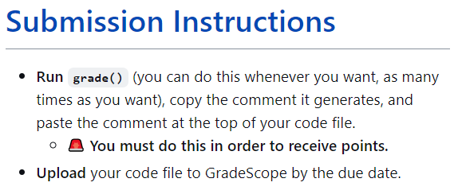

Slide 237
most of you did not do this

Slide 238


Slide 239
you have 24 hours to do this

Slide 240
record LEC 01

Slide 241
Java memory model (references to objects)

Slide 242
references and null

Slide 243
references (1/2)
in Java, we deal with references to objects
int[] foo; // foo is a reference to an int array
String bar; // bar is a reference to a String object
Vector2 a; // a is a reference to a Vector2 object

Slide 244
references (2/2)
☠️ you can (unintentionally) make multiple reference to one object
Vector2 a = new Vector2(3.0, 4.0);
Vector2 b = a;
// a and b are references to the same Vector2 object!
a
x
y
3.0
4.0
b

Slide 245
null
a null reference doesn't refer to any object
Vector2[] array = new Vector2[3]; // { null, null, null }
Vector2 a = null;

Slide 246
the heap a reference is a memory address a memory address is an integer

Slide 247
the heap
objects made using new are stored "on the heap"
the heap is a huuuuuge chunk of memory
objects have an address in that memory (that says where they live)
0x00110022
0x00a20038
0x0ff0a147

Slide 249
Vector2 a = new Vector2(3.0, 4.0);
a
0x00000008
3.0
4.0
0x00000000
0x00000003
0x00000013
0x00000001
0x00000002
0x00000010
0x00000011
0x00000004
0x00000007
0x0000000b
0x00000012
0x00000005
0x00000006
0x00000008
0x00000009
0x0000000a
0x00000014
0x0000000c
0x0000000f
0x00000015
0x0000000d
0x00000008
0x0000000e

Slide 250
references (1/2)
= assigns the value on the right-hand side to the variable on the left-hand side
int a = 3;
int b = a;
a
b
3
3

Slide 251
references (1/2)
= assigns the value on the right-hand side to the variable on the left-hand side
int a = 3;
int b = a;
a = 7;
a
b
7
3

Slide 252
references (2/2)
int a = 3;
int b = a;
a
b
☠️ new doesn't actually return the object it created; it returns a reference to the object it created
a reference is an object's location in memory
this reference is a number (it acts like an int)!
3
3
Foo a = new Foo();
Foo b = a;
a
b
0x7aae6227
0x7aae6227
0x7aae6227

Slide 253
references (2/2)
int a = 3;
int b = a;
a
b
☠️ new doesn't actually return the object it created; it returns a reference to the object it created
a reference is an object's location in memory
this reference is a number (it acts like an int)!
3
3
Foo a = new Foo();
Foo b = a;
a = null;
a
b
0x7aae6227
null
0x7aae6227

Slide 254
references (3/2)
i told a small lie last time we talked
System.out.println(array); does NOT actually print array's memory address
rather, it prints a number called array's "hash code"
(the hash code is typically calculated using the memory address)
🤷
the important point is that a reference is a memory address
and a memory address is an integer (often written in hex) 🙂👍

Slide 255
static

Slide 256
static variables and static methods

Slide 257
instance variables vs. static variables
an instance variable is part of an instance of a class
a static variable (class variable) is part of the class itself
there is only one, period. (it's a global variable that lives "on the class")
class Vector3 {
double x;
double y;
double z;
static Vector3 red = new Vector3(1.0, 0.0, 0.0);
...
}
// drawLine(a, b, Vector3.red);

Slide 258
instance methods vs. static methods
an instance method must be called on an instance (object) of a class
a static method (class method) can be called on the class itself
✅ there is no this in a static method
class Vector2 {
double length() { ... }; // (non-static method)
static double distanceBetween(Vector2 a, Vector2 b) { ... }
...
}
// a.length();
// Vector2.distanceBetween(a, b);

Slide 259
example

Slide 260
class Dog {
static int numTimesAllDogsBarked;
String bark;
Dog(String bark) {
this.bark = bark;
}
void makeBark() {
System.out.println(this.bark);
Dog.numTimesAllDogsBarked++;
}
> public static void main(String[] args) {
Dog rex = new Dog("woof!");
> Dog fido = new Dog("yip!");
rex.makeBark();
fido.makeBark();
System.out.println(Dog.numTimesAllDogsBarked);
}
}
Dog
(the class)
int numTimesAllDogsBarked;
args
(an instance/object of String[])
rex
(an instance of Dog)
rex.bark
(an instance of String)
String bark;
"woof!"
String[] args;
Dog rex;
Dog fido;
fido
(an instance of Dog)
fido.bark
(an instance of String)
main()
(stack frame)
String bark;
"yip!"
(these are references!)
----Stack----
(local variables)
-------Heap-------
(instances aka objects)
-----Static-----
(static data)

Slide 261
💻Class Tutorial

Slide 262
ANNOUNCEMENTS today is Jim Codes At You For 50 Minutes Friday 🎉🎉
WARMUP explain!
TODAY Homework-03
65 turrets = new Turret[100];
66 for (int i = 0; i < turrets.length; i++) {
67 Turret turret = turrets[i];
68 turret = new Turret();
69 }
70 turrets[0].position = new Vector2(40.0, 0.0);
java.lang.NullPointerException
at HW03.setup(HW03.java:70)

Slide 263
record LEC 01

Slide 264
example

Slide 265
turrets = new Turret[100]; for (int i = 0; i < turrets.length; i++) { // consider iteration i <- 0 Turret turret = turrets[i]; turret = new Turret(); } turrets[0].position = new Vector2(40.0, 0.0);
turret
turrets
0x00000010
0x00000010
null
null
null
null
0x00000000
0x00000003
0x00000013
0x00000001
0x00000002
0x00000010
0x00000011
0x00000004
0x00000007
0x0000000b
0x00000012
0x00000005
0x00000006
0x00000008
0x00000009
0x0000000a
0x00000014
0x0000000c
0x0000000f
0x00000015
0x0000000d
0x0000000e

Slide 266
turrets = new Turret[100]; for (int i = 0; i < turrets.length; i++) { // consider iteration i <- 0 Turret turret = turrets[i]; turret = new Turret(); } turrets[0].position = new Vector2(40.0, 0.0);
turret
turrets
0x00000002
0x00000010
null
null
0.0, 0.0
0
0.0, 0.0
null
null
0x00000000
0x00000003
0x00000013
0x00000001
0x00000002
0x00000010
0x00000011
0x00000004
0x00000007
0x0000000b
0x00000012
0x00000005
0x00000006
0x00000008
0x00000009
0x0000000a
0x00000014
0x0000000c
0x0000000f
0x00000015
0x0000000d
0x0000000e

Slide 267
ANNOUNCEMENTS today is Jim Codes At You For 50 Minutes Friday 🎉🎉
Help Hours
WARMUP explain!
TODAY Homework-03
65 turrets = new Turret[100];
66 for (int i = 0; i < turrets.length; i++) {
67 turrets[i] = new Turret();
68 // Turret turret = turrets[i]; OK here
69 }
70 turrets[0].position = new Vector2(40.0, 0.0);

Slide 268
stack trace
a stack trace is the state of the call stack (all the functions that got called and haven't returned yet), usually printed when your program crashes
java.lang.NullPointerException
at HW03.setup(HW03.java:70)
at App.paintComponent(Cow.java:397)
at javax.swing.JComponent.paint(JComponent.java:1056)
at javax.swing.JComponent.paintChildren(JComponent.java:889)
at javax.swing.JComponent.paint(JComponent.java:1065)
at javax.swing.JComponent.paintChildren(JComponent.java:889)
at javax.swing.JComponent.paint(JComponent.java:1065)
at javax.swing.JLayeredPane.paint(JLayeredPane.java:586)
at javax.swing.JComponent.paintChildren(JComponent.java:889)
at javax.swing.JComponent.paintToOffscreen(JComponent.java:5217)
at javax.swing.RepaintManager$PaintManager.paintDoubleBuffered(RepaintManager.java:1579)
at javax.swing.RepaintManager$PaintManager.paint(RepaintManager.java:1502)
at javax.swing.RepaintManager.paint(RepaintManager.java:1272)
at javax.swing.JComponent.paint(JComponent.java:1042)
at java.awt.GraphicsCallback$PaintCallback.run(GraphicsCallback.java:39)
at sun.awt.SunGraphicsCallback.runOneComponent(SunGraphicsCallback.java:79)
at sun.awt.SunGraphicsCallback.runComponents(SunGraphicsCallback.java:116)
at java.awt.Container.paint(Container.java:1978)
at java.awt.Window.paint(Window.java:3906)
at javax.swing.RepaintManager$4.run(RepaintManager.java:842)
at javax.swing.RepaintManager$4.run(RepaintManager.java:814)
at java.security.AccessController.doPrivileged(Native Method)
at java.security.ProtectionDomain$JavaSecurityAccessImpl.doIntersectionPrivilege(ProtectionDomain.java:74)
at javax.swing.RepaintManager.paintDirtyRegions(RepaintManager.java:814)
at javax.swing.RepaintManager.paintDirtyRegions(RepaintManager.java:789)
at javax.swing.RepaintManager.prePaintDirtyRegions(RepaintManager.java:738)
at javax.swing.RepaintManager.access$1200(RepaintManager.java:64)
at javax.swing.RepaintManager$ProcessingRunnable.run(RepaintManager.java:1732)
at java.awt.event.InvocationEvent.dispatch(InvocationEvent.java:311)
at java.awt.EventQueue.dispatchEventImpl(EventQueue.java:758)
at java.awt.EventQueue.access$500(EventQueue.java:97)
at java.awt.EventQueue$3.run(EventQueue.java:709)
at java.awt.EventQueue$3.run(EventQueue.java:703)
at java.security.AccessController.doPrivileged(Native Method)
at java.security.ProtectionDomain$JavaSecurityAccessImpl.doIntersectionPrivilege(ProtectionDomain.java:74)
at java.awt.EventQueue.dispatchEvent(EventQueue.java:728)
at java.awt.EventDispatchThread.pumpOneEventForFilters(EventDispatchThread.java:205)
at java.awt.EventDispatchThread.pumpEventsForFilter(EventDispatchThread.java:116)
at java.awt.EventDispatchThread.pumpEventsForHierarchy(EventDispatchThread.java:105)
at java.awt.EventDispatchThread.pumpEvents(EventDispatchThread.java:101)
at java.awt.EventDispatchThread.pumpEvents(EventDispatchThread.java:93)
at java.awt.EventDispatchThread.run(EventDispatchThread.java:82)

Slide 269
stack trace
a stack trace is the state of the call stack (all the functions that got called and haven't returned yet), usually printed when your program crashes
java.lang.NullPointerException
at HW03.setup(HW03.java:70)

Slide 270
how did the starter code come to be?

Slide 271
run the starter code

Slide 272
delete the starter code

Slide 273
get familiar with App setup() runs once at the beginning loop() runs over and over, once per frame during a frame (like a frame of a movie) we update and draw the world

Slide 274

loop(); // update and draw
loop(); // update and draw
loop(); // update and draw
loop(); // update and draw
loop(); // update and draw
loop(); // update and draw
loop(); // update and draw
loop(); // update and draw
loop(); // update and draw

Slide 275
draw a circle for the player get something (anything) on the screen ☺

Slide 276
move the player around the player's position must "persist across frames" the simplest approach is to make playerPosition an instance variable of the HW03 class we will initialize it in setup() and update it in loop() keyboard input is explained in the ✨Documentation✨

Slide 277

DOCUMENTATION

Slide 278
make Player a class optional, but seems reasonable in Java (would have been okay to skip straight to this step; i tend not to)

Slide 279
make a Turret class keep it simple!--make it similar to Player

Slide 280
write usage code for how we'll create and update the bullets since it's Week-03, we'll store a bunch of "slots" for bullets in a huuuge array i'll call currently unused slots "not alive" ("dead") to fire a bullet, find the first empty slot in the bullets array and make that bullet alive 🧟

Slide 281


Slide 282
starting the homework

Slide 283
multiple turrets

Slide 284
fire function

Slide 285
extensions

Slide 286
turrets flashing upon hit i like having an instance variable called int framesSinceHitByBullet;

Slide 288
🎥 time

Slide 289
object-oriented programming

Slide 290
in Java, everything is a class

Slide 291
object-orientation != my-code-has-objects

Slide 292
compression-oriented programming

Slide 293
neo in the matrix (int) int a; int b

Slide 294
int[] nums; nums = new int[4]; int[] nums = new int[4];

Slide 295
details

Slide 296
garbage collection

Slide 297
garbage collector
the garbage collector is like a trash truck that drives around in memory; when it notices an object that your program no longer has any references to, it frees up that memory for future use
🌊 C does NOT have a garbage collector; in C you free heap-allocated memory yourself by calling free(...)

Slide 298

ANNOUNCEMENTS this week, the role of Jim will be played by Jeannie & Mark
WARMUP what is a (real-world) TODO list?
why are lists useful?
TODAY array lists

Slide 299
warmup: using lists
When are some real-life list examples?
What actions do you perform on lists?
What properties of lists do you care about?
Keep these in mind!

Slide 300
array list

Slide 301
motivation

Slide 302
limitations of arrays
think back to your days of using lists in Python
how do they compare to arrays in Java?
what are the pros/cons of arrays?

Slide 303
arrays are fixed-length
🔄 an array is a fixed-length sequence of elements all of the same type
🙂 simple, fast ($𝒪(1)$ access)
☹️ fixed-length (what if we don't know how many elements we'll have?)
solution A: make an array that's longer than you'll ever need
🔄 bullets = new Bullet[256]; // from HW-03
🙂 simple
☹️ wastes space, might end up not actually be long enough
solution B: make an array that grows as needed (an array list)

Slide 304
array list

Slide 305
array list
an array list (dynamic array, stretchy buffer, vector) acts like an array that can grow as needed
like an array, the user can access the $i$-th element in an array list
get the value of an element that is already there
set the value of an element that is already there
unlike an array, the user can always add a new element to an array list, no matter how many elements it already has
append (push back) a new element to the back or end
insert a new element at any index
the user can also remove elements from an array list

Slide 306
implementing array list
what properties of lists do we care about?
The items
Total number of items
what actions do we perform on lists?
adding item to end
removing item(s)
inserting item in middle
maybe sorting items? we’ll discuss this later…
these features will guide our implementation
properties: instance variables
actions: instance methods

Slide 307
the internal (private) array
an array list stores its elements inside of an array
an array list's capacity is the length of this array
an array list's size (length) is the number of (non-null) elements currently actually stored in this array
class ArrayList<ElementType> {
private ElementType[] privateArray;
private int numberOfElementsActuallyStoredInPrivateArray;
// int capacity() { return privateArray.length; }
int size() {
return numberOfElementsActuallyStoredInPrivateArray;
};
}

Slide 308
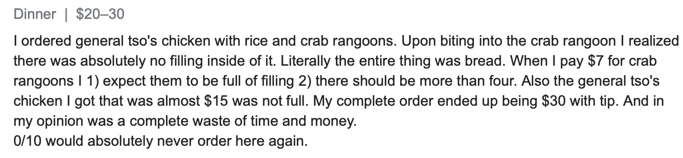
array list
☠️ an array list's capacity is NOT the same thing as its size
imagine ArrayList<String> bestaurants; with capacity 5 and size 3 // if we could print bestaurants.privateArray... ["Blango", "Sproot", "Sparket", null, null] ...we would see 5 – 3 = 2 "empty slots."

Slide 309
array list
☠️ even though another name for an array list is a "vector," the array list is NOT related to Vector2 (vector from math/physics)

Slide 310
Java's ArrayList<ElementType>

Slide 311
generic
Replace ElementType with the type of object being stored in your array list
Java's ArrayList<ElementType> is generic
// make a list of Foo's ArrayList<Foo> list = new ArrayList<>(); ArrayList<Foo> list = new ArrayList<Foo>();
// make a list of int's // NOTE: you must use Integer instead of int inside the <> ArrayList<Integer> list = new ArrayList<>();
ArrayList<Boolean> list = new ArrayList<>();
ArrayList<Double> list = new ArrayList<>();

Slide 312
generic
Java's ArrayList<ElementType> is generic
// make a list of lists of Vector2's ArrayList<ArrayList<Vector2>> list = new ArrayList<>();

Slide 313
internal array is private
Java's ArrayList<ElementType> uses access modifiers
specifically, its internal array is private (so is the int storing its size)
private means you can't access a variable/function directly
instead, you will need to use the functions (instance methods) given in our Documentation
class ArrayList<ElementType> {
int size(); // number of elements in the list
void add(ElementType element); // add element to the end of the list
void add(int index, ElementType element); // insert element into the list at index
ElementType get(int index); // get element at index
void removeElementAt(int index); // remove element by index
boolean removeElement(ElementType element); // remove element by value
}

Slide 314
the user doesn't think about the "empty slots"
ArrayList<String> list = new ArrayList<>();
System.out.println(list); // []
list.add("Hello");
list.add("World");
System.out.println(list); // [Hello, World]
list.add(1, "Cruel");
System.out.println(list); // [Hello, Cruel, World]
System.out.println(list.size()); // 3
System.out.println(list.get(1)); // Cruel
list.removeElementAt(0);
System.out.println(list); // [Cruel, World]

Slide 315
array list functions (under the hood)

Slide 316
ArrayList() { ... } // constructor
a new array list should have...
this.privateArray = new ElementType[STARTING_CAPACITY];
this.numberOfElementsActuallyStoredInPrivateArray = 0;
there isn't one right answer to what the STARTING_CAPACITY should be
perhaps...8?
8 sounds good.
🙂👍
note: in the tutorial, we'll use 1 🤷

Slide 317
ElementType get(int index) { ... }
to get an element with a given index...
return privateArray[index];
this is a "getter"
we need it because privateArray is private
users never access privateArray directly

Slide 318
void add(ElementType element) { ... }
to append (push back) a new element to the back (end) of an array list...
write the new element to the first available empty slot in privateArray
increment numberOfElementsActuallyStoredInPrivateArray
potential problems?
what if privateArray is full?
need to make room, but how?

Slide 319
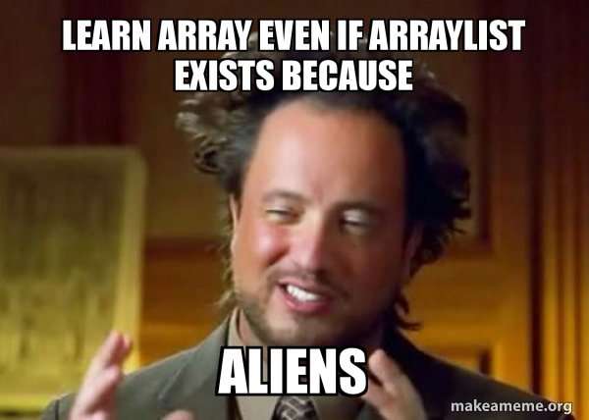
TODAY array lists (continued!)

Slide 320
array list
an array list (dynamic array, stretchy buffer, vector) acts like an array that can grow as needed
like an array, the user can access the $i$-th element in an array list
get the value of an element that is already there
set the value of an element that is already there
unlike an array, the user can always add a new element to an array list, no matter how many elements it already has
append (push back) a new element to the back or end
insert a new element at any index
the user can also remove elements from an array list

Slide 321
generic
Replace ElementType with the type of object being stored in your array list
Java's ArrayList<ElementType> is generic
// make a list of Foo's ArrayList<Foo> list = new ArrayList<>(); ArrayList<Foo> list = new ArrayList<Foo>();
// make a list of int's // NOTE: you must use Integer instead of int inside the <> ArrayList<Integer> list = new ArrayList<>();
ArrayList<Boolean> list = new ArrayList<>();
ArrayList<Double> list = new ArrayList<>();

Slide 322
internal array is private
Java's ArrayList<ElementType> uses access modifiers
specifically, its internal array is private (so is the int storing its size)
private means you can't access a variable/function directly
instead, you will need to use the functions (instance methods) given in our Documentation
class ArrayList<ElementType> {
int size(); // number of elements in the list
void add(ElementType element); // add element to the end of the list
void add(int index, ElementType element); // insert element into the list at index
ElementType get(int index); // get element at index
void removeElementAt(int index); // remove element by index
boolean removeElement(ElementType element); // remove element by value
}

Slide 323
ArrayList() { ... } // constructor
a new array list should have...
this.privateArray = new ElementType[STARTING_CAPACITY];
this.numberOfElementsActuallyStoredInPrivateArray = 0;
there isn't one right answer to what the STARTING_CAPACITY should be
perhaps...8?
8 sounds good.
🙂👍
note: in the tutorial, we'll use 1 🤷

Slide 324
ElementType get(int index) { ... }
to get an element with a given index...
return privateArray[index];
this is a "getter"
we need it because privateArray is private
users never access privateArray directly

Slide 325
void add(ElementType element) { ... }
to append (push back) a new element to the back (end) of an array list...
write the new element to the first available empty slot in privateArray
increment numberOfElementsActuallyStoredInPrivateArray
potential problems?
what if privateArray is full?
need to make room, but how?

Slide 326
void add(ElementType element) { ... }
to append (push back) a new element to the back (end) of an array list...
if privateArray is full...
make a new array two times the length of the current private array
copy the elements of the current private array into this new array (using a for loop)
update the privateArray reference to refer to this new array
write the new element to the first available empty slot in privateArray
increment numberOfElementsActuallyStoredInPrivateArray
food for thought: why is new array 2x size of old array? why not just add 1 extra spot? should we ever shrink the array?
this is an example of the time-space tradeoff!

Slide 327
void add(int index, ElementType element)
to insert a new element so it has a given index...
assert that the given index is valid!
0 OK ("prepend")
numberOfElementsActuallyStoredInPrivateArray OK (append)
-1 BAD VERY BAD (out of bounds)
if privateArray is full...
double its length (see previous slide)
make room for the new element!
move elements with index greater than or equal to the given index one slot to the right
how?

Slide 328
b c d e f g h .
a b c d e f g h

Slide 329

for (int i = index; i < numberOfElements-2, ++i) {
privateArray[i+1] = privateArray[i];
}
...
b c d e f g h .
a b b b b b b b

Slide 330

for (int i = numberOfElements-1; i >= index, --i) {
//copy from right to left
privateArray[i+1] = privateArray[i];
}
...
b c d e f g h .
a b c d e f g h

Slide 331
void add(int index, ElementType element)
to insert a new element so it has a given index...
assert that the given index is valid!
0 OK ("prepend")
numberOfElementsActuallyStoredInPrivateArray OK (append)
-1 BAD VERY BAD (out of bounds)
if privateArray is full...
double its length (see previous slide)
make room for the new element!
move elements with index greater than or equal to the given index one slot to the right (starting at the back!)
✨ for (int i = ...; i >= index, --i) { ... }
write the new element to the given index in privateArray
increment numberOfElementsActuallyStoredInPrivateArray

Slide 332
✨ functions can call other functions
the less general add (append) can be implemented using the more general add (insert)
void add(ElementType element) { add(numberOfElementsActuallyStoredInPrivateArray, element); }
☠️ however, if i were implementing an array list from scratch, i would implement the less general version first because it is simpler

Slide 333
void remove(int index) { ... }
to remove an element with a given index...
move elements with index greater than or equal to the given index one slot to the left
decrement numberOfElementsActuallyStoredInPrivateArray

Slide 334
💻 Array List Tutorial (linked on website)

Slide 335
Tut04() {
// TODO: construct new array list with starting capacity of 1
this.privateArray = new String[1];
this.numberOfElementsActuallyStoredInPrivateArray = 0;
}
String get(int index) {
// TODO: get element at given index
assert index >= 0 && index < numberOfElementsActuallyStoredInPrivateArray;
return privateArray[index];
}

Slide 336
void add(String element) {
// TODO: append element to the back of the list
add(numberOfElementsActuallyStoredInPrivateArray, element);
}
void add(int index, String element) {
// TODO: insert element so it has given index in the list
assert index >= 0 && index <= numberOfElementsActuallyStoredInPrivateArray;
if (numberOfElementsActuallyStoredInPrivateArray == privateArray.length) {
//must make array bigger
String tempArray[] = new String[privateArray.length * 2];
for (int i=0; i<privateArray.length; i++){
tempArray[i]=privateArray[i];
}
privateArray = tempArray; // update the reference
}
//room in the array
//copy from right to left down to index
for (int i=numberOfElementsActuallyStoredInPrivateArray-1; i>=index; --i){
privateArray[i+1]=privateArray[i];
}
privateArray[index] = element;
numberOfElementsActuallyStoredInPrivateArray++;
}

Slide 337
void remove(int index) {
// TODO: remove element at given index
assert index >= 0 && index < numberOfElementsActuallyStoredInPrivateArray;
for (int i=index; i<privateArray.length-1; ++i){
privateArray[i]=privateArray[i+1];
}
privateArray[numberOfElementsActuallyStoredInPrivateArray-1] = null;
numberOfElementsActuallyStoredInPrivateArray--;
}
void repeatElements(int numRepeats) {
int saveValue = size();
for (int i=0; i<saveValue; ++i){
for (int j=0; j<numRepeats-1; j++) {
add(i*numRepeats, get(i*numRepeats));
}
}
}

Slide 338
runtime of array list functions

Slide 339
runtime of array list operations
get() – a single operation that retrieves a value from privateArray
O(1)
set() - a single operation that sets a value in privateArray
O(1)
add() – insert element, shift other elements down to make room in for loop
O(1) – if adding to back (and no need to make room)
O(n) – if adding to middle
O(n) – if adding to any location and we have to grow privateArray (ideally this won’t happen often)
remove() – remove element, shift other elements down to eliminate gap
O(n)

Slide 340
ANNOUNCEMENTS Jim is back; Jim got sick
Midterm info on website
Midterm review session info on website
WARMUP is this code good?
were array lists helpful?
TODAY array list wrap-up
abstraction 🙂 and ☹️
void repeatElements(int numRepeats) {
int numBefore = size();
for (int i = 0; i < numBefore; ++i) {
int index = i * numRepeats;
for (int rep = 0; rep < (numRepeats - 1); ++rep) {
add(index, get(index));
}
}
}

Slide 341
big-O runtime of void add(...);

Slide 342
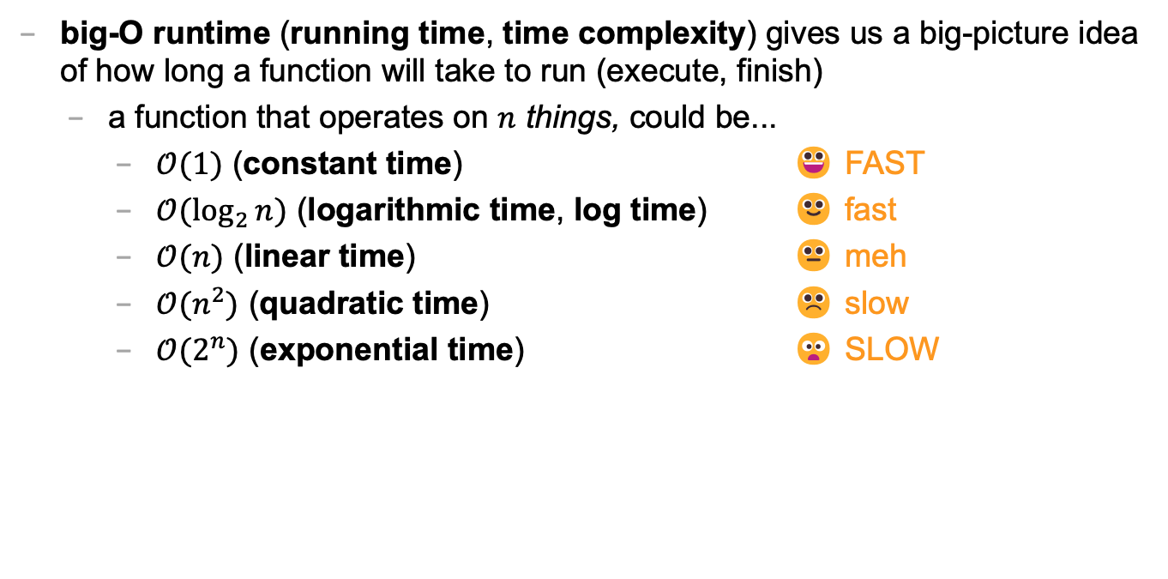
big-O runtime
big-O runtime (running time, time complexity) gives us a big-picture idea of how long a function will take to run (execute, finish)
a function that operates on $n$ things, could be...
$𝒪(1)$ (constant time) 😀 FAST
$𝒪(\log_{2}{n})$ (logarithmic time, log time) 🙂 fast
$𝒪(n)$ (linear time) 😐 meh
$𝒪(n^{2})$ (quadratic time) ☹️ slow
$𝒪(2^{n})$ (exponential time) 😦 SLOW

Slide 343
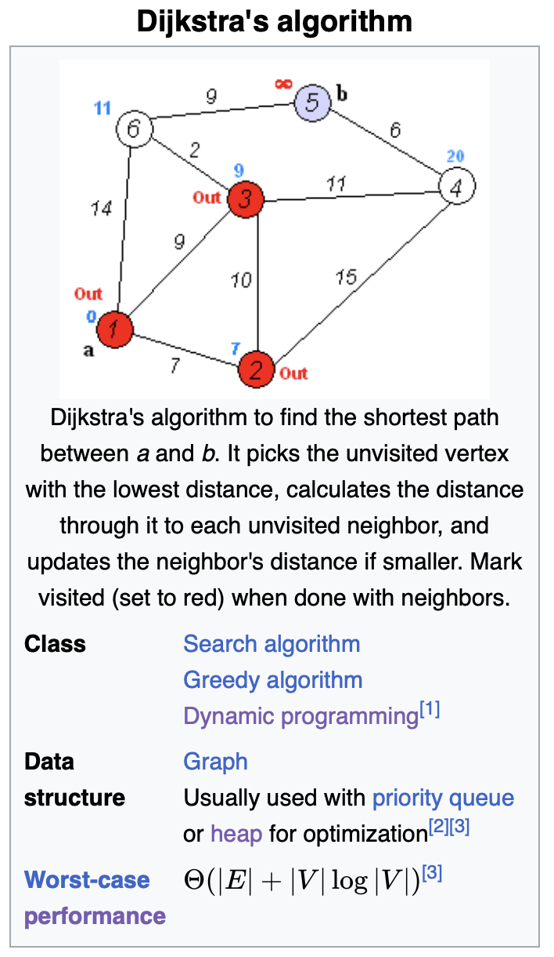
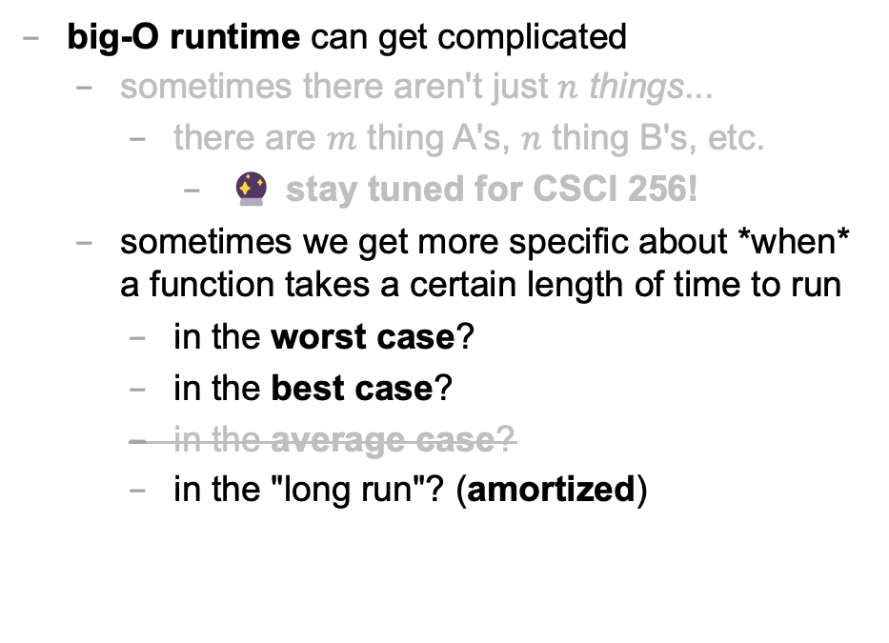
big-O runtime
big-O runtime can get complicated
sometimes there aren't just $n$ things...
there are $m$ thing A's, $n$ thing B's, etc.
🔮 stay tuned for CSCI 256!
sometimes we get more specific about *when* a function takes a certain length of time to run
in the worst case?
in the best case?
in the average case?
in the "long run"? (amortized)

Slide 344
best case and worst case runtime of adding to the back of an array list

Slide 345
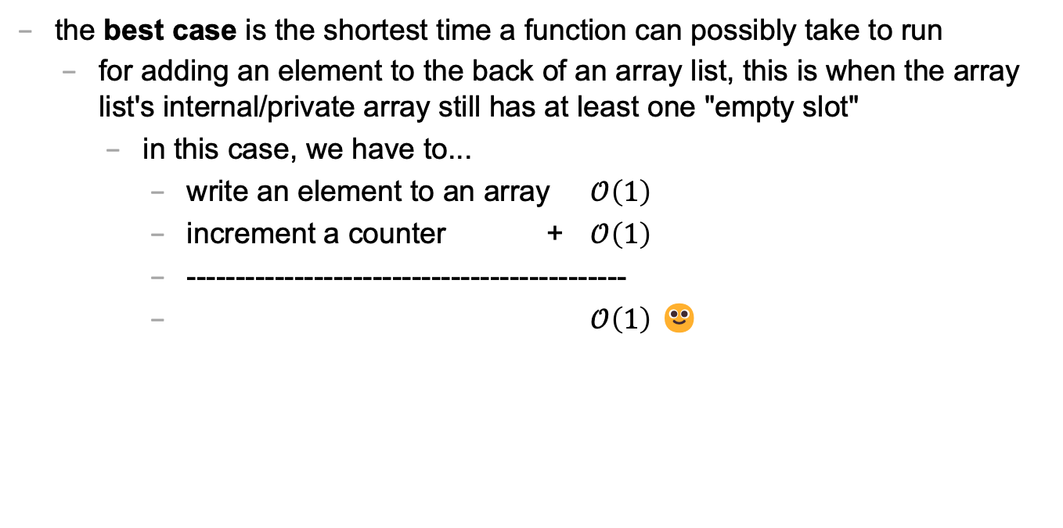
best case
the best case is the shortest time a function can possibly take to run
for adding an element to the back of an array list, this is when the array list's internal/private array still has at least one "empty slot"
in this case, we have to...
write an element to an array $𝒪\left(1\right)$
increment a counter + $𝒪\left(1\right)$
---------------------------------------------
$𝒪\left(1\right)$ 🙂

Slide 346
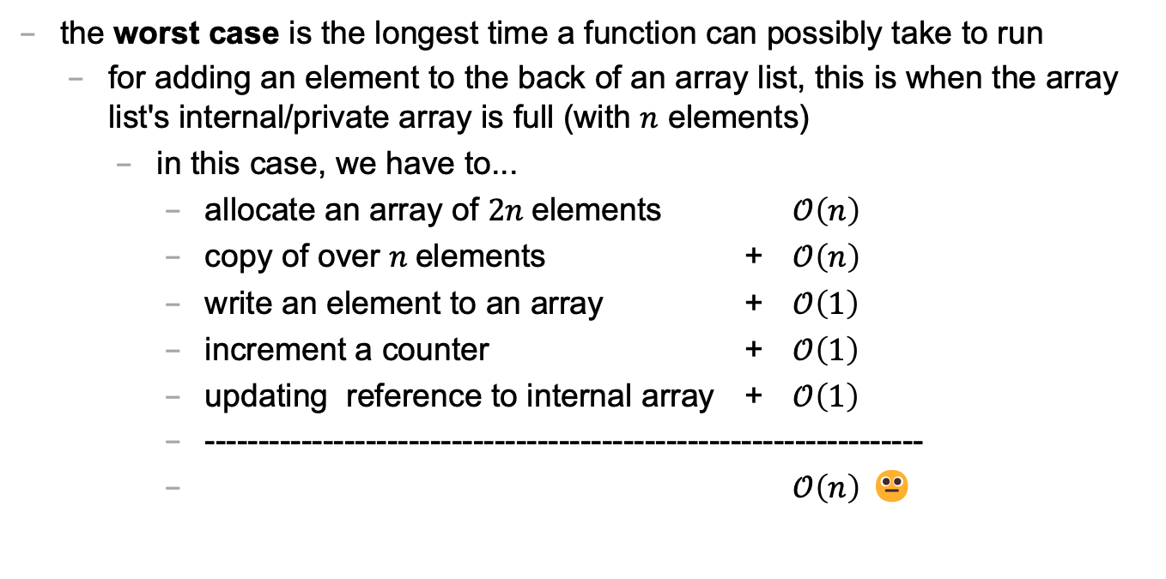
worst case
the worst case is the longest time a function can possibly take to run
for adding an element to the back of an array list, this is when the array list's internal/private array is full (with $n$ elements)
in this case, we have to...
allocate an array of $2n$elements $𝒪\left(n\right)$
copy of over $n$elements + $𝒪\left(n\right)$
write an element to an array + $𝒪\left(1\right)$
increment a counter + $𝒪\left(1\right)$
updating reference to internal array + $𝒪\left(1\right)$
-------------------------------------------------------------------
$𝒪\left(n\right)$ 😐

Slide 347
sometimes the best case and worst case are very different

Slide 348
amortized runtime of adding to the back of an array list

Slide 349
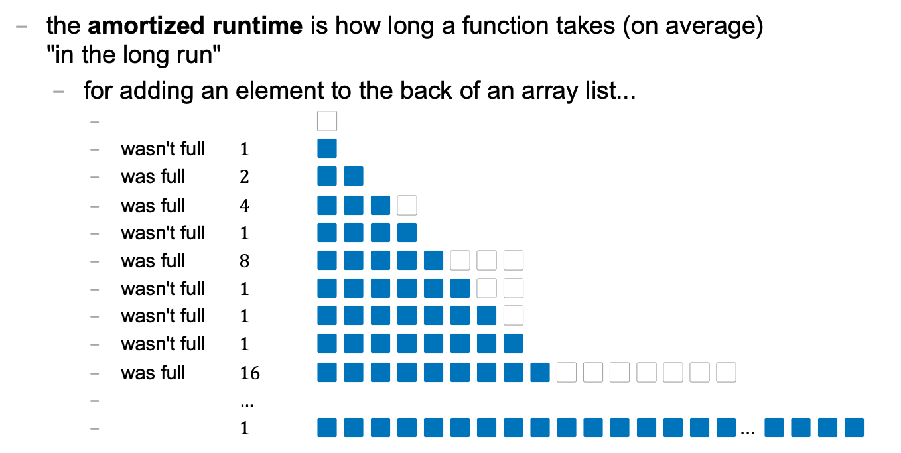
amortized
the amortized runtime is how long a function takes (on average) "in the long run"
for adding an element to the back of an array list...
⬜️
wasn't full $1$ 🟦
was full $2$ 🟦🟦
was full $4$ 🟦🟦🟦⬜️
wasn't full $1$ 🟦🟦🟦🟦
was full $8$ 🟦🟦🟦🟦🟦⬜️⬜️⬜️
wasn't full $1$ 🟦🟦🟦🟦🟦🟦⬜️⬜️
wasn't full $1$ 🟦🟦🟦🟦🟦🟦🟦⬜️
wasn't full $1$ 🟦🟦🟦🟦🟦🟦🟦🟦
was full $16$ 🟦🟦🟦🟦🟦🟦🟦🟦🟦⬜️⬜️⬜️⬜️⬜️⬜️⬜️
$…$
$1$ 🟦🟦🟦🟦🟦🟦🟦🟦🟦🟦🟦🟦🟦🟦🟦🟦... 🟦🟦🟦🟦

Slide 350
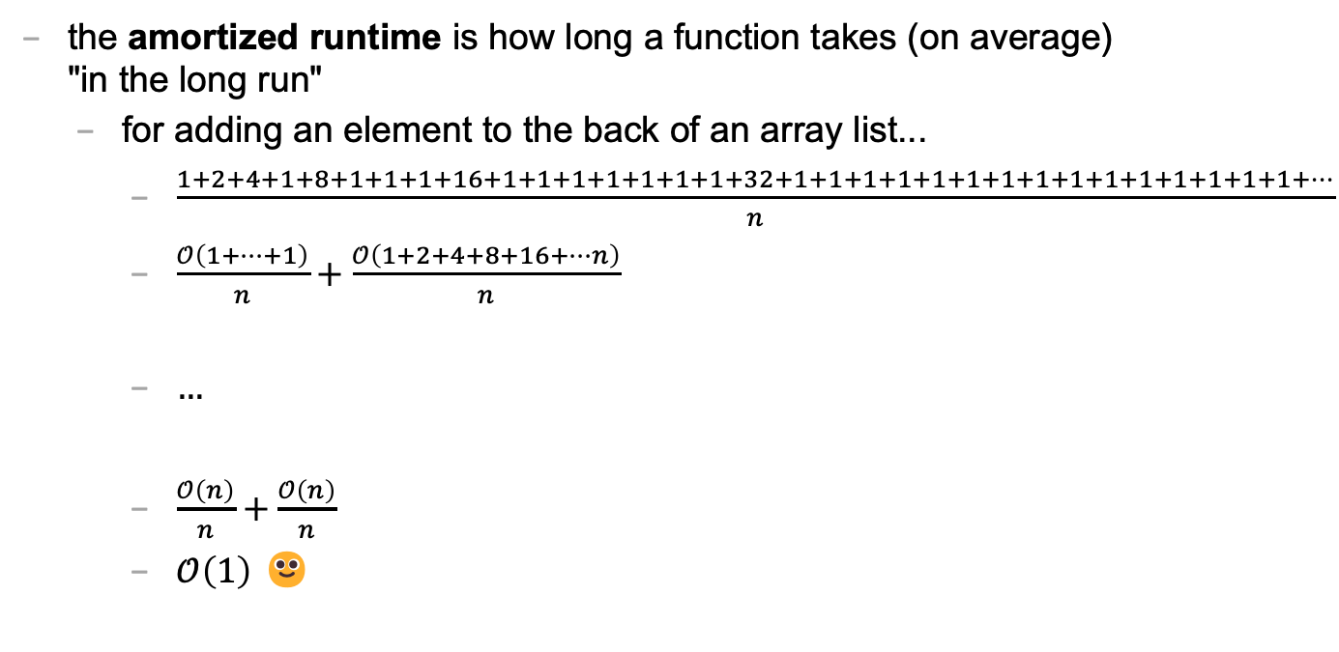
amortized
the amortized runtime is how long a function takes (on average) "in the long run"
for adding an element to the back of an array list...
$\frac{1+2+4+1+8+1+1+1+16+1+1+1+1+1+1+1+32+1+1+1+1+1+1+1+1+1+1+1+1+1+1+1+…}{n}$
$\frac{𝒪\left(1+…+1\right)}{n}+\frac{𝒪\left(1+2+4+8+16+…n\right)}{n}$
$…$
$\frac{𝒪\left(n\right)}{n}+\frac{𝒪\left(n\right)}{n}$
$𝒪\left(1\right)$ 🙂

Slide 351
the amortized run time is less "pessimistic" than worst case

Slide 352
the most relevant runtime depends on context 💭 when might worst case be more relevant? 💭 when might amortized be more relevant?

Slide 353
best case and worst case runtime of inserting into the front of an array list

Slide 354
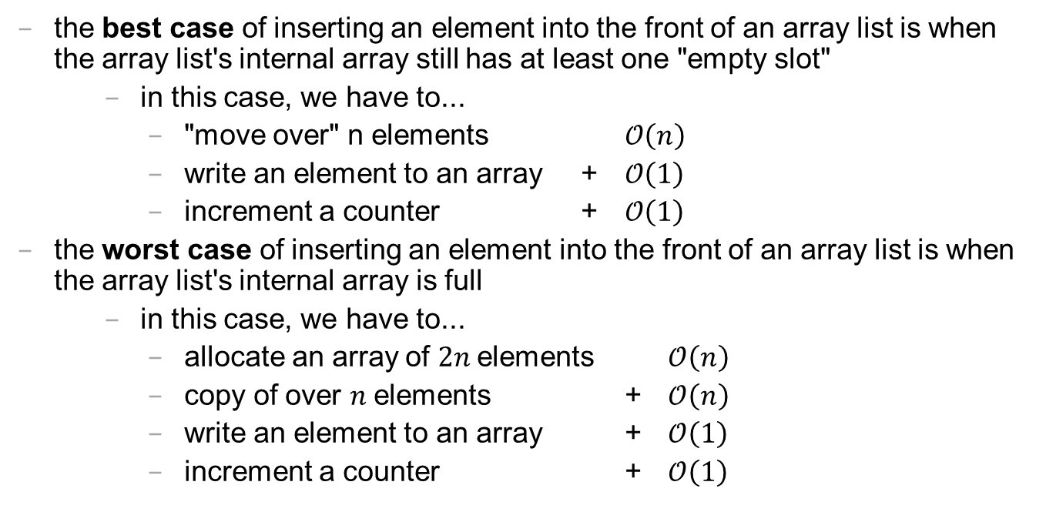
best case and worst cast
the best case of inserting an element into the front of an array list is when the array list's internal array still has at least one "empty slot"
in this case, we have to...
"move over" n elements $𝒪\left(n\right)$
write an element to an array + $𝒪\left(1\right)$
increment a counter + $𝒪\left(1\right)$
the worst case of inserting an element into the front of an array list is when the array list's internal array is full
in this case, we have to...
allocate an array of $2n$elements $𝒪\left(n\right)$
copy of over $n$elements + $𝒪\left(n\right)$
write an element to an array + $𝒪\left(1\right)$
increment a counter + $𝒪\left(1\right)$

Slide 355
lesson?: sometimes best case and worst case are the same

Slide 356
abstraction

Slide 357
repeatElements two ways

Slide 358
naive array solution
void repeatElementsArrayVersion(int numRepeats) {
int numBefore = size();
// allocate a new array O(n) String[] newPrivateArray = new String[numRepeats * numBefore];
// fill it + O(n)
int k = 0; for (int i = 0; i < numBefore; ++i) { for (int rep = 0; rep < numRepeats; ++rep) { newPrivateArray[k++] = privateArray[i]; } }
// "swap" references + O(1)
privateArray = newPrivateArray; }

Slide 359
the naive array solution is linear

Slide 360
naive array list solution
void repeatElements(int numRepeats) { int numBefore = size(); for (int i = 0; i < numBefore; ++i) { // n * int index = i * numRepeats; for (int rep = 0; rep < (numRepeats - 1); ++rep) { add(index, get(index)); // insert an element } // O(n) because we have to } // "move stuff over" }

Slide 361
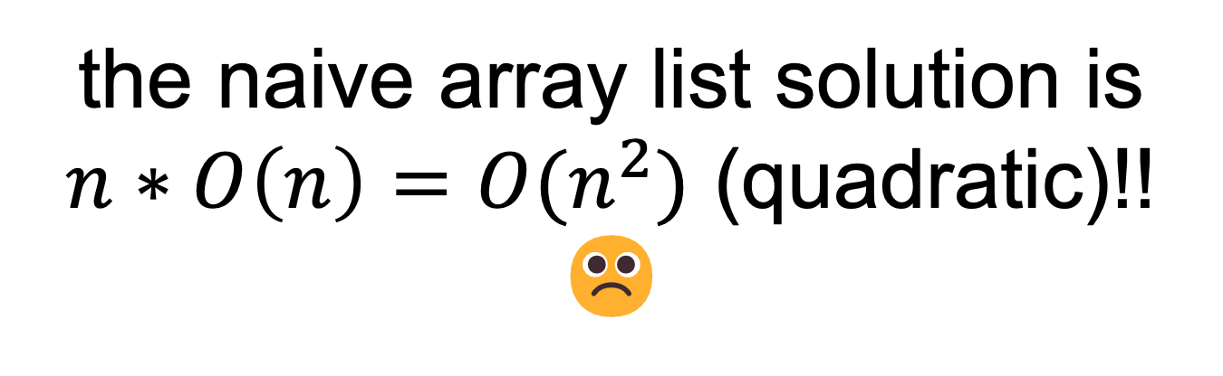
the naive array list solution is $n∗O\left(n\right)={O(n}^{2})$ (quadratic)!! ☹️

Slide 362
🧪

Slide 363
lesson: ignoring what's actually happening under the hood is dangerous!

Slide 364
int a = 5; int b=8;

Slide 365

ANNOUNCEMENTS welcome back i hope you had a nice mountain day :)
WARMUP what is this robot for? →
TODAY stacks and queues

Slide 366
record LEC-02

Slide 367
where are we?

Slide 368
recap of first half

Slide 369
we built a foundation
Java!
types, operators, & compiler errors
when should we compile?
early and often!
avoid repetition!
functions!
for when we have the same chunk of logic repeated in multiple places
classes!
for when we repeatedly pass around the same chunk of data

Slide 370
we started thinking about code more deeply
the array!
how *fast* is an array?
what are pros and cons of the array?
how might we address the cons of an array?
the array list!
how *fast* is an array list? best case? worst case? ...
what are pros and cons of the array list?
how might we address the cons of an array list?
...

Slide 371


Slide 372
preview of second half

Slide 373
we will look at how to structure data
we will meet a whole menagerie of data structures
stacks
queues
hash tables
linked lists
trees
graphs
heaps
we will analyze speed and space

Slide 374
we will learn to choose the right data structure for the job
fun homeworks (at least in my opinion) 🙂👍
Flip Book
array list of array lists of array lists of Vector2's
PostScript Interpreter
stack and hash table
Text Generator
hash table of hash tables
...

Slide 375
data structures

Slide 376
what is a data structure? why is a data structure?

Slide 377
data structures
In computer science, a data structure is a data organization, management, and storage format that is usually chosen for efficient access to data.^{[1][2][3]} More precisely, a data structure is a collection of data values, the relationships among them, and the functions or operations that can be applied to the data,^{[4]} i.e., it is an algebraic structure about data. --Wikipedia

Slide 378
data structures
In computer science, a data structure is the organization and implementation of values and information. In simple words, it is the way of organizing information in a computer so that it can be more easily understood and worked with. --Simple Wikipedia

Slide 379
data structures
A data structure is...a system for organizing and using information... It...make[s] information easier to understand and work with.. --Simple Wikipedia, further simplified by ChatGPT

Slide 380
data structures
data means numbers (and letters)
a data structure organizes your data
for a particular task...
...a good data structure is...
easy to work with (programmer time)
runs fast (runtime / user's time)

Slide 381
were array lists a good choice for implementing a Flip Book? 💭 (how) could you have done it with just arrays?

Slide 382
we didn't know how many...
frames in each animation
strokes in each frame
points (Vector2's) in each stroke

Slide 383
"Alternative" 1: just use arrays, but resize them yourself when needed (essentially, implement the functionality of an array list without actually having a class)

Slide 384
"Alternative" 2: // ~30,000,000 elements Vector2[][][] animation = new Vector2[64][512][1024]; // need all these counter variables // can't just call .size() like before! int numFrames = 0; int[] numStrokes = ...; int[][] numPoints = ...;

Slide 385
interface

Slide 386
interface
add, get, set, remove, ...
ArrayList<ElementType>'s
state
your state

Slide 387
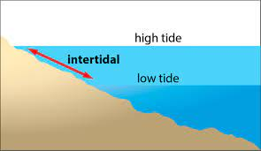

Slide 388
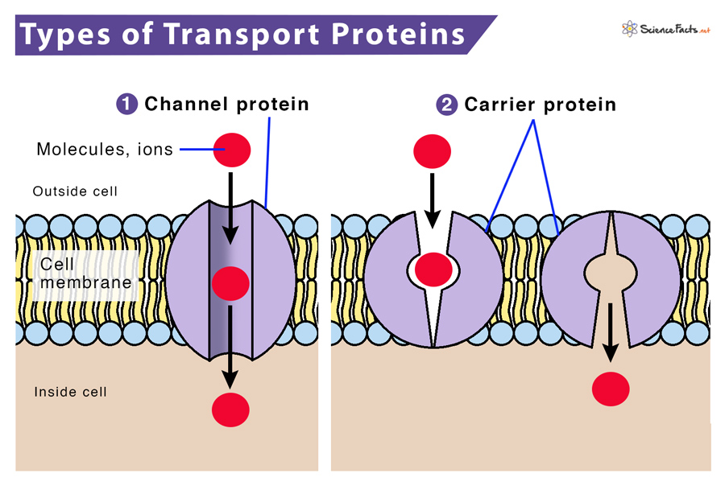

Slide 389
interface
a data structure's interface (API) or abstract data type is a set of functions a data structure must have
a list has...
get
set
add
remove
etc.
a data structure is a specific implementation (code that does the thing) of that interface
an array list implements the list interface using an array
🔮 a linked list implements a list using nodes that refer to nodes

Slide 390
you can get (very) formal about this
The abstract list type L with elements of some type E (a monomorphic list) is defined by the following functions:
nil: () → L
cons: E × L → L
first: L → E
rest: L → L
with the axioms
first (cons (e, l)) = e
rest (cons (e, l)) = l
for any element e and any list l. It is implicit that
cons (e, l) ≠ l
cons (e, l) ≠ e
cons (e₁, l₁) = cons (e₂, l₂) if e₁ = e₂ and l₁ = l₂
Note that first (nil ()) and rest (nil ()) are not defined.
These axioms are equivalent to those of the abstract stack data type.

Slide 391
i typically won't. just know there is a difference between interface ("list") and implementation (ArrayList<Element>)

Slide 392
Tungsten break 😀 did you know the density of Tungsten is 19.25 g/cm³? Gold is 19.32 g/cm³ did you know Tungsten is really hard? Tungsten alloys can be as hard as Sapphire! that's really hard! Tungsten is expensive (that cube is $60) but not like...that expensive what could YOU do with Tungsten?

Slide 393
stacks

Slide 394
stack

Slide 395
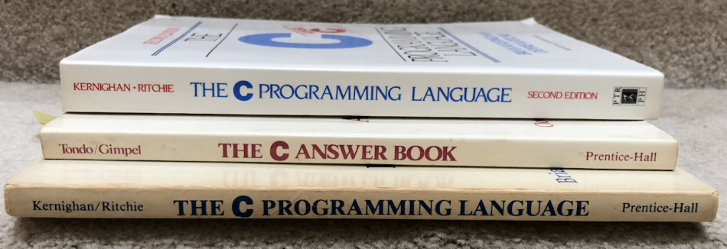

Slide 396


Slide 397
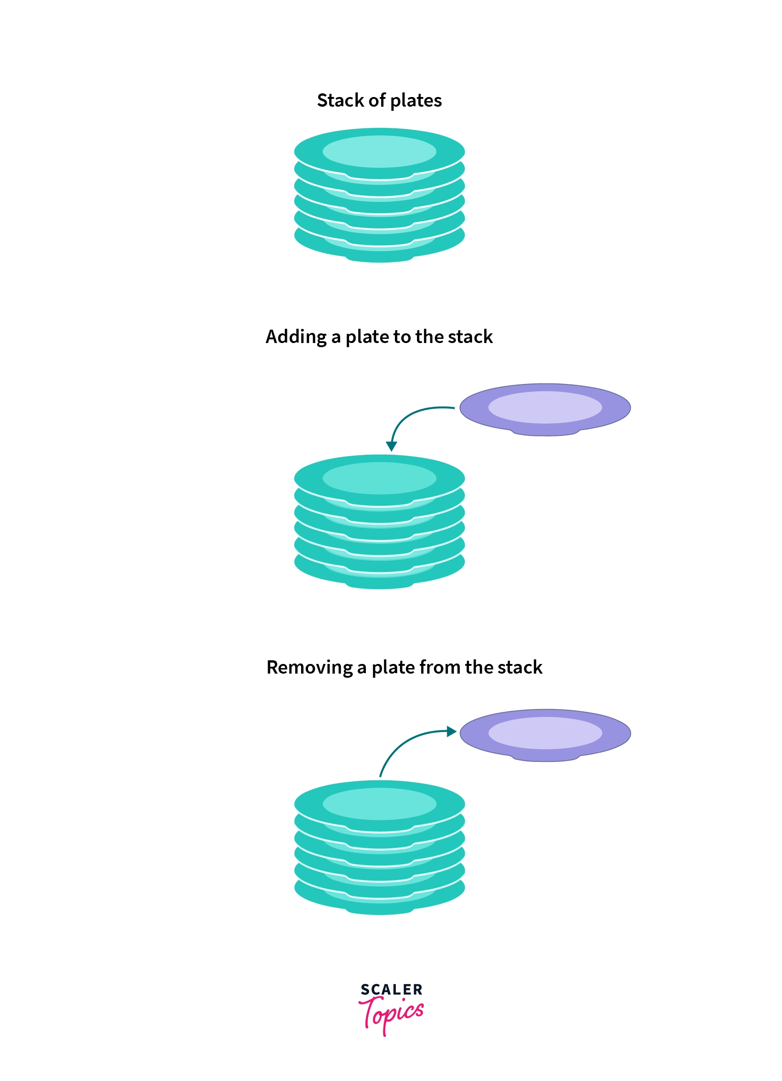
pushing
popping

Slide 398
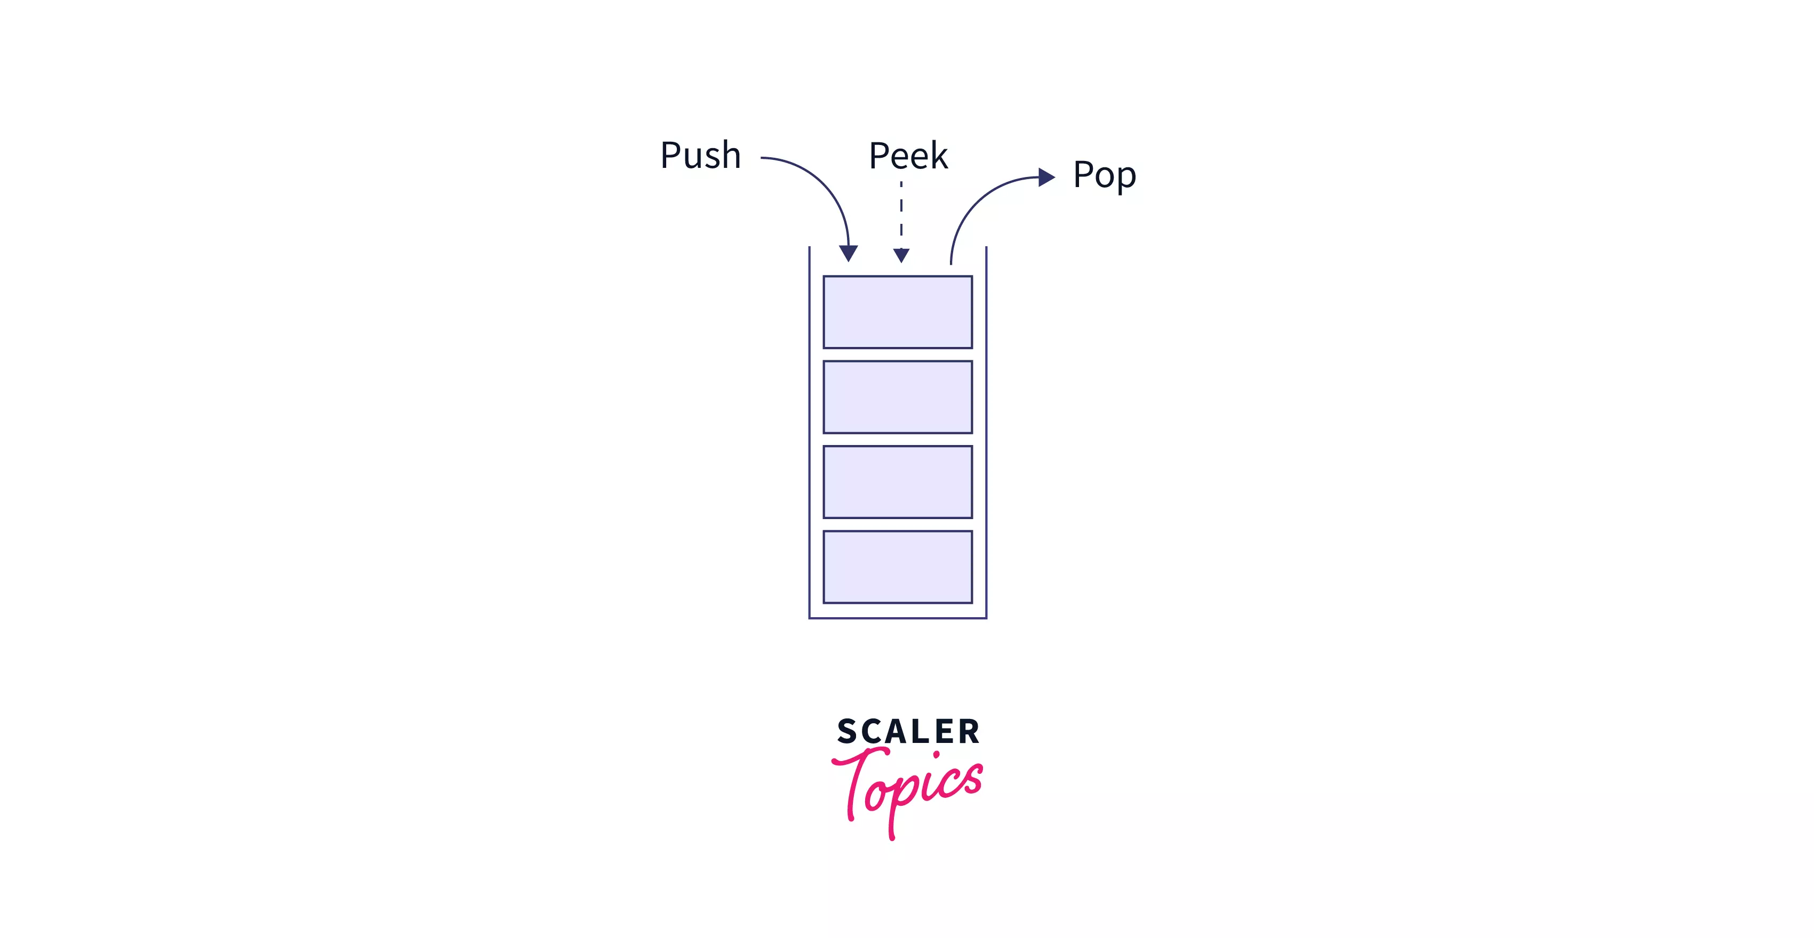

Slide 399
stack interface
// Push (add) a new element to the top of the stack. void push(ElementType element);
// Pop (remove) the top element of the stack. // and returns it. ElementType pop();
// Peek (look) at the top element of the stack // (without removing it) and return it. ElementType peek();
// Returns the number of elements currently in the stack. int size();

Slide 400
queues

Slide 401
queue

Slide 402
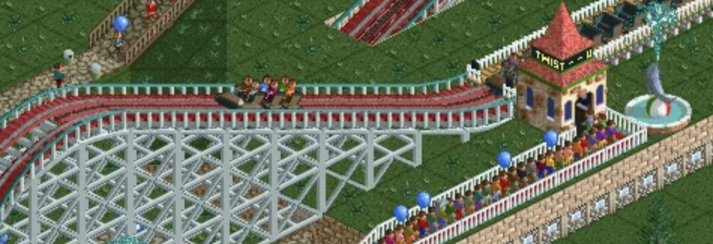

Slide 403
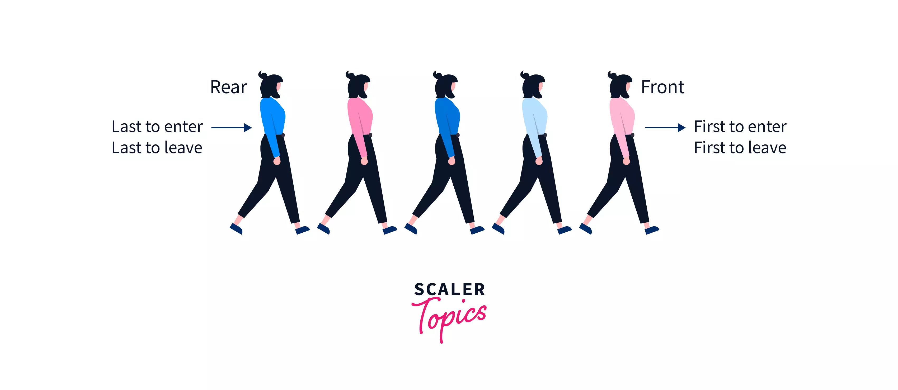
Back

Slide 404
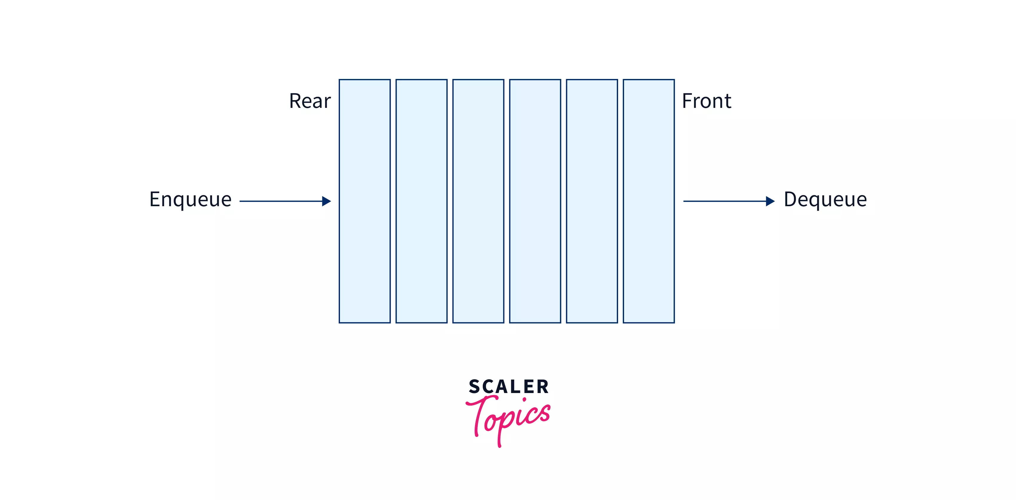
Back
add
remove

Slide 405
queue interface
// Add (enqueue) a new element to the back of the queue. void add(ElementType element);
// Remove (dequeue) the front element of the queue // and return it. ElementType remove();
// Peek (look) at the front element of the queue // (without removing it) and return it. ElementType peek();
// Returns the number of elements currently in the queue. int size();

Slide 406
why stacks and queues in the same lecture?

Slide 407
stack interface
// Push (add) a new element to the top of the stack. void push(ElementType element);
// Remove (pop) the top element of the stack. // and returns it. ElementType pop();
// Peek (look) at the top element of the stack // (without removing it) and return it. ElementType peek();
// Returns the number of elements currently in the stack. int size();

Slide 408
queue interface
// Add (enqueue) a new element to the back of the queue. void add(ElementType element);
// Remove (dequeue) the front element of the queue // and return it. ElementType remove();
// Peek (look) at the front element of the queue // (without removing it) and return it. ElementType peek();
// Returns the number of elements currently in the queue. int size();

Slide 409
💭 what are some example uses of stacks and queues in computer science?

Slide 410
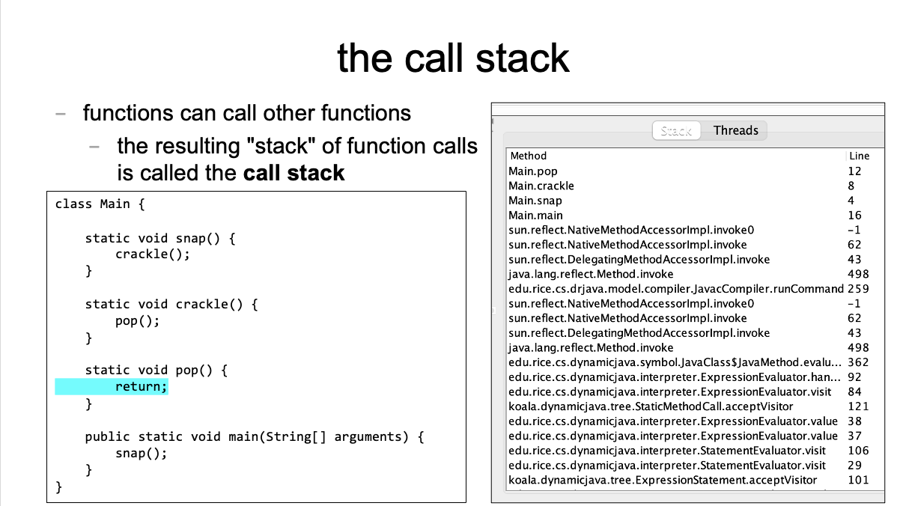
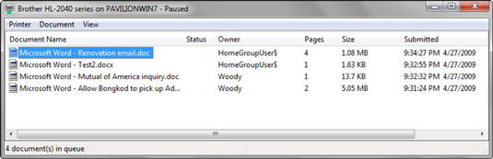

Slide 411
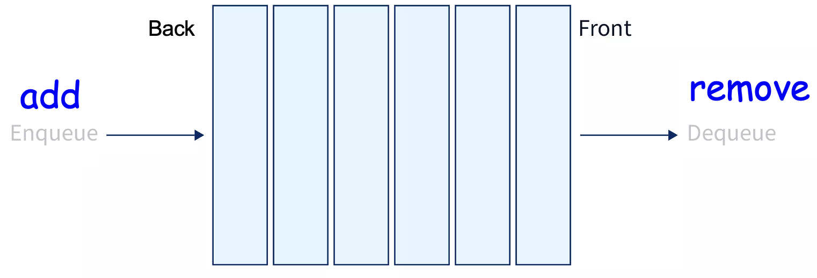
ANNOUNCEMENTS today is Laptop Wednesday!
replace interpret(...tokens) with version from the Writeup
WARMUP a couple (slightly silly) interview questions
- implement a stack using a (basic) queue
- just implement push and pop (and peek?)
- (don't worry about efficiency)
- pseudocode is fine
- what is the runtime (big O)?
- implement a queue using 2 stacks TODAY stacks and queue tutorial

Slide 412
record LEC-02

Slide 413
Stack and Queue tutorial 💻

Slide 414
the midterm 😱

Slide 415
i graded the midterm over the weekend

Slide 416
i had so much fun

Slide 417
not really

Slide 418
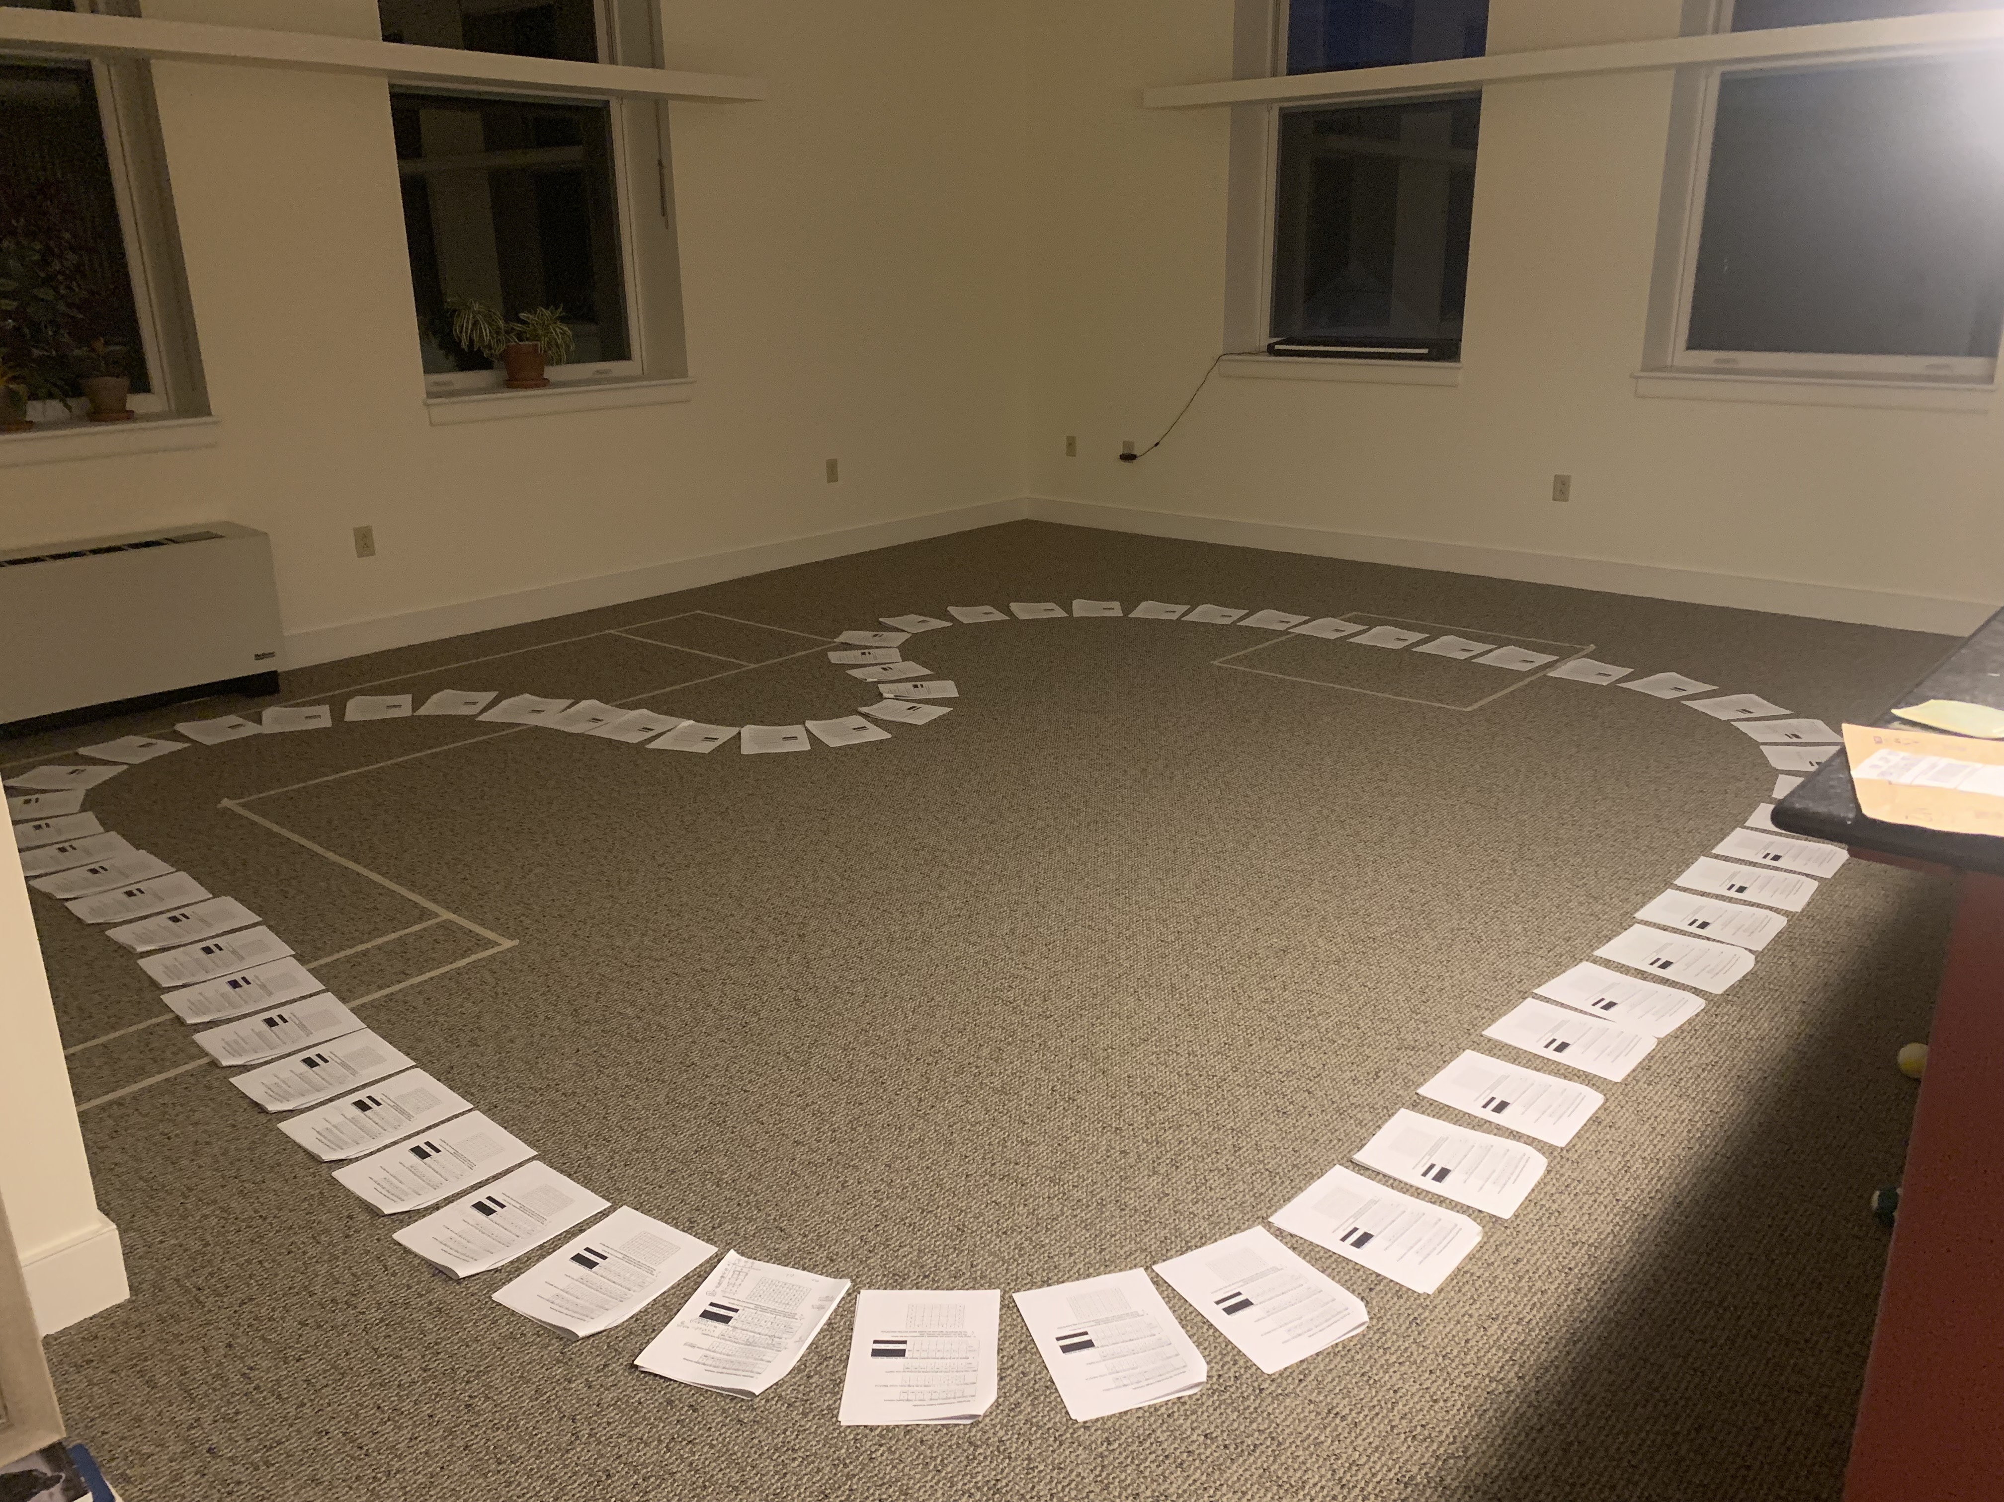

Slide 420
the midterm
overall, i think it went well!
MEAN ~ 87
STANDARD DEVIATION ~ 11
if you have any questions (how to prep for final, why did you lose points), let's chat in Lab (we can also schedule a chat)
notes on grading
some feedback just for your benefit (no lost points) – variable names, etc.
feedback is very sparse! (please ask questions if unsure what i mean)

Slide 421
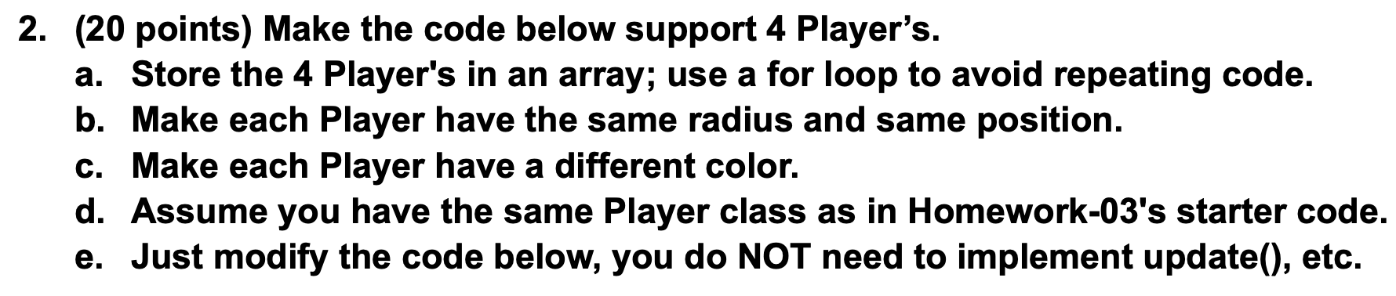
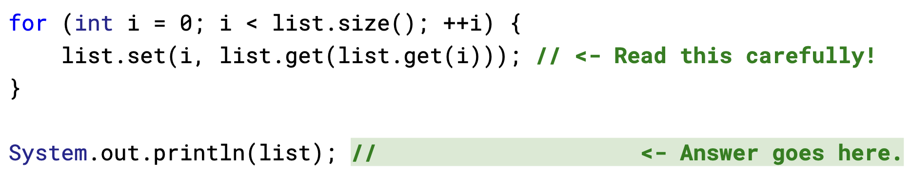
some common pain points
i have removed them from the HW-03;
let's take a look
let's also redo this problem together on the board
"convenience variables" created lots of problems
this is an example of modifying an array while you're iterating over it (see HW-02 README)
let's redo it together on the board

Slide 422
ANNOUNCEMENTS today is Friday! (fun Colloquium today at 2:35 in TCL 123)
apply to TA next semester! also next next (next?) semester!
WARMUP implement a queue using two stacks
- just implement add and remove (and peek?)
- (don't worry about efficiency)
- pseudocode is fine
- what is the runtime (big O)?
TODAY odds and ends

Slide 423
record LEC-02

Slide 424
tricky midterm questions

Slide 425
Player -> Player[]

Slide 426
question
class HW03 extends App { // BEFORE
Player player;
void setup() {
player = new Player();
player.color = Vector3.cyan;
player.radius = 4.0;
player.position = new Vector2(0.0, 0.0)
}
}

Slide 427
answer
class HW03 extends App { // AFTER
Player[] players;
void setup() {
players = new Player[4];
for (int i = 0; i < players.length; i++) {
players[i] = new Player();
players[i].radius = 4.0;
players[i].position = new Vector2(0.0, 0.0);
}
players[0].color = Vector3.red;
players[1].color = Vector3.orange;
players[2].color = Vector3.yellow;
players[3].color = Vector3.green;
}
}

Slide 428
alternate answer
class HW03 extends App { // AFTER
Player[] players;
Vector3[] colors =
{ Vector3.red, Vector3.orange, Vector3.yellow, Vector3.green };
void setup() {
players = new Player[4];
for (int i = 0; i < players.length; i++) {
players[i] = new Player();
players[i].radius = 4.0;
players[i].position = new Vector2(0.0, 0.0);
players[i].color = colors[i];
}
}
}

Slide 429
what will this code print? (arrays and array lists)

Slide 430
question
int[] array = { 2, 3, 4 };
ArrayList<Integer> list = new ArrayList<>();
for (int i = 0; i < array.length; ++i) {
for(int rep = 0; rep < 3; ++rep) {list.add(array[i]);}
}

Slide 431
question
int[] array = { 2, 3, 4 };
ArrayList<Integer> list = new ArrayList<>();
int i = 0;
for (int rep = 0; rep < 3; ++rep) { list.add(array[i]); }
i = 1;
for (int rep = 0; rep < 3; ++rep) { list.add(array[i]); }
i = 2;
for (int rep = 0; rep < 3; ++rep) { list.add(array[i]); }

Slide 432
question
int[] array = { 2, 3, 4 };
ArrayList<Integer> list = new ArrayList<>();
for (int rep = 0; rep < 3; ++rep) { list.add(array[0]); }
for (int rep = 0; rep < 3; ++rep) { list.add(array[1]); }
for (int rep = 0; rep < 3; ++rep) { list.add(array[2]); }

Slide 433
question
int[] array = { 2, 3, 4 };
ArrayList<Integer> list = new ArrayList<>();
list.add(array[0]);
list.add(array[0]);
list.add(array[0]);
list.add(array[1]);
list.add(array[1]);
list.add(array[1]);
list.add(array[2]);
list.add(array[2]);
list.add(array[2]);

Slide 434
question
int[] array = { 2, 3, 4 };
ArrayList<Integer> list = new ArrayList<>();
list.add(2);
list.add(2);
list.add(2);
list.add(3);
list.add(3);
list.add(3);
list.add(4);
list.add(4);
list.add(4);

Slide 435
question
int[] array = { 2, 3, 4 };
ArrayList<Integer> list = new ArrayList<>();
list.add(2);
list.add(2);
list.add(2);
list.add(3);
list.add(3);
list.add(3);
list.add(4);
list.add(4);
list.add(4);
// { 2, 2, 2, 3, 3, 3, 4, 4, 4 }

Slide 436
question
// { 2, 2, 2, 3, 3, 3, 4, 4, 4 }
for (int i = 0; i < list.size() / 2; ++i) {
int j = (list.size() - 1) - i;
int tmp = list.get(i);
list.set(i, list.get(j));
list.set(j, tmp);
}

Slide 437
question
// { 2, 2, 2, 3, 3, 3, 4, 4, 4 }
for (int i = 0; i < list.size() / 2; ++i) {
int j = (list.size() - 1) - i;
int tmp = list.get(i);
list.set(i, list.get(j));
list.set(j, tmp);
} // { 4, 4, 4, 3, 3, 3, 2, 2, 2 }

Slide 438
question
// { 4, 4, 4, 3, 3, 3, 2, 2, 2 }
for (int i = 0; i < list.size(); ++i) {
list.set(i, list.get(list.get(i)));
}

Slide 439
question
// { 4, 4, 4, 3, 3, 3, 2, 2, 2 }
for (int i = 0; i < list.size(); ++i) {
int j = list.get(i);
list.set(i, list.get(j));
}

Slide 440
question
// { 4, 4, 4, 3, 3, 3, 2, 2, 2 }
for (int i = 0; i < list.size(); ++i) {
int j = list.get(i);
list.set(i, list.get(j));
}
// 0 1 2 3 4 5 6 7 8
// { 4, 4, 4, 3, 3, 3, 2, 2, 2 }
// ^ ^
// | |
// | j
// |
// i

Slide 441
question
// { 4, 4, 4, 3, 3, 3, 2, 2, 2 }
for (int i = 0; i < list.size(); ++i) {
int j = list.get(i);
list.set(i, list.get(j));
}
// 0 1 2 3 4 5 6 7 8
// { 3, 4, 4, 3, 3, 3, 2, 2, 2 }
// ^ ^
// | |
// | j
// |
// i

Slide 442
question
// { 4, 4, 4, 3, 3, 3, 2, 2, 2 }
for (int i = 0; i < list.size(); ++i) {
int j = list.get(i);
list.set(i, list.get(j));
}
// 0 1 2 3 4 5 6 7 8
// { 3, 4, 4, 3, 3, 3, 2, 2, 2 }
// ^ ^
// | |
// | j
// |
// i

Slide 443
question
// { 4, 4, 4, 3, 3, 3, 2, 2, 2 }
for (int i = 0; i < list.size(); ++i) {
int j = list.get(i);
list.set(i, list.get(j));
}
// 0 1 2 3 4 5 6 7 8
// { 3, 3, 4, 3, 3, 3, 2, 2, 2 }
// ^ ^
// | |
// | j
// |
// i

Slide 444
question
// { 4, 4, 4, 3, 3, 3, 2, 2, 2 }
for (int i = 0; i < list.size(); ++i) {
int j = list.get(i);
list.set(i, list.get(j));
}
// 0 1 2 3 4 5 6 7 8
// { 3, 3, 4, 3, 3, 3, 2, 2, 2 }
// ^ ^
// | |
// | j
// |
// i

Slide 445
question
// { 4, 4, 4, 3, 3, 3, 2, 2, 2 }
for (int i = 0; i < list.size(); ++i) {
int j = list.get(i);
list.set(i, list.get(j));
}
// 0 1 2 3 4 5 6 7 8
// { 3, 3, 3, 3, 3, 3, 2, 2, 2 }
// ^ ^
// | |
// | j
// |
// i

Slide 446
question
// { 4, 4, 4, 3, 3, 3, 2, 2, 2 }
for (int i = 0; i < list.size(); ++i) {
int j = list.get(i);
list.set(i, list.get(j));
}
// 0 1 2 3 4 5 6 7 8
// { 3, 3, 3, 3, 3, 3, 2, 2, 2 }
// ^
// |
// j
// |
// i

Slide 447
question
// { 4, 4, 4, 3, 3, 3, 2, 2, 2 }
for (int i = 0; i < list.size(); ++i) {
int j = list.get(i);
list.set(i, list.get(j));
}
// 0 1 2 3 4 5 6 7 8
// { 3, 3, 3, 3, 3, 3, 2, 2, 2 }
// ^
// |
// j
// |
// i

Slide 448
question
// { 4, 4, 4, 3, 3, 3, 2, 2, 2 }
for (int i = 0; i < list.size(); ++i) {
int j = list.get(i);
list.set(i, list.get(j));
}
// 0 1 2 3 4 5 6 7 8
// { 3, 3, 3, 3, 3, 3, 2, 2, 2 }
// ^ ^
// | |
// j |
// |
// i

Slide 449
question
// { 4, 4, 4, 3, 3, 3, 2, 2, 2 }
for (int i = 0; i < list.size(); ++i) {
int j = list.get(i);
list.set(i, list.get(j));
}
// 0 1 2 3 4 5 6 7 8
// { 3, 3, 3, 3, 3, 3, 2, 2, 2 }
// ^ ^
// | |
// j |
// |
// i

Slide 450
question
// { 4, 4, 4, 3, 3, 3, 2, 2, 2 }
for (int i = 0; i < list.size(); ++i) {
int j = list.get(i);
list.set(i, list.get(j));
}
// 0 1 2 3 4 5 6 7 8
// { 3, 3, 3, 3, 3, 3, 2, 2, 2 }
// ^ ^
// | |
// j |
// |
// i

Slide 451
question
// { 4, 4, 4, 3, 3, 3, 2, 2, 2 }
for (int i = 0; i < list.size(); ++i) {
int j = list.get(i);
list.set(i, list.get(j));
}
// 0 1 2 3 4 5 6 7 8
// { 3, 3, 3, 3, 3, 3, 2, 2, 2 }
// ^ ^
// | |
// j |
// |
// i

Slide 452
question
// { 4, 4, 4, 3, 3, 3, 2, 2, 2 }
for (int i = 0; i < list.size(); ++i) {
int j = list.get(i);
list.set(i, list.get(j));
}
// 0 1 2 3 4 5 6 7 8
// { 3, 3, 3, 3, 3, 3, 2, 2, 2 }
// ^ ^
// | |
// j |
// |
// i

Slide 453
question
// { 4, 4, 4, 3, 3, 3, 2, 2, 2 }
for (int i = 0; i < list.size(); ++i) {
int j = list.get(i);
list.set(i, list.get(j));
}
// 0 1 2 3 4 5 6 7 8
// { 3, 3, 3, 3, 3, 3, 3, 2, 2 }
// ^ ^
// | |
// j |
// |
// i

Slide 454
question
// { 4, 4, 4, 3, 3, 3, 2, 2, 2 }
for (int i = 0; i < list.size(); ++i) {
int j = list.get(i);
list.set(i, list.get(j));
}
// 0 1 2 3 4 5 6 7 8
// { 3, 3, 3, 3, 3, 3, 3, 2, 2 }
// ^ ^
// | |
// j |
// |
// i

Slide 455
question
// { 4, 4, 4, 3, 3, 3, 2, 2, 2 }
for (int i = 0; i < list.size(); ++i) {
int j = list.get(i);
list.set(i, list.get(j));
}
// 0 1 2 3 4 5 6 7 8
// { 3, 3, 3, 3, 3, 3, 3, 3, 2 }
// ^ ^
// | |
// j |
// |
// i

Slide 456
question
// { 4, 4, 4, 3, 3, 3, 2, 2, 2 }
for (int i = 0; i < list.size(); ++i) {
int j = list.get(i);
list.set(i, list.get(j));
}
// 0 1 2 3 4 5 6 7 8
// { 3, 3, 3, 3, 3, 3, 3, 3, 2 }
// ^ ^
// | |
// j |
// |
// i

Slide 457
question
// { 4, 4, 4, 3, 3, 3, 2, 2, 2 }
for (int i = 0; i < list.size(); ++i) {
int j = list.get(i);
list.set(i, list.get(j));
}
// 0 1 2 3 4 5 6 7 8
// { 3, 3, 3, 3, 3, 3, 3, 3, 3 }
// ^ ^
// | |
// j |
// |
// i

Slide 458
HW06.java HW06.class ~HW06.java

Slide 459
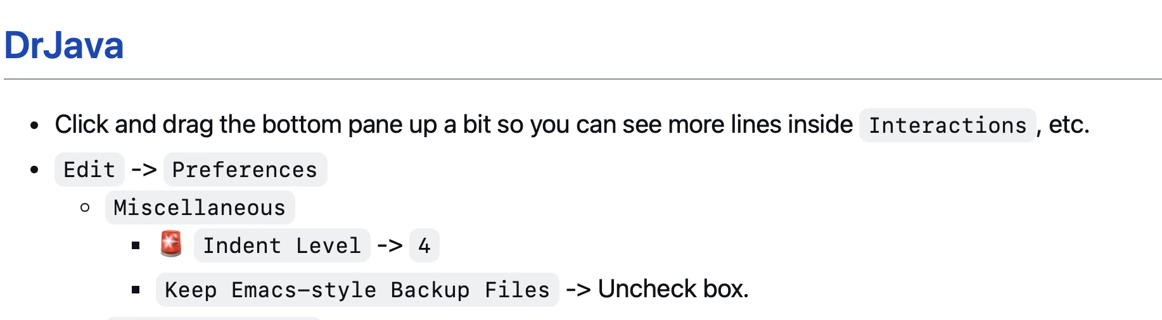
filetypes
HW06.java is source code (input to the compiler)
HW06.class is bytecode (output from the compiler)
~HW06.java is a backup file created by DrJava 🤨

Slide 460
_thisUnderscoreMeansDoNotUse (unless you really know what you're doing)

Slide 461
constants and readability & searchability

Slide 462
if (token.type == 2) {
...
}
if (token.type == Token.TYPE_STRING) {
...
}

Slide 463
where did the Starter Code come from? (forgive me, I know this should have been on Wednesday)

Slide 464
the big decision in the Starter Code is that we're going to chop the program into a list of "tokens" and each token could be a boolean, double, String, or list

Slide 465
in Python, a variable's type is dynamic
token = True
print(type(token)) # <class 'bool'>
token = 5.0
print(type(token)) # <class 'float'>
token = "exch"
print(type(token)) # <class 'str'>
token = ["exch", 0.0, "add"]
print(type(token)) # <class 'list'>

Slide 466
in Java, a variable's type is static
class Token {
int type;
private boolean _valueIfTypeBoolean;
private double _valueIfTypeDouble;
private String _valueIfTypeString;
private ArrayList<Token> _valueIfTypeList;
static final int TYPE_BOOLEAN = 0;
static final int TYPE_DOUBLE = 1;
static final int TYPE_STRING = 2;
static final int TYPE_LIST = 3;
}
0 | false | 0.0 | null | null

Slide 467
examples
new Token(true)
new Token(5.0)
new Token("exch")
0 | true | 0.0 | null | null
1 | false | 5.0 | null | null
2 | false | 0.0 | 0x02343af34... | null
"exch"

Slide 468
in Java, a variable's type is static
// Create a String-type Token.
Token token = new Token();
token.type = Token.TYPE_STRING;
token._valueIfTypeString = "exch";
// Get the value of a String-type token.
assert token.type = Token.TYPE_STRING : "..."; // check type!
String string = token._valueIfTypeString;
this usage code makes me sad ☹️
let's write some ✨functions✨!

Slide 469
in Java, a variable's type is static
// Create a String-type Token.
Token token = new Token("exch");
// Get the value of a String-type token.
String string = token.getString();
all better 🙂

Slide 470
tl;dr

Slide 471
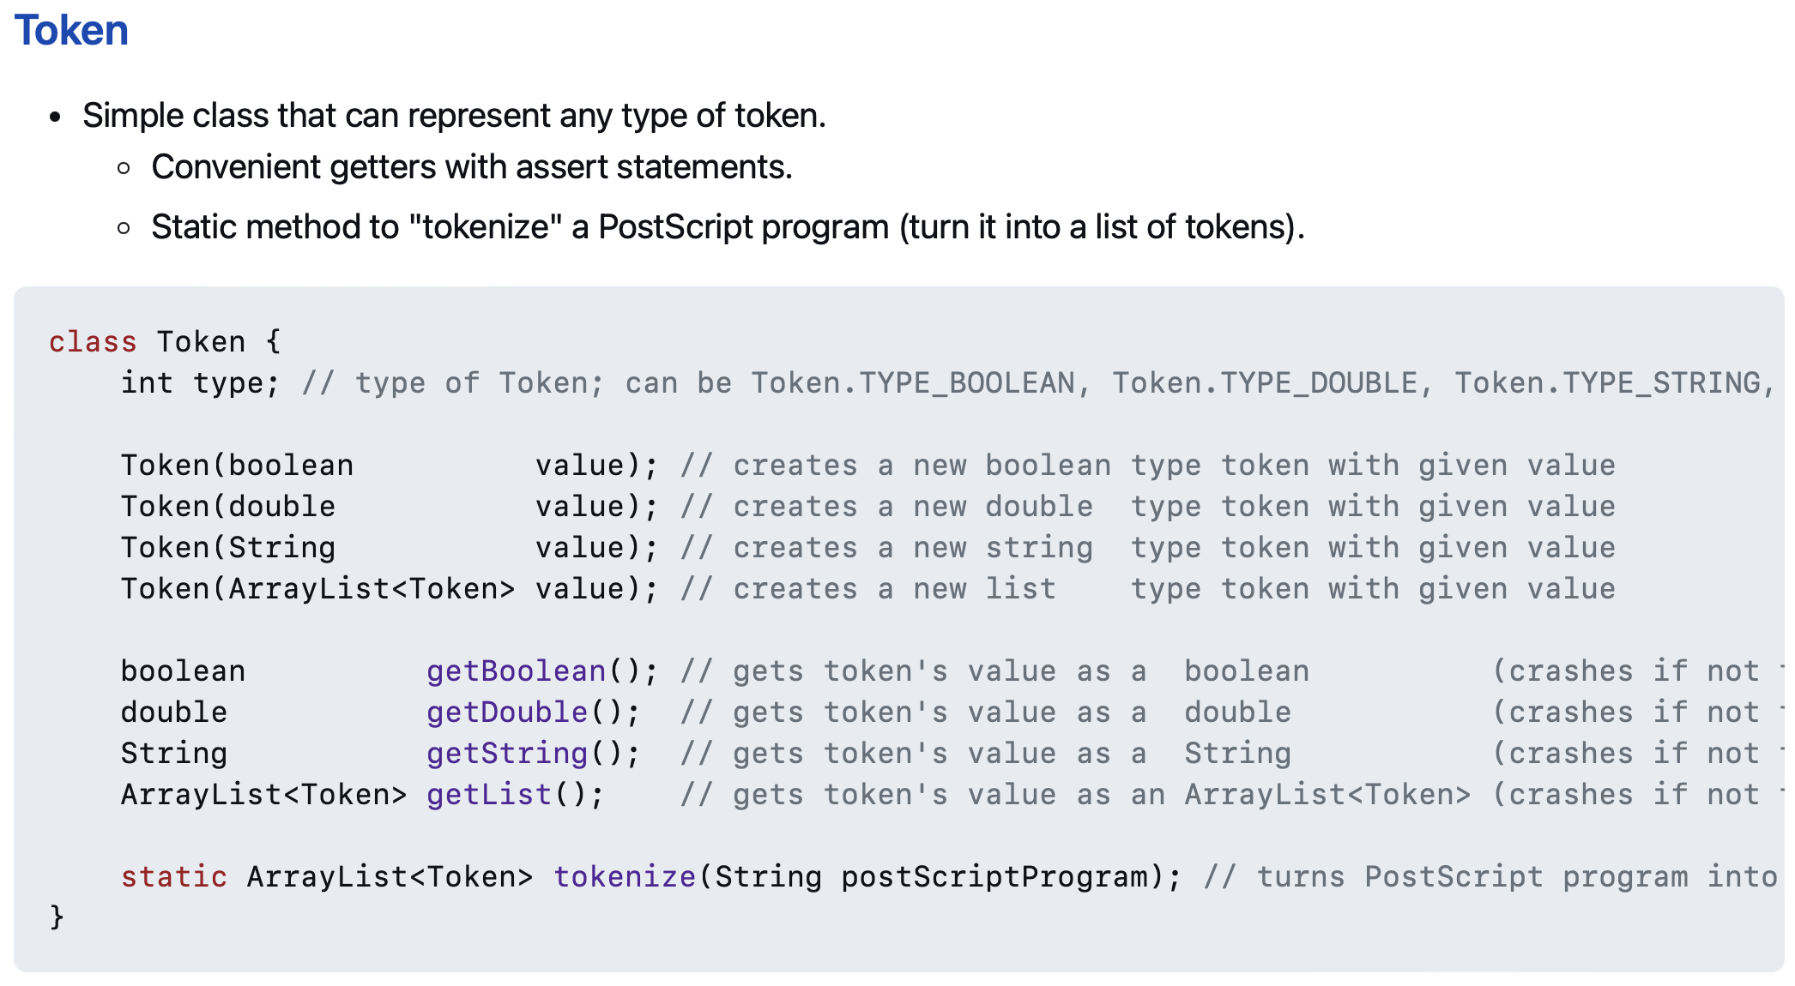
use these functions 🙂👍

Slide 472

and these functions!! 🙂👍

Slide 473
// Pop a double off the stack
assert _stack.size() > 0;
Token token = _stack.pop();
double num = token.getDouble();
// Push a double onto the stack.
_stack.push(new Token(5.0));
☹️

Slide 474
// Pop a double off the stack
double num = stackPopDouble();
// Push a double onto the stack.
stackPush(5.0);
🙂

Slide 475
midsemester feedback

Slide 476
do you want to give midsemester feedback?

Slide 477

help improve cs136
even though
you're never going to
take it again

Slide 478

tinyurl.com/yf725rdk

Slide 479
ANNOUNCEMENTS today is No Laptop For the First Half of Lecture Monday!
today is Prof. Bill Jannen Is Visiting LEC-02 Monday!
WARMUP long, long, ago, many people owned a large, physical book called a ✨Dictionary✨
- what was it used for?
- did you know there were different kinds of dictionaries?
TODAY maps (dictionaries, tables)

Slide 480
record LEC-01

Slide 481



HashMap<String, String> dictionary;
// {Dog=A cute, four-legged mammal, ...}
HashMap<String, String> englishToSpanishDictionary;
// {Gato=Cat, Perro=Dog, ...}
HashMap<String, ArrayList<String>> rhymingDictionary;
// {Dog=[Bog, Cog, Frog], ...}

Slide 482


Slide 483


Slide 484
maps

Slide 485
map interface

Slide 486
map
a pair is two things
a map (dictionary, table) stores key-value pairs
a map is used to lookup a key's value
a map in Java's standard library is HashMap<KeyType, ValueType>
HashMap<String, ArrayList<String>> rhymingDictionary;

Slide 487
let us imagine...

Slide 488
you have a three week long road trip planned to Bennington, but your prized parrot Hans is deathly afraid of driving it's time to put Hans in the bird kennel

Slide 489
🤵
🦜
map.put("Hans", 🦜)

Slide 490
you return invigorated from a lovely trek to Bennington it's time to get Hans from the bird kennel

Slide 491

here is Hans
🤵
Hans
squack
🦜
map.get("Hans")

Slide 492
HashMap<String, Bird>
🤵

Slide 493
map interface
// Put (add, insert) a new key-value pair into the map. // NOTE: Can also be used to update a key's value. void put(KeyType key, ValueType value);
// Get (lookup) a key's value in the map. ValueType get(KeyType key);
// Get the (unordered) set of all keys. // NOTE: Use this to iterate through all keys. // for (KeyType key : map.keySet()) { ... } Set<KeyType> keySet();

Slide 494
motivating example

Slide 495

Pokémon
there are 151 Pokémon
each has its own number
Bulbasaur
Ivysaur
Venusaur
Charmander
...

Slide 496
number → name
1 → "Bulbasaur"
2 → "Ivysaur"
3 → "Venusaur"
4 → "Charmander"
...

Slide 497
number → name (Option I)
String[] names = { "Bulbasaur", "Ivysaur", ... };
int number = ...;
String name = names[number – 1]; // NOTE: Bulbasaur is #1

Slide 498
number → name (Option II)
String[] _names = { "Bulbasaur", "Ivysaur", ... };
String getName(int number) {
return _names[number – 1];
}
int number = ...;
String name = getName(number);

Slide 499
number → name (Option I)
String[] names = { "Bulbasaur", "Ivysaur", ... };
int number = ...;
String name = names[number – 1]; // NOTE: Bulbasaur is #1

Slide 500
number → name (Option III)
String[] names = { "", "Bulbasaur", "Ivysaur", ... };
int number = ...;
String name = names[number];

Slide 501
lesson: if you're mapping from A → B, and A is something like 0, 1, 2, 3, ... ...then you can just use an array 🙂👍

Slide 502
buuut, if you're mapping from A → B, and A is nothing like 0, 1, 2, 3, ... ...then you're going to want a map 🗺️

Slide 503
name → number
🗺️ solve this problem using a
HashMap<KeyType, ValueType>
"Bulbasaur" → 1
"Ivysaur" → 2
"Venusaur" → 3
"Charmander" → 4
...
// Put (add, insert) a new key-value pair into the map. // NOTE: Can also be used to update a given key's value. void put(KeyType key, ValueType value);
// Get (look up) a key's value in the map. ValueType get(KeyType key);
what data structures will you need?
how will you set them up?
how will you use them?

Slide 504
name → number
// data structures
HashMap<String, Integer> numberFromName;
// setup
String[] names = { "Bulbasaur", "Ivysaur", ... };
numberFromName = new HashMap<>();
for (int i = 0; i < names.length; ++i) {
// Bulbasaur = 1
numberFromName.put(names[i], i + 1);
}
// usage
String name = ...;
int number = numberFromName.get(name);

Slide 505
let's implement numberFromName TODO (Jim): use keySet() method in test code

Slide 506
PokemonExample
import java.util.*;
class PokemonExample {
public static void main(String[] arguments) {
// setup
HashMap<String, Integer> numberFromName = new HashMap<>();
String[] names = { "Bulbasaur", "Ivysaur", "Venusaur", ... };
for (int number = 0; number < names.length; number++) {
numberFromName.put(names[number], number + 1);
}
// usage
for (String name : numberFromName.keySet()) {
System.out.println(name + " -> " + numberFromName.get(name));
}
}
}
Mewtwo -> 150
Raichu -> 26
Arbok -> 24
Kabuto -> 140
Charmander -> 4
Charmeleon -> 5
Shellder -> 90
Fearow -> 22
Kangaskhan -> 115
Mankey -> 56
Dodrio -> 85
Vaporeon -> 134
Golem -> 76
Marowak -> 105
Pikachu -> 25
Raticate -> 20
Kadabra -> 64
Primeape -> 57
Venomoth -> 49
Magikarp -> 129
Pidgeotto -> 17
Slowbro -> 80
Gastly -> 92
Magneton -> 82
Jolteon -> 135
Metapod -> 11
Diglett -> 50
Eevee -> 133
Caterpie -> 10
Goldeen -> 118
Abra -> 63
Blastoise -> 9
Magnemite -> 81
Pinsir -> 127
Machoke -> 67
Graveler -> 75
Meowth -> 52
Staryu -> 120
Gengar -> 94
Moltres -> 146
Dragonite -> 149
Golbat -> 42
Persian -> 53
Dugtrio -> 51
Onix -> 95
Hypno -> 97
Machop -> 66
Victreebel -> 71
Krabby -> 98
Jynx -> 124
Seadra -> 117
Rhydon -> 112
Jigglypuff -> 39
Machamp -> 68
Psyduck -> 54
Rapidash -> 78
Pidgey -> 16
Horsea -> 116
Poliwrath -> 62
Omastar -> 139
Clefairy -> 35
Exeggutor -> 103
Farfetch'd -> 83
Clefable -> 36
Oddish -> 43
Weedle -> 13
Gloom -> 44
Vileplume -> 45
Vulpix -> 37
Slowpoke -> 79
Lickitung -> 108
Golduck -> 55
Tentacruel -> 73
Weezing -> 110
Zapdos -> 145
Doduo -> 84
Haunter -> 93
Poliwhirl -> 61
Squirtle -> 7
Omanyte -> 138
Wigglytuff -> 40
Arcanine -> 59
Hitmonlee -> 106
Kabutops -> 141
Sandshrew -> 27
Venusaur -> 3
Kakuna -> 14
Tangela -> 114
Ekans -> 23
Wartortle -> 8
Venonat -> 48
Muk -> 89
Articuno -> 144
Electrode -> 101
Electabuzz -> 125
Cubone -> 104
Nidoran♀ -> 29
Magmar -> 126
Nidoran♂ -> 32
Dewgong -> 87
Tauros -> 128
Mr. Mime -> 122
Koffing -> 109
Starmie -> 121
Bulbasaur -> 1
Gyarados -> 130
Nidoqueen -> 31
Seel -> 86
Mew -> 151
Alakazam -> 65
Nidoking -> 34
Drowzee -> 96
Seaking -> 119
Rattata -> 19
Sandslash -> 28
Tentacool -> 72
Grimer -> 88
Ponyta -> 77
Exeggcute -> 102
Ditto -> 132
Flareon -> 136
Growlithe -> 58
Beedrill -> 15
Nidorina -> 30
Ivysaur -> 2
Cloyster -> 91
Kingler -> 99
Nidorino -> 33
Scyther -> 123
Dratini -> 147
Spearow -> 21
Charizard -> 6
Hitmonchan -> 107
Paras -> 46
Aerodactyl -> 142
Parasect -> 47
Butterfree -> 12
Snorlax -> 143
Weepinbell -> 70
Zubat -> 41
Chansey -> 113
Lapras -> 131
Voltorb -> 100
Dragonair -> 148
Ninetales -> 38
Bellsprout -> 69
Rhyhorn -> 111
Porygon -> 137
Geodude -> 74
Pidgeot -> 18
Poliwag -> 60

Slide 507
maps in other languages

Slide 508
🐍 Python has a built-in map (dictionary)
numbers = {}
numbers['Bulbasaur'] = 1
numbers['Ivysaur'] = 2
print(numbers['Bulbasaur']) # 1
print(numbers) # {'Bulbasaur': 1, 'Ivysaur': 2}
# Map + Dynamic type = hmm...
map = {}
map[True] = False
map['Jim'] = 3
map[-1] = map
print(map) # {True: False, 'Jim': 3, -1: {...}}

Slide 509
🥰 Lua's only data structure is a map (table)
why?
how?
what about like...arrays?
names = {}
names[1] = "Bulbasaur" -- okay fine, Lua has strings too
names[2] = "Ivysaur"
print(names[1]) -- Bulbasaur

Slide 510


Slide 511
ANNOUNCEMENTS
today is Prof. Bill Is Visiting LEC-02 Laptop Wednesday! WARMUP what is 7 % 3 ?
- ✏️do it on paper
- ☕️do it in Java (java means coffee)
- 🐍 do it in Python (a python is a kind of snake)
what is (-7) % 3 ?
- ✏️do it on paper
- ☕️do it in Java
- 🐍 do it in Python TODAY hash maps

Slide 512
record LEC-01

Slide 513
let's learn someting upsetting 🙂👍

Slide 514
7 % 3
2
R1
3
7
-
6
1

Slide 515
🐍 -7 % 3
☕️ Math.floorMod(-7, 3)
☕️ -7 % 3
-2
R-1
3
-7
-7 - (-6)
= -7 + 6
= -1
+ 3 = 2
-
-6
-1
-1

Slide 516
%
x % y returns the remainder of (x / y) and is read "x modulo y"
int foo = 17 % 5; // 2 ("17 divided by 5 is 3 remainder 2")
☠ % probably doesn't do what you expect for negative numbers; if x can be negative, use Math.floorMod(x, y) instead
5 % 3 // 2
4 % 3 // 1
3 % 3 // 0
2 % 3 // 2
1 % 3 // 1
0 % 3 // 0
-1 % 3 // -1 WAIT WHAT 🤔
Math.floorMod(-1, 3) // 2 🙂👍

Slide 517
Math.floorMod(x, y)
Math.floorMod( 5, 3) // 2
Math.floorMod( 4, 3) // 1
Math.floorMod( 3, 3) // 0
Math.floorMod( 2, 3) // 2
Math.floorMod( 1, 3) // 1
Math.floorMod( 0, 3) // 0
Math.floorMod(-1, 3) // 2
Math.floorMod(-2, 3) // 1
Math.floorMod(-3, 3) // 0
Math.floorMod(-4, 3) // 2
Math.floorMod(-5, 3) // 1
Math.floorMod(-6, 3) // 0
Math.floorMod(-7, 3) // 2

Slide 518
hash maps

Slide 519

hash map
a hash map (hash table) is a great way to implement a map
hash map are implemented using an array and a hash function
hash maps are FAST
put(key, value) is $𝒪\left(1\right)$ 😀 FAST
get(key) is $𝒪(1)$ 😀 FAST
there are many different "flavors" of hash maps
separate chaining (today)
linear probing (friday)
and so much more!

Slide 520
hash function

Slide 521
hash function
a hash function takes some data and returns an int called the data's hash code (hash, hash value)
this is called "hashing" the data
🚨 a hash function MUST be deterministic
given the same data, a hash function MUST return the same value
a hash collision (hash clash) happens when two different pieces of data have the hash code
a good hash function has very few collisions

Slide 522


Slide 523
hash function
all Java objects have a (fine) built-in hash function called hashCode()
hashCode() can be negative!
System.out.println( "Hans".hashCode()); // 2241694
System.out.println( "Gary".hashCode()); // 2212033
System.out.println("Kahoot".hashCode()); // -2054990942
System.out.println("Kahoot".hashCode()); // -2054990942

Slide 524
hash function
often, you want to turn a hash code into an index
✨ Math.floorMod(object.hashCode(), array.length)
System.out.println(Math.floorMod( "Hans".hashCode(), 10)); // 4
System.out.println(Math.floorMod( "Gary".hashCode(), 10)); // 3
System.out.println(Math.floorMod("Kahoot".hashCode(), 10)); // 8
System.out.println(Math.floorMod("Kahoot".hashCode(), 10)); // 8

Slide 525
separate chaining

Slide 526
separate chaining
separate chaining is one way of implementing a hash map
key-value pairs are stored in an array of buckets
one good choice of bucket is an array list
ArrayList<KeyValuePair> bucket;
in practice, you don't have to use an array list; you can use linked lists, binary search trees, or some mixture of the two (this is actually what Java does)

Slide 527

previously, on Hans the Parrot

Slide 528
you have a three week long road trip planned to Bennington, but your prized parrot Hans is deathly afraid of driving it's time to put Hans in the bird kennel

Slide 529
🤵
🦜
map.put("Hans", 🦜)

Slide 530
you return invigorated from a lovely trek to Bennington it's time to get Hans from the bird kennel

Slide 531
here is Hans
🤵
Hans
squack
🦜
map.get("Hans")

Slide 532
HashMap<String, Bird>
🤵

Slide 533
now, let us imagine again...

Slide 534
in a thrilling twist, it turns out that the Bennington trip was secretly cover for Agent Hans's corporate espionage of the bird kennel (rumor had it they were keeping the birds in buckets 🤨) it's time to get Hans back to the hideout

Slide 535
🐧🦉
🦜
🐤
🪣
🪣
🐦
🦆🐓🦃
🪣
🪣
🪣
Joe Kahoot Cheep Hans Doug Io Gary Max
0
1
2
3
4
👮

Slide 536
is this Hans?
buckets[bucketIndex].get(i).key.equals("Hans")?
🐧🦉
🦜
🐤
🪣
🪣
🐦
🦆🐓🦃
🪣
🪣
🪣
Joe Kahoot Cheep Hans Doug Io Gary Max
0
1
2
2
3
4
👮
which bucket is Hans in?
Math.floorMod("Hans".hashCode(), buckets.length)
map.get("Hans")

Slide 537
// Bucket[] buckets ArrayList<KeyValuePair>[] buckets;

Slide 538
ArrayList<KeyValuePair>[] buckets;
to construct the hash map
create a new buckets array
iterate through the array and create a new (empty) bucket in each slot

Slide 539
ArrayList<KeyValuePair>[] buckets;
to put a key-value pair into the hash map
// NOTE: hashCode() can be negative bucketIndex = Math.floorMod(key.hashCode(), buckets.length)
// update value if key in the map iterate through that bucket
if you find a key-value pair with matching key...
update its value
return;
if you did NOT find any key-value pair with matching key
add the key-value pair to the bucket

Slide 540
ArrayList<KeyValuePair>[] buckets;
to get a key's value from the hash map
// NOTE: hashCode() can be negative bucketIndex = Math.floorMod(key.hashCode(), buckets.length)
// return value if key in the map iterate through that bucket
if you find a key-value pair with matching key...
return its value
if you did NOT find any key-value pair with matching key
return null;

Slide 541
ANNOUNCEMENTS
today is an important Colloquium! 2:35 in Wege (TCL 123)
also juggling club after colloquium :)
🦉 today is Kahoot Friday! today is also No Blazer Friday :(
WARMUP last class, i said that hash maps have O(1) put and O(1) get
why is this sus? 🤨 list as many reasons as you can
TODAY more hash maps

Slide 542
record LEC-01

Slide 543
what happens when we call get(key)?

Slide 544
is this Hans?
buckets[bucketIndex].get(i).key.equals("Hans")?
🐧🦉
🦜
🐤
🪣
🪣
🐦
🦆🐓🦃
🪣
🪣
🪣
Joe Kahoot Cheep Hans Doug Io Gary Max
0
1
2
2
3
4
👮
which bucket is Hans in?
Math.floorMod("Hans".hashCode(), buckets.length)
map.get("Hans")

Slide 545
step 1: hashing the key (in our specific case, where key is a String and we use key.hashCode())

Slide 546
hashing the key (our specific case, where key is a String and we use key.hashCode())
// hash the key (not including the Math.floorMod) hash = 0 foreach character in string hash *= 31 hash += character return hash
🤨 this is O(numberOfCharactersInString)
but, if we assume all strings are less than, say, 64 characters... (assume a constant time hash function)
O(1) 😀

Slide 547
getting (a reference to) the correct bucket (our specific case, where bucket is an unsorted ArrayList<KeyValuePair>)
// get the bucket int bucketIndex = Math.floorMod(hash, buckets.length); ArrayList<KeyValuePair> bucket = buckets[bucketIndex];
O(1) 😀

Slide 548
searching the bucket for the key (our specific case, where bucket is an unsorted ArrayList<KeyValuePair>)
// find a key-value pair in the bucket with matching key // (or conclude no such pair exists)
foreach pair in bucket if (key matches pair.key): return pair.value return null
🤨 this is actually O(numberOfPairsInBucket)
assume a lot of buckets...
assume a good hash function...
do a lot of math...
O(1) 😀

Slide 549
🤨 also what about resizing the hash map?! that has to be O(n) !

Slide 550
resizing is O(1) amortized runtime 🙂🤨

Slide 551

REVIEW: amortized
the amortized runtime is how long a function takes (on average) "in the long run"
for adding an element to the back of an array list...
$\frac{1+2+4+1+8+1+1+1+16+1+1+1+1+1+1+1+32+1+1+1+1+1+1+1+1+1+1+1+1+1+1+1+…}{n}$
$\frac{𝒪\left(1+…+1\right)}{n}+\frac{𝒪\left(1+2+4+8+16+…n\right)}{n}$
$…$
$\frac{𝒪\left(n\right)}{n}+\frac{𝒪\left(n\right)}{n}$
$𝒪\left(1\right)$ 🙂
we can make a similar argument for a hash map

Slide 552
lesson: there is a lot of subltety hiding in the seemingly simple statement "hash maps are O(1)" buuut, in an interview, still probably just say O(1) 🙂👍

Slide 553
Tutorial: hash map with separate chaining (using array list buckets)

Slide 554


Slide 555
open addressing

Slide 556
a hash map with separate chaining used an array of buckets of key-value pairs put(key,value) hash key to find bucketIndex add (key, value) to buckets[bucketIndex]

Slide 557
a hash map with open addressing just uses an array of key-value pairs (slots) put(key, value) hash key to find slotIndex if slots[slotIndex] is full, try slots[slotIndex + 1] if slots[slotIndex + 1] is full, try slots[slotIndex + 2] if slots[slotIndex + 2] is full, try slots[slotIndex + 3] ... put (key,value) in first empty slot

Slide 558
get(key) is interesting hash key to find slotIndex is key in slots[slotIndex]? if yes, return slot.value; is key in slots[slotIndex + 1]? if yes, return slot.value; is key in slots[slotIndex + 2]? ... give up if you hit a null (empty) slot map does NOT contain key → return null;

Slide 559
open addressing -- deleting an entry
deletion must be handled (very) carefully!
BAD broken approach: delete an entry by making it null
array: [ ..., ???, notNull, notNull, deleteMe, notNull, notNull, ???, ... ]
array: [ ..., ???, notNull, notNull, null, notNull, notNull, ???, ... ]
but later...what if we call get and null is in the middle?
array: [ ..., ???, initialCollision, notNull, null, notNull, notNullKeyValuePairWeAreActuallyLookingFor, ???, ... ]
then we return null instead of notNullKeyValuePairWeAreActuallyLookingFor.value!
lazy solution: mark newly empty slot; slot.usedToBeFull = true;
good solution: swap the rightmost contiguous notNull entry into newly empty slot
array: [ ..., ???, notNull, notNull, deleteMe, notNull, notNull, ???, ... ]
array: [ ..., ???, notNull, notNull, notNull, notNull, null, ???, ... ]

Slide 560
note: these slides described a specific kind of open addressing called linear probing open addressing is a strategy for resolving collisions linear probing is just one way of doing open addressing

Slide 561
🦉 would you fancy a Kahoot?

Slide 562
ANNOUNCEMENTS today is No Laptop Monday!
WARMUP "a chain is only as strong as its weakest link"
- what does this expression mean?
- what is a chain?
- what is a link?
- is this true for real-world metal chains? why or why not?
TODAY linked lists

Slide 563


Slide 564


Slide 565
Kahoot review (map, %, modifying data while you iterate over it)

Slide 566


Slide 567
linked lists

Slide 568
review: list interface

Slide 569
list interface
// Get the element with this index.
ElementType get(int index);
// Add (append) an element to the back of the list. void add(); // Add (insert) an element into the list so it has this index void add(int index, ElementType element);
// Remove (delete) the element in the list at this index. void removeByIndex(int index); // Remove (delete) the first element with this value. void removeByValue(ElementType element);
// Get the number of elements currently in the list. int size();

Slide 570
list interface
// Many other functions can be included in the list interface.
void sort(); // Sort the list.
void reverse(); // Reverse the list.
List<ElementType> sorted(); // Get sorted copy of the list.
List<ElementType> reversed(); // Get reversed copy of list.
// Get index of first element with this value. int find(ElementType element);
...

Slide 571
a few weeks ago, we implemented the list interface using an array this was the array list

Slide 572
now we will implement the list interface using nodes with links to other nodes this will be the linked list

Slide 573
why are we doing this?

Slide 574
it will be cool to see two very different implementations of the same interface ☃️

Slide 575
review: array list

Slide 576
review: accessing an array [list] is O(1)
how Java does array[4], step-by-step:
start at the head (0-th element) of the array 🟦⬛⬛⬛⬛⬛⬛⬛
move over 4 slots (using an $𝒪(1)$ "add") ⬛⬛⬛⬛🟦⬛⬛⬛
return the value of the element in that slot ⬛⬛⬛⬛🟨⬛⬛⬛
we can't actually see Java do this (it's too "low level")
but we *can* see C do it! (stay tuned 🙂)

Slide 577
runtime of array list operations
get() – a single operation that retrieves a value from privateArray
O(1)
set() - a single operation that sets a value in privateArray
O(1)
add() – insert element, shift other elements down to make room in for loop
O(1) – if adding to back (and no need to make room)
O(n) – if adding to middle
O(n) – if adding to any location and we have to grow privateArray (ideally this won’t happen often)
remove() – remove element, shift other elements down to eliminate gap
O(n)

Slide 578
linked list

Slide 580
1.0
2.0
3.0

Slide 581
3.0
1.0
2.0

Slide 582
linked list
List list = new List();
class LinkedList {
Node head;
}
list.head = new Node(1.0);
1.0
list.head.next = new Node(2.0);
class Node {
ValueType value;
Node next;
}
1.0
2.0
list.head.next.next = new Node(3.0);
1.0
2.0
3.0

Slide 583
linked list
List list = new List();
class LinkedList {
Node head;
}
list.add(1.0);
1.0
list.add(2.0);
class Node {
ValueType value;
Node next;
}
1.0
2.0
list.add(3.0);
1.0
2.0
3.0

Slide 584
what does this actually look like in memory?

Slide 585
class LinkedList {
Node head;
}
list
LinkedList list = new LinkedList();
list.head = new Node(1.0);
list.head.next = new Node(2.0);
list.head.next.next = new Node(3.0);
0x0a2bcefa
class Node {
double value;
Node next;
}
0x2349d47a3
1.0 0x05287a12
3.0 null
2.0 0xab334b19

Slide 586
1.0 0x05287a12
3.0 null
2.0 0xab334b19

Slide 587
what does this mean? cons? ☹️ pros? 🙂

Slide 588
class LinkedList {
Node head;
}
List list = new List();
list.head = new Node("Hans");
list.head.next = new Node("The");
list.head.next.next = new Node("Parrot");
list
class Node {
String value;
Node next;
}
0x0a2bcefa
'H' 'a' 'n' 's'
0x2349d47a3
'T' 'h' 'e'
0x234c8b7a 0x05287a12
0x7766231a null
0x3425ff1a 0xab334b19
'P' 'a' 'r' 'r' 'o' 't'

Slide 589
linked list implementation

Slide 590
write the usage code first

Slide 591


Slide 592
implement Node and LinkedList

Slide 593


Slide 594
implement size()

Slide 595


Slide 596
all code

Slide 597


Slide 598
ANNOUNCEMENTS it's snowing! ☃️
WARMUP for a linked list, recalculating size() is O(n)
- why?
- how could you make size() (or perhaps... size) O(1)?
-- is this spooky in any way?👻
TODAY linked list big O, garbage collection preview 🚛

Slide 599
☃️

Slide 600
record LEC 02

Slide 601
size()
how would implement this method?
start out with...
curr = head
result = 0
while curr not null... ++result and set curr = curr.next
what is the big O runtime of this method?
O(n) ☹️
this seems like a pretty steep cost to pay just to know the list’s size... what would be a more efficient approach?
store size as an instance variable
update it every time you change the number of elements in the list (inside of add, remove, etc.)
what is the runtime of this approach?
O(1) 🙂

Slide 602
while way more efficient, this approach is perhaps a bit spooky 👻 a whole bunch of different functions now have to modify the instance variable size (mess up, and functions that use size will be very weirdly broken) maybe... start out with size() as a function, get everything working perfectly, and then (very carefully) rewrite size as an instance variable note: none of the homework problems require you to know the size of the list

Slide 603
link lsssssst

Slide 604
🐍
3.0
head
|
|
head.next
|
|
|
|
|
null

Slide 605
addFront(value) // add(0, value)

Slide 606
addFront(2.0)
3.0
4.0
head

Slide 607
addFront(2.0)
Node tmp = new Node(2.0);
2.0 | null
3.0
4.0
tmp
head

Slide 608
addFront(2.0)
2.0 | null
3.0
4.0
tmp
head

Slide 609
addFront(2.0)
tmp.next = head;
2.0
3.0
4.0
tmp
head

Slide 610
addFront(2.0)
2.0
3.0
4.0
tmp
head

Slide 611
addFront(2.0)
head
head = tmp;
2.0
3.0
4.0
tmp

Slide 612
addFront(2.0)
head
2.0
3.0
4.0
tmp

Slide 613
addFront(2.0)
head
2.0
3.0
4.0
// tmp leaves scope
tmp

Slide 614
addFront(2.0)
head
2.0
3.0
4.0

Slide 615
same thing but with labels instead of arrows for head and tmp

Slide 616
addFront(2.0)
head
3.0
4.0

Slide 617
addFront(2.0)
Node tmp = new Node(2.0);
tmp
head
2.0 | null
3.0
4.0

Slide 618
addFront(2.0)
tmp
head
2.0 | null
3.0
4.0

Slide 619
addFront(2.0)
tmp.next = head;
tmp
head
2.0
3.0
4.0

Slide 620
addFront(2.0)
tmp
head
2.0
3.0
4.0

Slide 621
addFront(2.0)
head = tmp;
head
2.0
3.0
4.0

Slide 622
addFront(2.0)
head
2.0
3.0
4.0

Slide 623
head
2.0
3.0
4.0

Slide 624
2.0
3.0
4.0
(even) more abstract diagram

Slide 625
example to try on paper

Slide 626
example
Node snap = new Node(1.0);
Node crackle = new Node(2.0);
Node pop = new Node(3.0);
snap.next = crackle;
crackle.next = pop;
pop.next = head;
head = snap;
4.0
5.0
head

Slide 627
example
Node snap = new Node(1.0);
Node crackle = new Node(2.0);
Node pop = new Node(3.0);
snap.next = crackle;
crackle.next = pop;
pop.next = head;
head = snap;
4.0
5.0
head

Slide 628
example
Node snap = new Node(1.0);
Node crackle = new Node(2.0);
Node pop = new Node(3.0);
snap.next = crackle;
crackle.next = pop;
pop.next = head;
head = snap;
snap
1.0 | null
4.0
5.0
head

Slide 629
example
Node snap = new Node(1.0);
Node crackle = new Node(2.0);
Node pop = new Node(3.0);
snap.next = crackle;
crackle.next = pop;
pop.next = head;
head = snap;
snap
crackle
1.0 | null
2.0 | null
4.0
5.0
head

Slide 630
example
Node snap = new Node(1.0);
Node crackle = new Node(2.0);
Node pop = new Node(3.0);
snap.next = crackle;
crackle.next = pop;
pop.next = head;
head = snap;
snap
crackle
pop
1.0 | null
2.0 | null
3.0 | null
4.0
5.0
head

Slide 631
example
Node snap = new Node(1.0);
Node crackle = new Node(2.0);
Node pop = new Node(3.0);
snap.next = crackle;
crackle.next = pop;
pop.next = head;
head = snap;
snap
crackle
pop
1.0
2.0 | null
3.0 | null
4.0
5.0
head

Slide 632
example
Node snap = new Node(1.0);
Node crackle = new Node(2.0);
Node pop = new Node(3.0);
snap.next = crackle;
crackle.next = pop;
pop.next = head;
head = snap;
snap
crackle
pop
1.0
2.0
3.0 | null
4.0
5.0
head

Slide 633
example
Node snap = new Node(1.0);
Node crackle = new Node(2.0);
Node pop = new Node(3.0);
snap.next = crackle;
crackle.next = pop;
pop.next = head;
head = snap;
snap
crackle
pop
1.0
2.0
3.0
4.0
5.0
head

Slide 634
example
Node snap = new Node(1.0);
Node crackle = new Node(2.0);
Node pop = new Node(3.0);
snap.next = crackle;
crackle.next = pop;
pop.next = head;
head = snap;
snap
crackle
pop
1.0
2.0
3.0
4.0
5.0
head

Slide 635
example
Node snap = new Node(1.0);
Node crackle = new Node(2.0);
Node pop = new Node(3.0);
snap.next = crackle;
crackle.next = pop;
pop.next = head;
head = snap;
1.0
2.0
3.0
4.0
5.0
head

Slide 636
was that faster than calling addFront() over and over? same big O or different big O?

Slide 637
was that faster than calling addFront() over and over? yes (only updated head once) same big O or different big O? same (still have to "hook up" O(n) references)

Slide 638
doubly-linked list

Slide 639
singly-linked list
head
class LinkedList {
Node head;
}
class Node {
double value;
Node next;
}

Slide 640
doubly-linked list
tail
head
class LinkedList2 {
Node2 head;
Node2 tail;
}
class Node2 {
double value;
Node2 next;
Node2 prev;
}

Slide 641
🤷
3.0
4.0
5.0

Slide 642
3.0
4.0
5.0

Slide 643
runtimes

Slide 644
singly-linked list runtimes
head
list.add(index, value)
// O(n)
list.removeByIndex(index)
// O(n)
list.size()
// O(n)
list.addFront() // list.add(0, value)
// O(1)
list.removeFront() // list.removeByIndex(0)
// O(1)
list.addBack()
// O(n)
list.removeBack()
// O(n)

Slide 645
doubly-linked list runtimes
tail
head
list.add(index, value)
// O(n)
list.removeByIndex(index)
// O(n)
list.size()
// O(n)
list.addFront()
// O(1)
list.removeFront()
// O(1)
list.addBack()
// O(1)
list.removeBack()
// O(1)

Slide 646
a doubly-linked list is a great way to implement a deque (double-ended queue)
O(1) addFront() O(1) removeFront() O(1) addBack() O(1) removeBack()
🧠 could you pull this off with an array list?
no.
addFront() is O(n)
🧠 could you pull this off with an array?
actually yes! (at least if you mean amortized runtime – resizing is O(n))

Slide 647
array deque (implementing a double-ended queue using an array)
just one idea: store list in the middle of the array
[ null, null, null, null, null, null, null, null, null, null ]
// addFront(1.0)
[ null, null, null, null, 1.0, null, null, null, null, null ]
// addFront(2.0)
[ null, null, null, 2.0, 1.0, null, null, null, null, null ]
// addFront(3.0)
[ null, null, 3.0, 2.0, 1.0, null, null, null, null, null ]
// addBack(4.0)
[ null, null, 3.0, 2.0, 1.0, 4.0, null, null, null, null ]
// removeFront()
[ null, null, null, 2.0, 1.0, 4.0, null, null, null, null ]
could also treat the array as circular (using % or floorMod)

Slide 648
remove

Slide 649
remove
prev
curr
curr.next
3.0
4.0
5.0
Node prev = null; // the previous node
Node curr = head; // the current node
while (...) {
...
prev = curr;
curr = curr.next;
}

Slide 650
remove
prev
curr
curr.next
3.0
4.0
5.0

Slide 651
remove
prev
curr
curr.next
3.0
4.0
5.0

Slide 652
remove
prev.next = curr.next;
prev
curr
curr.next
3.0
4.0
5.0

Slide 653
remove
prev.next = curr.next;
prev
curr
curr.next
3.0
4.0
5.0

Slide 654
remove
prev.next = curr.next;
prev
curr.next
3.0
5.0

Slide 655
remove
3.0
5.0

Slide 656
remove
3.0
5.0

Slide 657
where did the middle node go? - way back when...we created it using new - then we just like..."stopped referring to it" - is it gone now? 😥

Slide 658
answer: yes / sorta-kinda (at least in Java)

Slide 659
switch to Windows Laptop - garbage collection motivation - extra time: MD5 hash (review from last week)

Slide 660
ANNOUNCEMENTS☃️
colloquium (alumni panel) today! juggling club after colloquium!
WARMUP imagine you have n circles
how do you answer the querstion "are there any collisions?"
what is the worst case big O runtime
TODAY review, memory 🚛, memory in C

Slide 661
quadtrees preview

Slide 662

problem: collision detection
consider $n$ dots (bullets, orcs, etc.) that can all collide with each other...

Slide 663

naive collision detection is $𝒪(n^{2})$☹️ can we do better?

Slide 664
problem: collision detection
consider $n$ dots (bullets, orcs, etc.) that can all collide with each other...

Slide 665
problem: collision detection
consider $n$ dots (bullets, orcs, etc.) that can all collide with each other...

Slide 666

yes 🙂 this is called a quadtree

Slide 667


Slide 668
james-bern.github.io
open the Best Stack Overflow Answer of All Time
answer...
what does user4842163 do for work?
what is their test case?
how fast is their fastest algorithm?
does their algorithm have any interesting features?

Slide 669
record LEC 02

Slide 670
review prepend example & array deque

Slide 671
review: prepending a list

Slide 672
example
Node snap = new Node(1.0);
Node crackle = new Node(2.0);
Node pop = new Node(3.0);
snap.next = crackle;
crackle.next = pop;
pop.next = head;
head = snap;
4.0
5.0
head

Slide 673
example
Node snap = new Node(1.0);
Node crackle = new Node(2.0);
Node pop = new Node(3.0);
snap.next = crackle;
crackle.next = pop;
pop.next = head;
head = snap;
4.0
5.0
head

Slide 674
example
Node snap = new Node(1.0);
Node crackle = new Node(2.0);
Node pop = new Node(3.0);
snap.next = crackle;
crackle.next = pop;
pop.next = head;
head = snap;
snap
1.0 | null
4.0
5.0
head

Slide 675
example
Node snap = new Node(1.0);
Node crackle = new Node(2.0);
Node pop = new Node(3.0);
snap.next = crackle;
crackle.next = pop;
pop.next = head;
head = snap;
snap
crackle
1.0 | null
2.0 | null
4.0
5.0
head

Slide 676
example
Node snap = new Node(1.0);
Node crackle = new Node(2.0);
Node pop = new Node(3.0);
snap.next = crackle;
crackle.next = pop;
pop.next = head;
head = snap;
snap
crackle
pop
1.0 | null
2.0 | null
3.0 | null
4.0
5.0
head

Slide 677
example
Node snap = new Node(1.0);
Node crackle = new Node(2.0);
Node pop = new Node(3.0);
snap.next = crackle;
crackle.next = pop;
pop.next = head;
head = snap;
snap
crackle
pop
1.0
2.0 | null
3.0 | null
4.0
5.0
head

Slide 678
example
Node snap = new Node(1.0);
Node crackle = new Node(2.0);
Node pop = new Node(3.0);
snap.next = crackle;
crackle.next = pop;
pop.next = head;
head = snap;
snap
crackle
pop
1.0
2.0
3.0 | null
4.0
5.0
head

Slide 679
example
Node snap = new Node(1.0);
Node crackle = new Node(2.0);
Node pop = new Node(3.0);
snap.next = crackle;
crackle.next = pop;
pop.next = head;
head = snap;
snap
crackle
pop
1.0
2.0
3.0
4.0
5.0
head

Slide 680
example
Node snap = new Node(1.0);
Node crackle = new Node(2.0);
Node pop = new Node(3.0);
snap.next = crackle;
crackle.next = pop;
pop.next = head;
head = snap;
snap
crackle
pop
1.0
2.0
3.0
4.0
5.0
head

Slide 681
example
Node snap = new Node(1.0);
Node crackle = new Node(2.0);
Node pop = new Node(3.0);
snap.next = crackle;
crackle.next = pop;
pop.next = head;
head = snap;
1.0
2.0
3.0
4.0
5.0
head

Slide 682
review: double-ended queue implementations

Slide 683
a doubly-linked list is a great way to implement a deque (double-ended queue)
O(1) addFront() O(1) removeFront() O(1) addBack() O(1) removeBack()
🧠 could you pull this off easily with Java's ArrayList?
no.
addFront() and removeFront() are both O(n) (we have to "move everything else over")
🧠 could you pull this off with just an array (or your own special array list)?
actually yes! (at least if you mean amortized runtime – resizing is O(n))

Slide 684
array deque (implementing a double-ended queue using an array)
TODO: replace line with nextFront and nextBack
just one idea: store list in the middle of the array
[ null, null, null, null, null, null, null, null, null, null ]
// addBack(1.0)
[ null, null, null, null, 1.0, null, null, null, null, null ]
// addBack(2.0)
[ null, null, null, 2.0, 1.0, null, null, null, null, null ]
// addBack(3.0)
[ null, null, 3.0, 2.0, 1.0, null, null, null, null, null ]
// addFront(4.0)
[ null, null, 3.0, 2.0, 1.0, 4.0, null, null, null, null ]
// removeBack()
[ null, null, null, 2.0, 1.0, 4.0, null, null, null, null ]
could also treat the array as circular (using % or floorMod)

Slide 685
review: type

Slide 686
variables in Java have a specified type
# okay in Python
foo = 7 # foo is an int
foo = False # now, foo is a boolean
// NOT okay in Java
int foo = 7; // foo is an int
foo = false; // Error: incompatible types:
// boolean cannot be converted to int

Slide 687
in Java, declaring and initializing variables are separate things
// Option A: two lines int foo; // declare a variable foo of type int foo = 7; // initialize foo to 7
// Option B: one line int foo = 7; // declare int foo and initialize it to 7

Slide 688
memory

Slide 689
note: i am intentionally breaking these examples into many steps to teach you about memory don't actually code this way! int foo = 7; // <-- Good!

Slide 690
"the stack"
local variable primitives & references to Objects
undefined by default (will NOT compile if used)
"the heap"
the actual Objects (arrays and String's count as Objects)
cleared to 0 or null by default

Slide 691
basic example int a is a primitive int[] b is a reference to an array

Slide 692
"the stack"
local variable primitives & references to Objects
undefined by default (will NOT compile if used)
"the heap"
the actual Objects (arrays and String's count as Objects)
cleared to 0 or null by default

Slide 693
{
int a = 7;
int[] b = new int[5];
b[0] = 3;
}

Slide 694
{
int a;
a = 7;
int[] b;
b = new int[5];
b[0] = 3;
}

Slide 695
{
int a;
a = 7;
int[] b;
b = new int[5];
b[0] = 3;
}

Slide 696
{
int a;
a = 7;
int[] b;
b = new int[5];
b[0] = 3;
}
a
UNDEFINED

Slide 697
{
int a;
a = 7;
int[] b;
b = new int[5];
b[0] = 3;
}
a
7

Slide 698
{
int a;
a = 7;
int[] b;
b = new int[5];
b[0] = 3;
}
a
b
7
UNDEFINED

Slide 699
{
int a;
a = 7;
int[] b;
b = new int[5];
b[0] = 3;
}
a
b
7
0x0a2bcefa
0 0 0 0 0

Slide 700
{
int a;
a = 7;
int[] b;
b = new int[5];
b[0] = 3;
}
a
b
7
0x0a2bcefa
0 0 0 0 0

Slide 701
{
int a;
a = 7;
int[] b;
b = new int[5];
b[0] = 3;
}
a
b
7
0x0a2bcefa
3 0 0 0 0

Slide 702
{
int a;
a = 7;
int[] b;
b = new int[5];
b[0] = 3;
}
a
b
7
0x0a2bcefa
3 0 0 0 0

Slide 703
{
int a;
a = 7;
int[] b;
b = new int[5];
b[0] = 3;
}
3 0 0 0 0

Slide 704
{
int a;
a = 7;
int[] b;
b = new int[5];
b[0] = 3;
}
3 0 0 0 0

Slide 705
{
int a;
a = 7;
int[] b;
b = new int[5];
b[0] = 3;
}
3 0 0 0 0
🚛

Slide 706
{
int a;
a = 7;
int[] b;
b = new int[5];
b[0] = 3;
}

Slide 707
linked list (from HW-08) example

Slide 708
singly-linked list
head
class LinkedList {
Node head;
}
class Node {
String value;
Node next;
}

Slide 709
"the stack"
local variable primitives & references to Objects
undefined by default (will NOT compile if used)
"the heap"
the actual Objects (arrays and String's count as Objects)
cleared to 0 or null by default

Slide 711
LinkedList list =
new LinkedList("Hans -> Parrot");

Slide 712
LinkedList list;
{
Node node;
String string;
list = new LinkedList();
node = new Node();
string = "Hans";
node.value = string;
list.head = node;
node = new Node();
string = "Parrot";
node.value = string;
list.head.next = node;
}

Slide 713
LinkedList list;
{
Node node;
String string;
list = new LinkedList();
node = new Node();
string = "Hans";
node.value = string;
list.head = node;
node = new Node();
string = "Parrot";
node.value = string;
list.head.next = node;
}
list
UNDEFINED

Slide 714
LinkedList list;
{
Node node;
String string;
list = new LinkedList();
node = new Node();
string = "Hans";
node.value = string;
list.head = node;
node = new Node();
string = "Parrot";
node.value = string;
list.head.next = node;
}
list
node
UNDEFINED
UNDEFINED

Slide 715
LinkedList list;
{
Node node;
String string;
list = new LinkedList();
node = new Node();
string = "Hans";
node.value = string;
list.head = node;
node = new Node();
string = "Parrot";
node.value = string;
list.head.next = node;
}
list
node
string
UNDEFINED
UNDEFINED
UNDEFINED

Slide 716
LinkedList list;
{
Node node;
String string;
list = new LinkedList();
node = new Node();
string = "Hans";
node.value = string;
list.head = node;
node = new Node();
string = "Parrot";
node.value = string;
list.head.next = node;
}
list
node
string
0x11111111
UNDEFINED
UNDEFINED
null

Slide 717
LinkedList list;
{
Node node;
String string;
list = new LinkedList();
node = new Node();
string = "Hans";
node.value = string;
list.head = node;
node = new Node();
string = "Parrot";
node.value = string;
list.head.next = node;
}
list
node
string
0x11111111
0x22222222
UNDEFINED
null
null null

Slide 718
LinkedList list;
{
Node node;
String string;
list = new LinkedList();
node = new Node();
string = "Hans";
node.value = string;
list.head = node;
node = new Node();
string = "Parrot";
node.value = string;
list.head.next = node;
}
list
node
string
0x11111111
0x22222222
0x88888888
null
null null
H a n s

Slide 719
LinkedList list;
{
Node node;
String string;
list = new LinkedList();
node = new Node();
string = "Hans";
node.value = string;
list.head = node;
node = new Node();
string = "Parrot";
node.value = string;
list.head.next = node;
}
list
node
string
0x11111111
0x22222222
0x88888888
null
0x88888888 null
H a n s

Slide 720
LinkedList list;
{
Node node;
String string;
list = new LinkedList();
node = new Node();
string = "Hans";
node.value = string;
list.head = node;
node = new Node();
string = "Parrot";
node.value = string;
list.head.next = node;
}
list
node
string
0x11111111
0x22222222
0x88888888
0x22222222
0x88888888 null
H a n s

Slide 721
LinkedList list;
{
Node node;
String string;
list = new LinkedList();
node = new Node();
string = "Hans";
node.value = string;
list.head = node;
node = new Node();
string = "Parrot";
node.value = string;
list.head.next = node;
}
list
node
string
0x11111111
0x33333333
0x88888888
0x22222222
0x88888888 null
null null
H a n s

Slide 722
LinkedList list;
{
Node node;
String string;
list = new LinkedList();
node = new Node();
string = "Hans";
node.value = string;
list.head = node;
node = new Node();
string = "Parrot";
node.value = string;
list.head.next = node;
}
list
node
string
0x11111111
0x33333333
0x99999999
0x22222222
0x88888888 null
null null
H a n s
P a r r o t

Slide 723
LinkedList list;
{
Node node;
String string;
list = new LinkedList();
node = new Node();
string = "Hans";
node.value = string;
list.head = node;
node = new Node();
string = "Parrot";
node.value = string;
list.head.next = node;
}
list
node
string
0x11111111
0x33333333
0x99999999
0x22222222
0x88888888 null
0x99999999 null
H a n s
P a r r o t

Slide 724
LinkedList list;
{
Node node;
String string;
list = new LinkedList();
node = new Node();
string = "Hans";
node.value = string;
list.head = node;
node = new Node();
string = "Parrot";
node.value = string;
list.head.next = node;
}
list
node
string
0x11111111
0x33333333
0x99999999
0x22222222
0x88888888 0x33333333
0x99999999 null
H a n s
P a r r o t

Slide 725
LinkedList list;
{
Node node;
String string;
list = new LinkedList();
node = new Node();
string = "Hans";
node.value = string;
list.head = node;
node = new Node();
string = "Parrot";
node.value = string;
list.head.next = node;
}
list
0x11111111
0x22222222
0x88888888 0x33333333
0x99999999 null
H a n s
P a r r o t

Slide 726
LinkedList list;
{
Node node;
String string;
list = new LinkedList();
node = new Node();
string = "Hans";
node.value = string;
list.head = node;
node = new Node();
string = "Parrot";
node.value = string;
list.head.next = node;
}
list
0x11111111
0x22222222
0x88888888 0x33333333
0x99999999 null
H a n s
P a r r o t

Slide 727
memory in C

Slide 728
in C, we often get to choose whether to allocate memory on the stack or the heap

Slide 729
memory allocation
// Java
int[] heapAllocatedArray = new int[10]
heapAllocatedArray[0] = 3;
// C
int stackAllocatedArray[10];
int *heapAllocatedArray = malloc(10000000 * sizeof(int));
stackAllocatedArray[0] = 3;
heapAllocatedArray[0] = 3;
free(heapAllocatedArray);

Slide 730

ANNOUNCEMENTS☃️
today is "We Ran Out of Time For Kahoot Friday" Monday!
WARMUP - a tree looks like this: what are some uses of trees?
- Kahoooot!
TODAY for-each loops, directed graphs & trees

Slide 731
🦉

Slide 732
~review

Slide 733
for-each loop

Slide 734
🐍 Python's for loop is a for-each loop
lst = [ True, 5.0, "Hello" ]
for element in lst: # for each item in the list...
print(element)

Slide 735
a for-each loop can be a convenient alternative to a for loop
for (int turretIndex = 0; turretIndex < turrets.length; ++turretIndex) {
Turret turret = turrets[turretIndex];
...
}
for (Turret turret : turrets) { // for each turret in turrets...
...
}

Slide 736
a for-each loop can be a convenient alternative to a for loop
for (int strokeIndex = 0; strokeIndex < currentFrame.size(); ++strokeIndex) {
ArrayList<Vector2> stroke = currentFrame.get(strokeIndex);
for (int pointIndex = 0; pointIndex < stroke.size(); ++pointIndex) {
Vector2 point = stroke.get(pointIndex);
...
}
}
for (ArrayList<Vector2> stroke : currentFrame) {
for (Vector2 point : stroke) {
...
}
}

Slide 737
for-each loop
a for-each loop can be a convenient alternative to a for loop
you never *need* a for-each loop
can always "fall back to" a for loop with an index
☠ for-each loops have the same dangers as "convenient references"
for (int turretIndex = 0; turretIndex < turrets.length; ++turretIndex) {
Turret turret = turrets[turretIndex]; // convenient reference
...
}
for (Turret turret : turrets) { // convenient reference
...
}

Slide 738
turrets = new Turret[100]; for (Turret turret : turrets) { // turret is NOT the same reference as in the turrets array turret = new Turret(); } turrets[0].position = new Vector2(40.0, 0.0); // turrets[0] is still null; this will crash
turret
turrets
0x00000002
0x00000010
null
null
0.0, 0.0
0
0.0, 0.0
null
null
0x00000000
0x00000003
0x00000013
0x00000001
0x00000002
0x00000010
0x00000011
0x00000004
0x00000007
0x0000000b
0x00000012
0x00000005
0x00000006
0x00000008
0x00000009
0x0000000a
0x00000014
0x0000000c
0x0000000f
0x00000015
0x0000000d
0x0000000e

Slide 739
directed graphs & trees

Slide 740
directed graph

Slide 741
a directed graph is a super general linked list
a node in a graph can have references to any number of other nodes
nodes are drawn as circles
references are drawn as arrows
class GraphNode {
ArrayList<GraphNode> outNeighbors;
}

Slide 742
(directed) tree

Slide 743
trees use kinship terms
a node has references to other nodes
it is their parent
they are its children

Slide 744
a tree is a graph that...
has exactly one node with zero parents (the root)
has no nodes with more than one parent
has no cycles (loops)
is connected (just one tree, not multiple disconnected trees)
5
16
2
2
2
13
18
1
4
11
15
19

Slide 745
time for everyone's favorite home game...

Slide 746






is it a tree?
yes
no
violates 2 & 3
tree rules
one node with zero parents
no node with more than one parent
no cycles
is connected
no
violates 2 & 3
no
violates 1 & 4
no
violates 1 & 3
yes

Slide 747
is it a tree?
yes

Slide 748

can be seen as

Slide 749
uses of trees

Slide 750
simplifying expressions

Slide 751
(2 + 3)
* 4
*
+
4
2
3

Slide 752
and so much more!

Slide 753
TODO: quadtrees (building up from grid)

